Slide 1

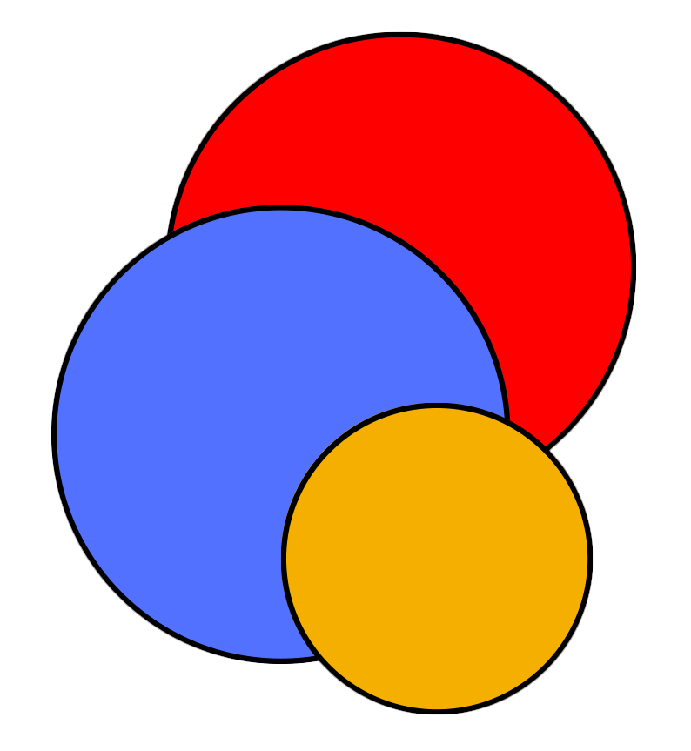
CIS
Lab
October 17
2023 INFORMS Annual Meeting
Balancing Accuracy and Computing Costs: Are Decomposition Methods Still Needed in the Era of Optimization Frameworks?
P. Bunnak¹, S. Coniglio², S. Galelli¹
¹ Cornell University
² University of Bergamo

Slide 2
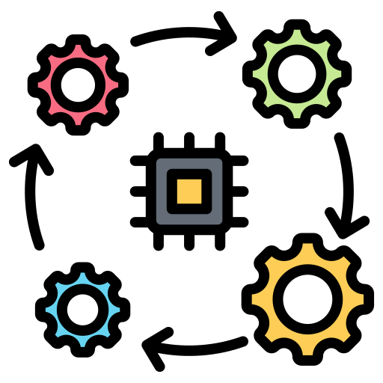



Energy / power system analysis
Common challenges
Representation of interactions with other socio-economic sectors
Analyses across large(r) spatio-temporal domains
Integration of weather and climate uncertainty
Increase in computational requirements

Slide 3
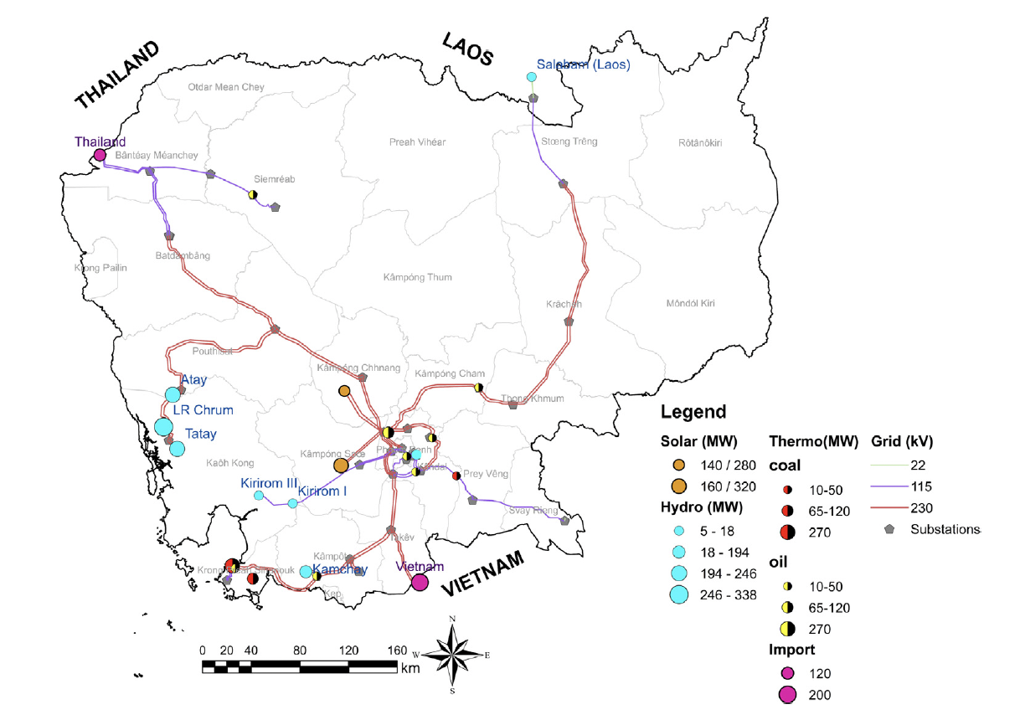
Increase in computational requirements
Example
  Cambodian power system
  Installed capacity ~ 2 GW
  Hydropower capacity ~ 1 GW
Koh et al. (2022), Applied Energy, 321, 119386

Slide 4
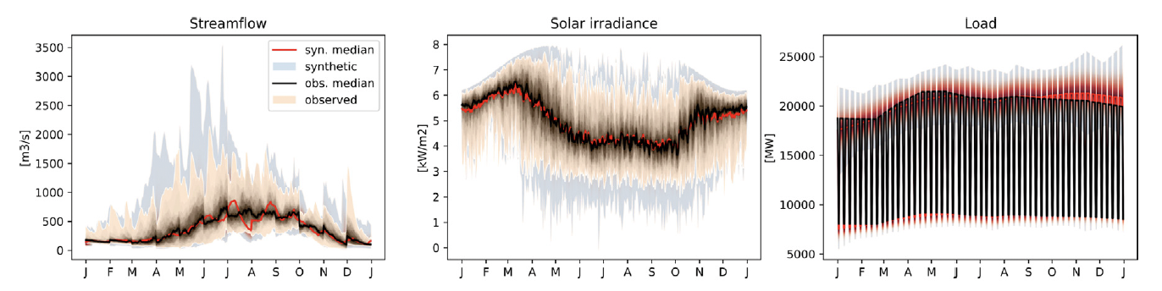
Increase in computational requirements
Example
  1000-year synthetic dataset of daily streamflow, solar irradiance and load
Koh et al. (2022), Applied Energy, 321, 119386
Notes:
- Kirsch–Nowak Streamflow Generator

Slide 5
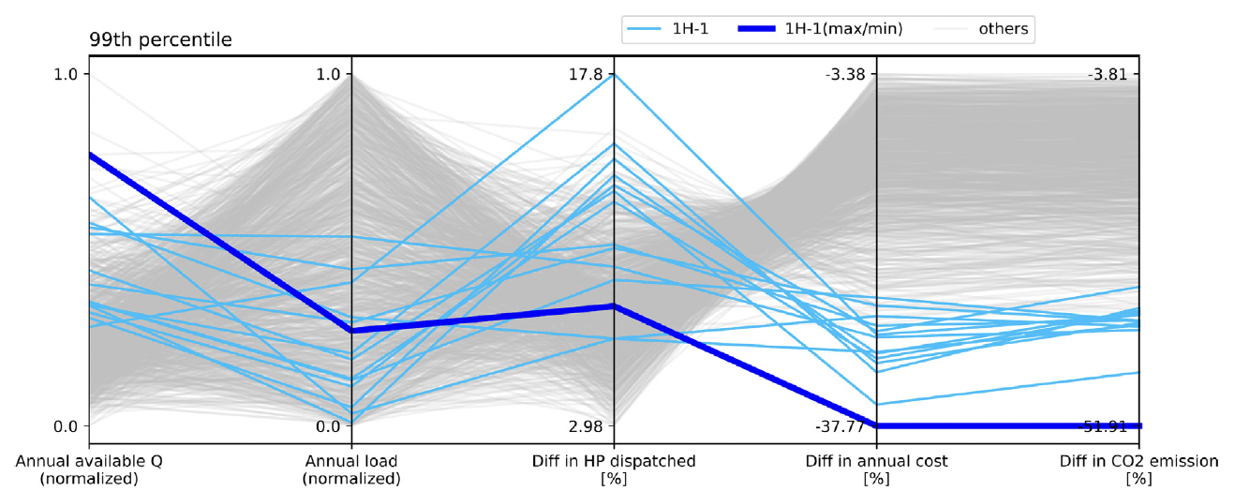
Increase in computational requirements
Example
  System’s response (evaluated via simulation)
  Run time ~ 7,900 sec
Koh et al. (2022), Applied Energy, 321, 119386
Notes:
- 0.0215 s

Slide 6

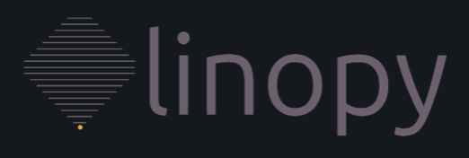





Balancing Accuracy and Computing Costs
Strategies
  Rely on faster optimization frameworks
Better connection between data analysis packages (e.g., xarray and pandas) with solvers
  Algebraic (opt.) modeling languages
  Time-to-build
  Solver
  Time-to-solve

Slide 7
Balancing Accuracy and Computing Costs
Strategies
  Rely on faster optimization frameworks
  Adopt simplifications of temporal, spatial, or technological dimensions
  Reduce the number of weather events
  Aggregate the representation of power fleet components into macro areas
  Generator
  Smaller uncertainty set
  Less decision variables
  Sub-station

Slide 8
Balancing Accuracy and Computing Costs
Strategies
  Rely on faster optimization frameworks
  Adopt simplifications of temporal, spatial, or technological dimensions
  Reduce the number of weather events
  Aggregate the representation of power fleet components into macro areas
  Generator
  Smaller uncertainty set
  Less decision variables
  Sub-station

Slide 9
Balancing Accuracy and Computing Costs
Strategies
  Rely on faster optimization frameworks
  Adopt simplifications of temporal, spatial, or technological dimensions
→ structural uncertainty
  Reduce the number of weather events
  Aggregate the representation of power fleet components into macro areas
  Drop the representation of unit commitment
  Smaller uncertainty set
  Less decision variables
  Simpler formulation (MILP → LP, MINLP → NLP)

Slide 10
Balancing Accuracy and Computing Costs
Strategies
  Accuracy
  Rely on faster optimization frameworks
  Adopt simplifications of temporal, spatial, or technological dimensions
  Build on decomposition methods
  Computing costs
  (time-to-solve)

Slide 11
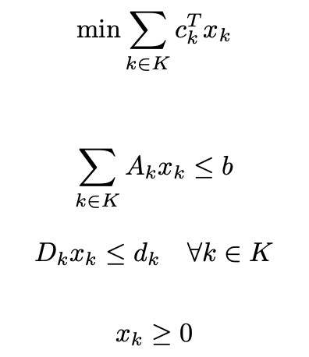

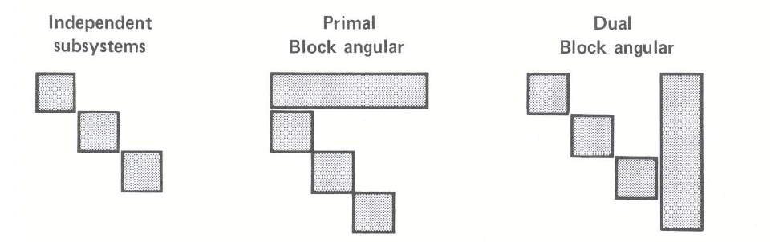
Decomposition methods
  Structural forms of large-scale problems
  Visualization of the A matrix
  Coupling constraints
  Coupling variables
  Nearly independent subsystems
  Constraint
  Variable
Source: Bradley et al. (1977), Applied Mathematical Programming.

Slide 12
Decomposition methods
  Structural forms of large-scale problems
  Visualization of the A matrix
  Coupling constraints
  Subproblems
  Constraint
  Variable
Source: Bradley et al. (1977), Applied Mathematical Programming.
Notes:
- Decomposition vs column generation?

Slide 13
Decomposition methods
  Advantages
  Preserve the original problem formulation / delay decisions on its simplification
  Reduce computing costs
  Allow for parallel computation
  Accuracy
  Computing costs
  (time-to-build)

Slide 14
Generation technology
PowNet
Other parameters
Dispatchable wind
and solar
Hourly electricity demand
Techno-economic parameters of thermoelectric units
Transmission capacity
Dispatchable hydropower
PowNet
(MILP problem: minimize production cost, meet demand)
Generation mix, power flow
+
Costs, CO₂ emissions
Chowdhury et al. (2020), Journal of Open Research Software, 8(1)
https://github.com/Critical-Infrastructure-Systems-Lab

Slide 15
PowNet + Dantzig-Wolfe decomposition
  Master problem
  Flow balance
  Reserve requirement
  Renewable/Import bound
  Transmission
    Min/Max line capacity
    Voltage angle
    Reference node
  ‘Self-scheduling’ sub-problems
  Minimum-down
  Minimum-up time
  Ramp down
  Ramp up
  MIP tightening constraints
    Strengthened minimum-down time
    Strengthened minimum-up time
    Trajectory down
    Trajectory up
    Relationship between variables
    Dispatch linkage
    Status linkage

Slide 16
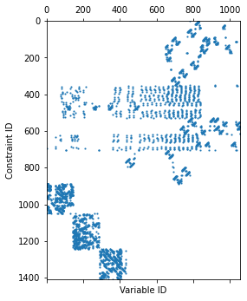
PowNet + Dantzig-Wolfe decomposition
  Example – ‘dummy’ power system
  Visualization of the A matrix
pGas
pOil
lineCap
1762 MW
lineCap
200 MW
Node 3
Buyer
MaxDemand
32 MW
pBiomass
lineCap
300 MW
lineCap
1762 MW
lineCap
300 MW
Node1
MaxDemand
700 MW
node2
MaxDemand
102 MW
lineCap
80 MW
lineCap
100 MW
pHydro
Max = 36 MW
lineCap
80 MW
Supplier
Max 60 MW

Slide 17
Experimental setup
  Formulation based on Knueven et al. (2020)
  Implementation in Gurobipy + Gurobi
  PowNet 2.0 vs PowNet 2.0 + DW
  Experiments carried out on Hopper Cluster (@Cornell CAC)
    Dual 20-core Intel Xeon Gold 5218R CPUs @ 2.1 GHz, 192 GB of RAM
    OpenHPC 2.3 with Rocky Linux 8.4
    Gurobi 9.5.1
  Modeling instances (24 hours)
    ‘Dummy’ power system (1,411 constraints and 1,056 variables)
    Cambodia (8,364 constraints and 5,952 variables)
    Thailand (74,633 constraints and 54,312 variables)
  PowNet 2.0
Knueven et al. (2020), INFORMS Journal on Computing, 32(4)

Slide 18
Preliminary results
  ‘Dummy’ power system (3 Blocks)
pGas
pOil
lineCap
1762 MW
lineCap
200 MW
 | PowNet | PowNet+DW
Obj. f. | 1,612,145 | 1,629,253
Time-to-solve, TOT (sec) | 0.0084 | 0.4692
Time-to-solve, Master problem (sec) | - | 0.0976
Time-to-solve, Sub-problems (sec) | - | 0.3716
Node 3
Buyer
MaxDemand
32 MW
pBiomass
lineCap
300 MW
lineCap
1762 MW
lineCap
300 MW
Node1
MaxDemand
700 MW
node2
MaxDemand
102 MW
lineCap
80 MW
lineCap
100 MW
pHydro
Max = 36 MW
lineCap
80 MW
Supplier
Max 60 MW

Slide 19
Preliminary results
  ‘Dummy’ power system (3 Blocks)
  Visualization of the A matrix
 | PowNet | PowNet+DW
Obj. f. | 1,612,145 | 1,629,253
Time-to-solve, TOT (sec) | 0.0084 | 0.4692
Time-to-solve, Master problem (sec) | - | 0.0976
Time-to-solve, Sub-problems (sec) | - | 0.3716
  Optimality gap:
  1.06%

Slide 20
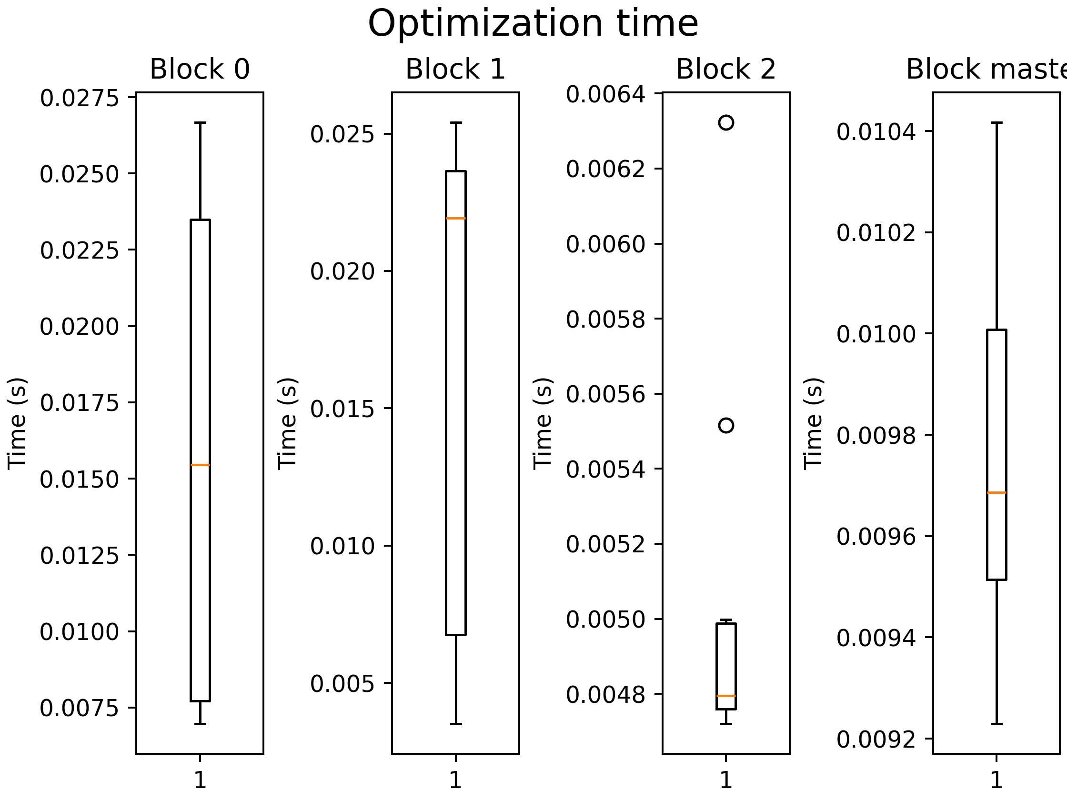
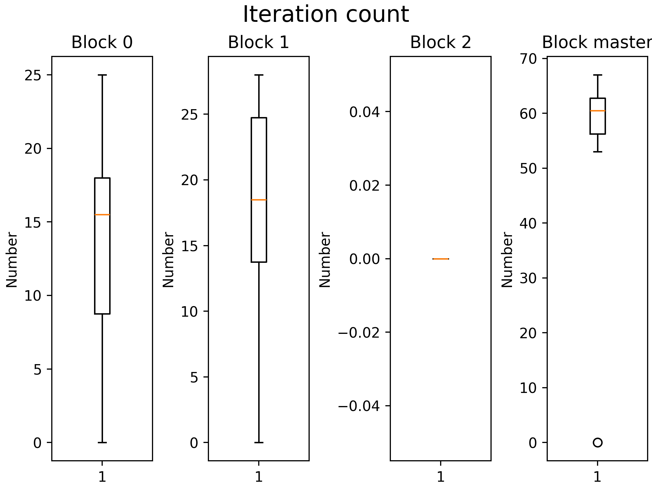
Preliminary results
  ‘Dummy’ power system (3 Blocks)
 | PowNet | PowNet+DW
Obj. f. | 1,612,145 | 1,629,253
Time-to-solve, TOT (sec) | 0.0084 | 0.4692
Time-to-solve, Master problem (sec) | - | 0.0976
Time-to-solve, Sub-problems (sec) | - | 0.3716
  Optimality gap:
  1.06%

Slide 21
Preliminary results
  Cambodia’s grid (18 Blocks)
 | PowNet | PowNet+DW
Obj. f. | 438,281 | 451,075
Time-to-solve, TOT (sec) | 0.0215 | 0.6643
Time-to-solve, Master problem (sec) | - | 0.0943
Time-to-solve, Sub-problems (sec) | - | 0.5700

Slide 22
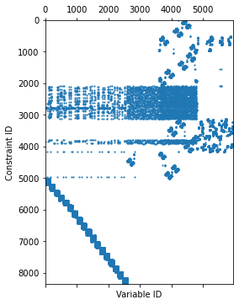
Preliminary results
  Cambodia’s grid (18 Blocks)
  Visualization of the A matrix
 | PowNet | PowNet+DW
Obj. f. | 438,281 | 451,075
Time-to-solve, TOT (sec) | 0.0215 | 0.6643
Time-to-solve, Master problem (sec) | - | 0.0943
Time-to-solve, Sub-problems (sec) | - | 0.5700
  Optimality gap:
  % 2.92

Slide 23
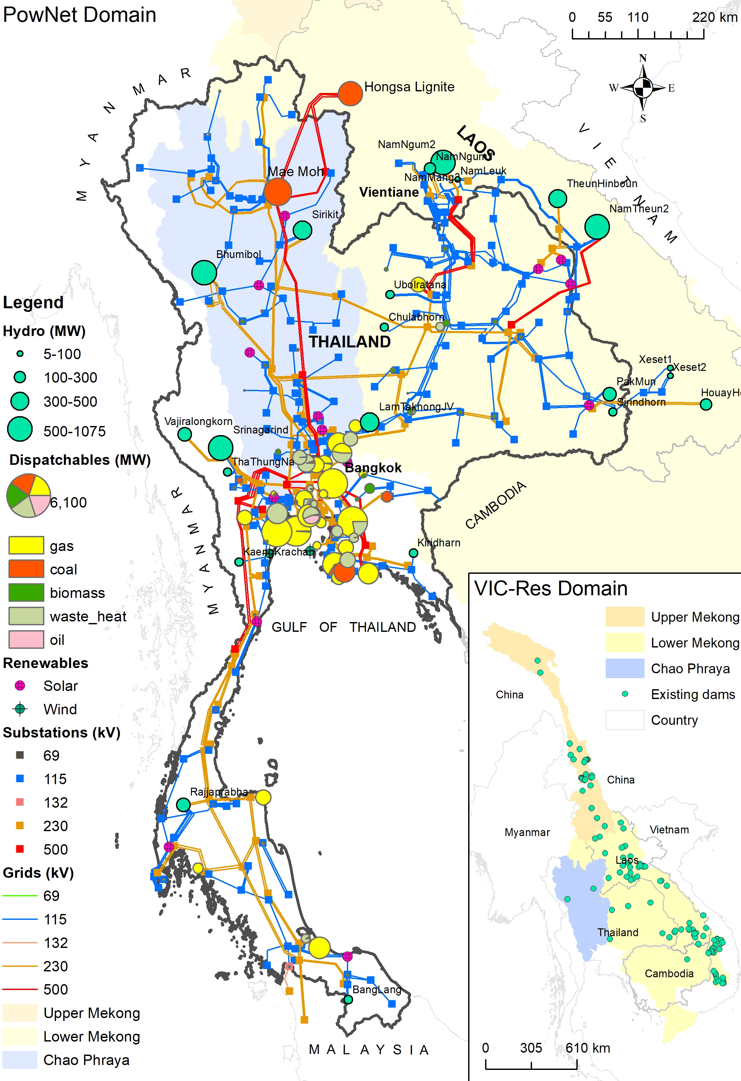
Preliminary results
  Thai grid (151 Blocks)
 | PowNet | PowNet+DW
Obj. f. | 36,888,014 | 38,763,317
Time-to-solve, TOT (sec) | 13.3008 | 19.8815
Time-to-solve, Master problem (sec) | - | 12.1936
Time-to-solve, Sub-problems (sec) | - | 7.6879

Slide 24
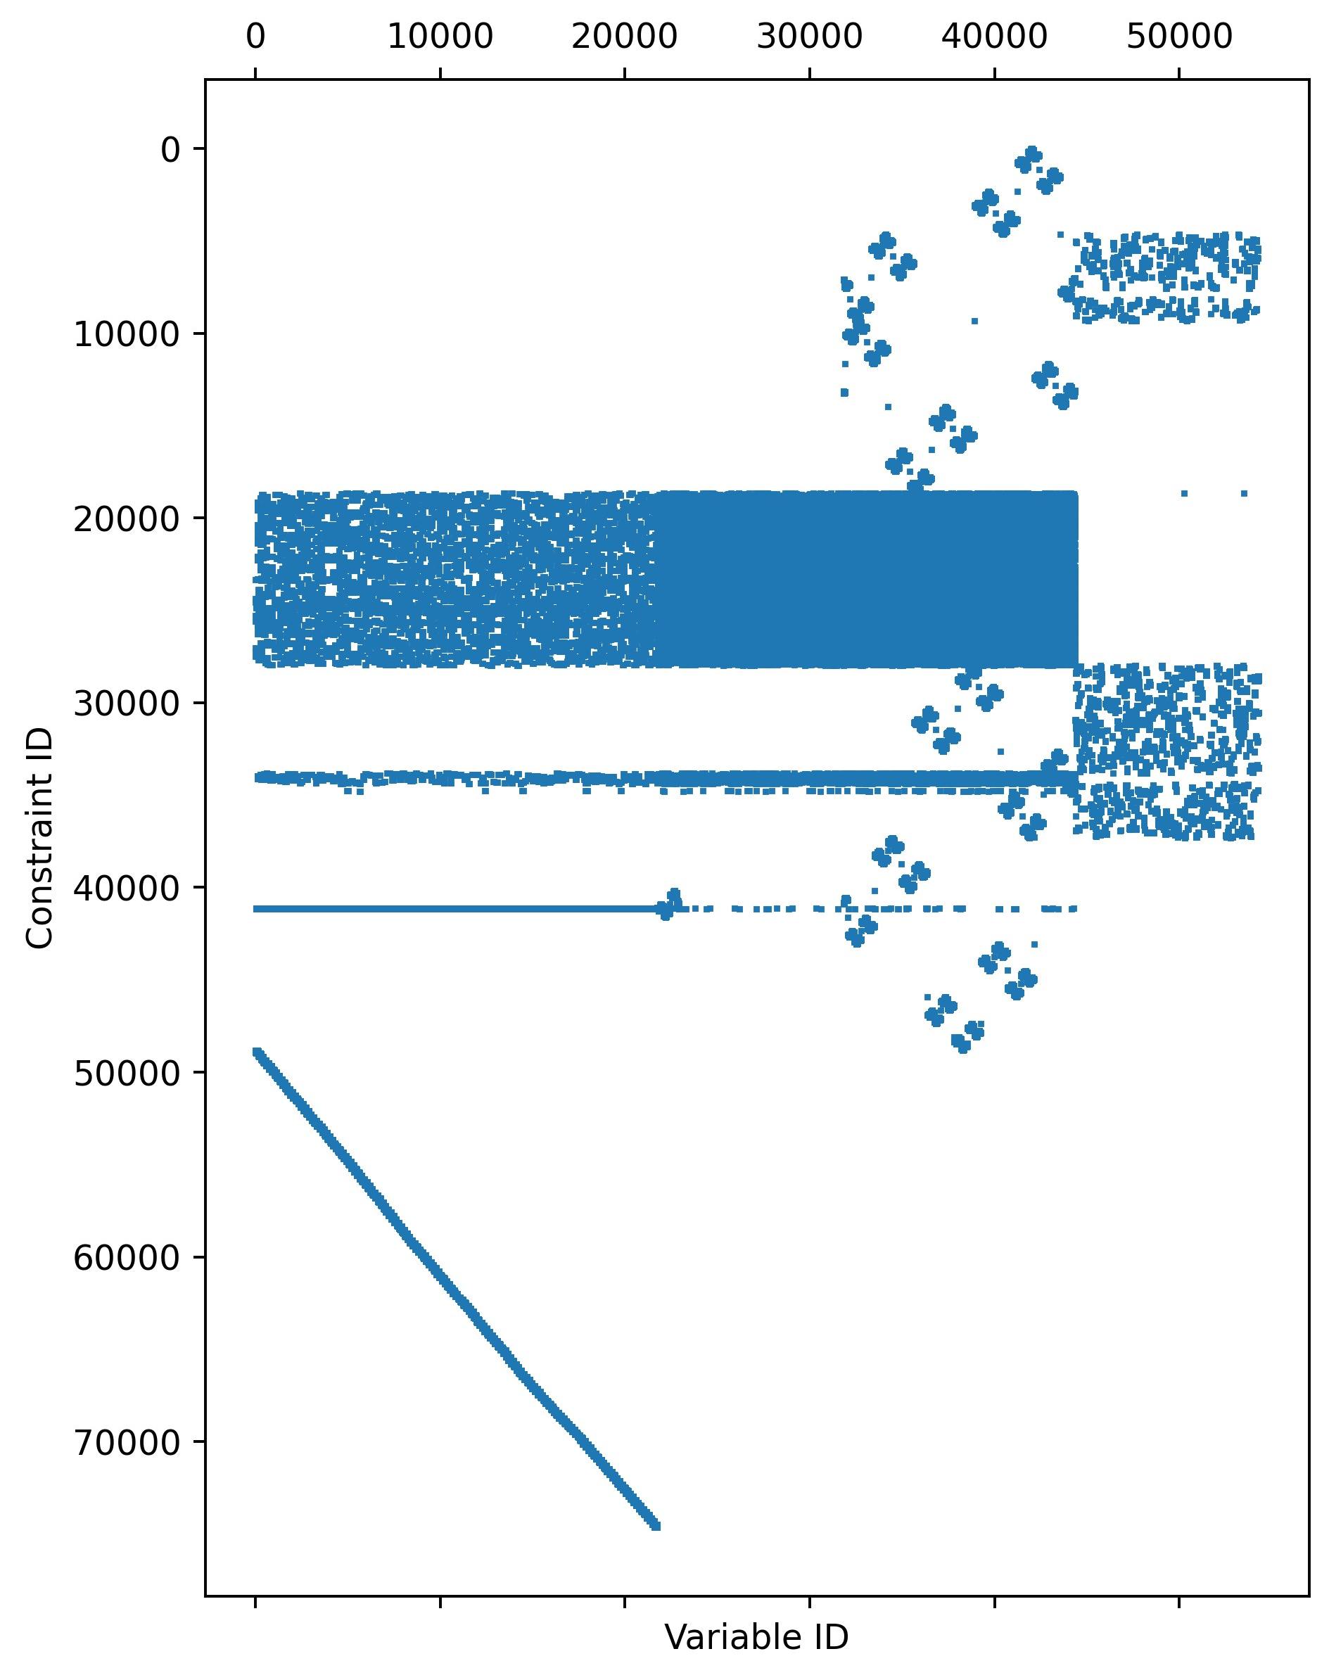
Preliminary results
  Thai grid (151 Blocks)
  Visualization of the A matrix
 | PowNet | PowNet+DW
Obj. f. | 36,888,014 | 38,763,317
Time-to-solve, TOT (sec) | 13.3008 | 19.8815
Time-to-solve, Master problem (sec) | - | 12.1936
Time-to-solve, Sub-problems (sec) | - | 7.6879
  Optimality gap:
  % 5.08
  Potential for parallelization

Slide 25
Conclusions
  Implementation of DW decomposition for a large-scale power system model
  Computing costs
  PowNet
  PowNet + DW
  # decision variables

Slide 26
Conclusions
  Implementation of DW decomposition for a large-scale power system model
  Major improvements expected with
    Parallelization schemes
  Computing costs
  PowNet
  PowNet + DW
  PowNet + DW + Parallel.
  # decision variables

Slide 27
Conclusions
  ASEAN Power Grid
  Implementation of DW decomposition for a large-scale power system model
  Major improvements expected with
    Parallelization schemes
    Larger grids

Slide 28
Conclusions
  ASEAN Power Grid
  Implementation of DW decomposition for a large-scale power system model
  Major improvements expected with
    Parallelization schemes
    Larger grids
  PowNet 2.0 + DW implementation to be released on GitHub PowNet’s webpage

Slide 29


Acknowledgments
  Phumthep Bunnak
  Stefano Coniglio

Slide 30






CIS
Lab
Thank you!
galelli@cornell.edu
https://galelli.cee.cornell.edu
@GalelliStefano

