Slide 1
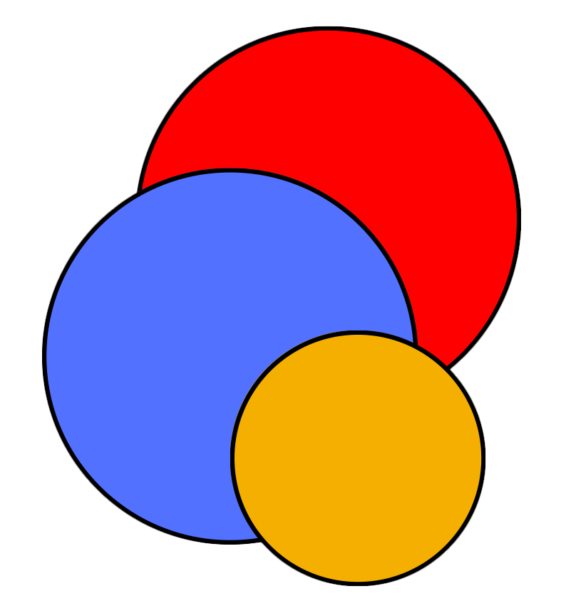
CIS
Lab
June 13, 2024
Hollister Hall 366
Exploring the impact of cross-border electricity trading on Southeast Asia’s bulk power systems
EWRS Ph.D. A-Exam
Phumthep Bunnak

Slide 2
A little bit about myself with respect to the energy transition
Education
B.S. Chem & Bio Engr
Georgia Tech
M.S. Biochem Engr
UCL
M.S. Public & Private Mgmt
NIDA
M.S. Analytics
Georgia Tech
(online)
Ph.D. Program
Sources: Statista
Energy system
Professional Experience
Bio
Undgr. Reseacher
Georgia Tech
Research Intern
UBE Chem.
Mgmt trainee
Thai Gov’t
Fossil
Electricity
Research Intern
KMUTT
Process Engr
XOM
Policy analyst
MoEN
Notes:
Talk about thesis too

Slide 3
Overview of progress
Funding
Taken courses
Planned courses
TA
H.R.H. Princess Maha Chakri Sirindhorn & SUTD Scholarship
Linear optimization
Stochastic modeling
Metaheuristic optimization
Machine Learning
Research methods
NA
Linear optimization (TA Award)
Engineering Systems & Design
GTA/GRA
Decision Framing and Analytics
Appl Parallel Computing
Water-Resources Systems Engr
Electric Power Systems I (Audit)
Regulation and Infra Policy
Infra Finance
??
Civil & Environmental Engr
Computational Science and Engr
Mathematical Programming
Notes:
Say done with course requirements

Slide 4
Why I’m here doing a Ph.D.?
Vision
Become an expert in energy systems modeling
Advance modeling techniques and bridge science and policy
Propel my career towards influencing energy policy at the global scale
Mission
Interested research questions
Advancing modeling techniques
What are fast solution methods for solving unit commitment problems?
Bridging science and policy
How can countries cooperate in electricity generation to reduce production costs and CO₂ emissions?
Who are the winners and losers from regional energy trade?
Notes:
Link to research questions

Slide 5
Motivations
Why study South-east Asia?
Notes:
Aim for 30th Min

Slide 6
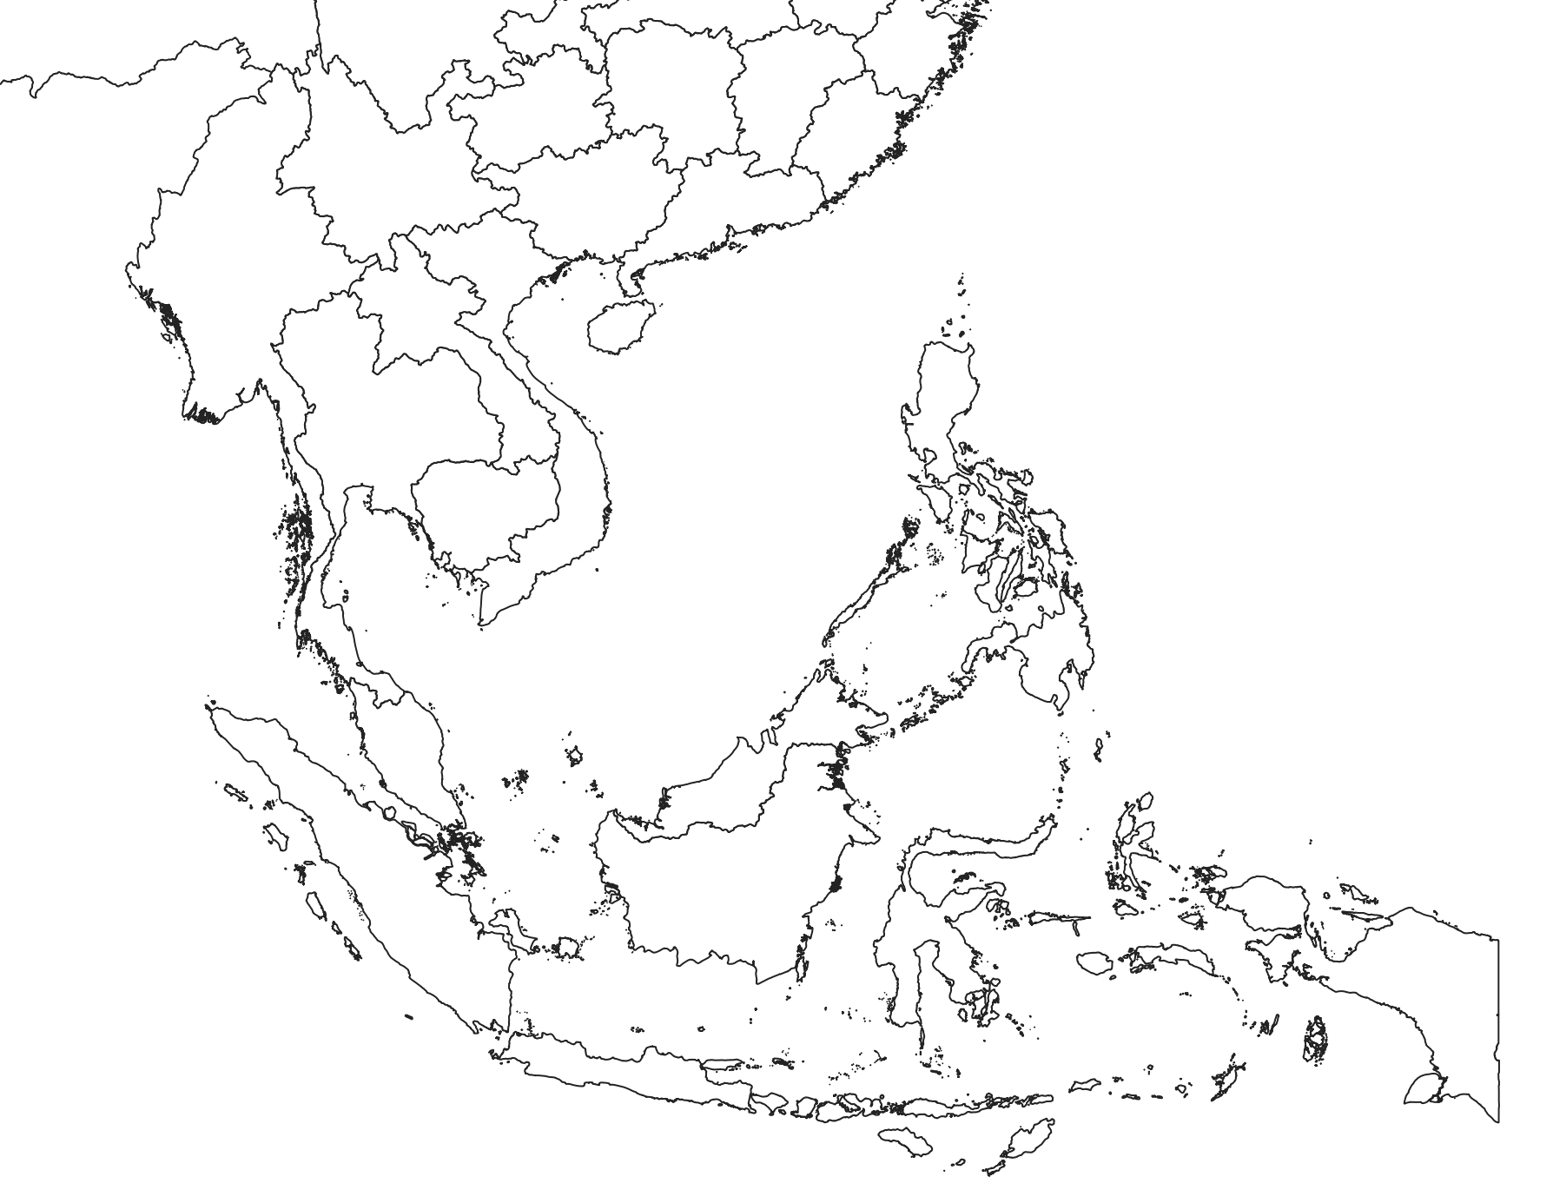
Electricity trading can promote RE integration
Map of major demand centers and renewable sources
Load center
Pros of APG
Increased regional power security
Effective integration of RE
Improved economic efficiency from competition
- Lower wholesale generation costs
- Potentially more innovation
Cons of APG
National grids are exposed to external events, especially for smaller countries
Domestic players under a regional regulator
Financial investments for interconnections
Solar
hydro
Geothermal
Wind
Illustrative only
SOURCE: Compiled from various sources, such as national reports
Notes:
How countries can cooperate or trade power to increase the reliability and improve the economics of their power systems.
Almost 700 million people

Slide 7
It has been a top policy agenda in regional cooperation
ASEAN Power Grid needs the following developments
Political factors
Political will
Agreement on location of the exchange
Common working language
Supporting factors
Cooperation Framework & Strong International Support
Existing bilateral trades
Available master plan
Greater Mekong Subregion Regional Grid Code for mainland
Technical factors
Grid codes – operational procedures, controls, tech spec
Third-party access
Wheeling charge calculation
Data and info sharing (especially Available Transmission Capacity)
Institutional factors
Central clearing house
Dispute resolution mechanism
SOURCE: IEA (2019), Establishing multilateral power trade in ASEAN, IEA, Paris
Notes:
How countries can cooperate or trade power to increase the reliability and improve the economics of their power systems.
Almost 700 million people

Slide 8
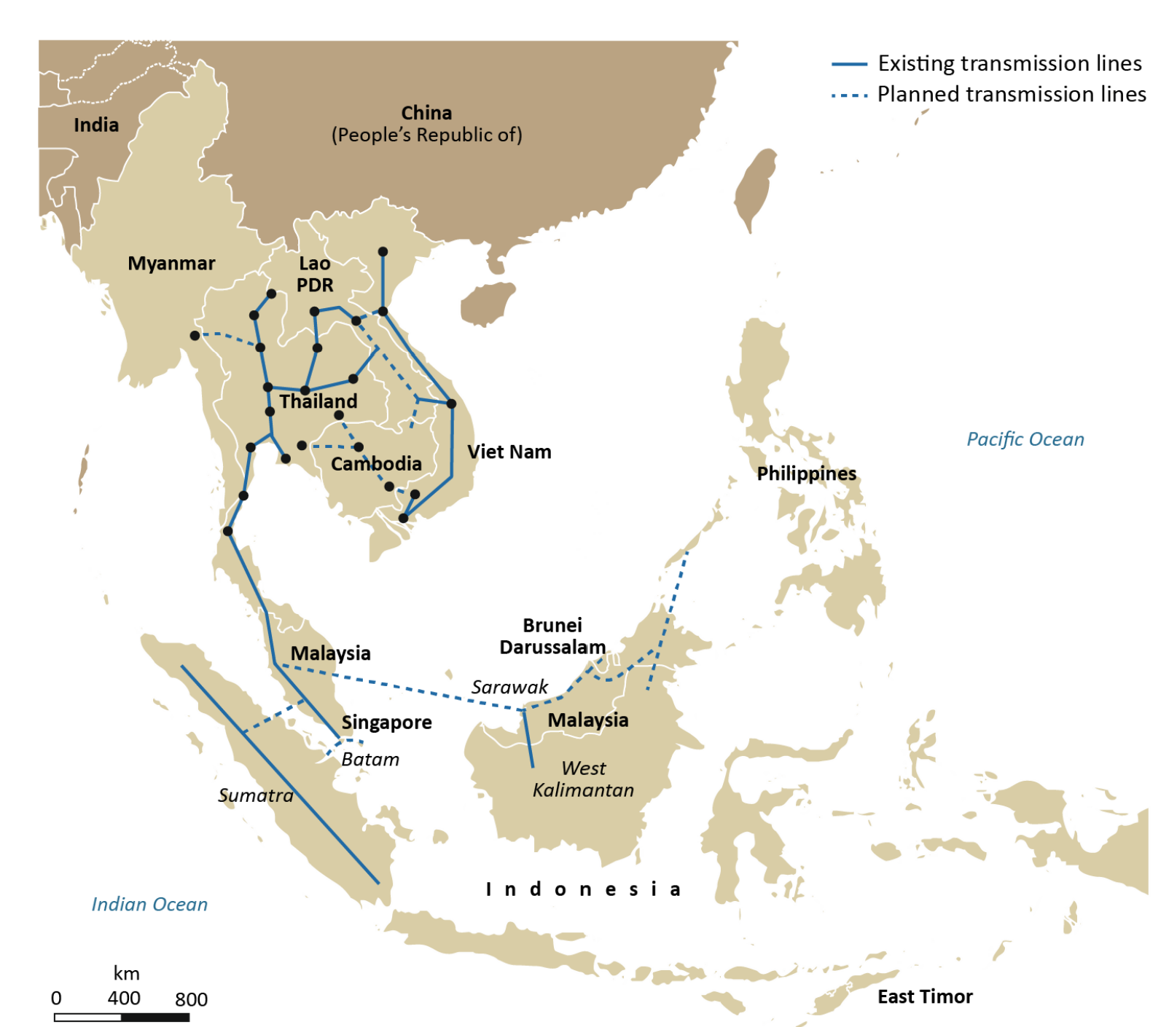
Thailand and Laos have an existing high-capacity interconnection
Interconnection map of ASEAN based on ASEAN Interconnection Masterplan Study II (AIMS II)
Current Status & Plan
Existing
7,645 MW
Ongoing (up to 2021)
30-100 MW
Future
19,000 to 22,000 MW
Total
Up to 30,000 MW
SOURCE: IEA (2019), Establishing multilateral power trade in ASEAN, IEA, Paris
Notes:
How countries can cooperate or trade power to increase the reliability and improve the economics of their power systems.
Almost 700 million people

Slide 9
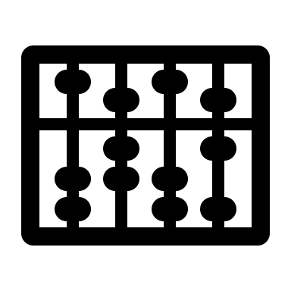
Key themes of my research relates to the regional electricity trade
Chapter 1
Chapter 2
Chapter 3
Advancing modeling
techniques
Bridging science and policy
Bridging science and policy
Fast heuristics to solve unit commitment problems
The impact of electricity trading on system economics and performance
The impact of electricity trading on household welfare
Detailed models have long runtime
Limited knowledge of cost-benefit of trading
No one should be left behind!

Slide 10
Research roadmap
Thesis chapters 1, 2, 3
Notes:
Aim for 30th Min

Slide 11
Key themes of my research relates to the regional electricity trade
Chapter 1
Chapter 2
Chapter 3
Advancing modeling
techniques
Bridging science and policy
Bridging science and policy
Fast heuristics to solve unit commitment problems
The impact of electricity trading on system economics and performance
The impact of electricity trading on household welfare
Detailed models have long runtime
Limited knowledge of cost-benefit of trading
No one should be left behind!

Slide 12
Models are needed in planning and operating power systems
Model type
Description
Purpose
Grid representation
Temporal scale
Power flow
Quickly solved using variations of Newton’s method
Electrical engineering domain
Serves many purposes:
State estimation
Contingency analysis
Economic dispatch
AC system
Continuous variables
Milli-seconds – Representing instantaneous events
Unit commitment
Solved with MIP solver
Operations research domain
Schedules generators
Simplified AC or DC system
Continuous + integer variables
Hours, days
Capacity expansion
Solved with MIP solver
Energy systems domain
Plans investments under a techno-economic scenario
Simplified AC or DC system
Time-scale: Continuous + integer variables
Years/decades
Notes:
It is important to distinguist the different types of power system models because they are very very different…
State estimation
Parameterize all metered and unmetered quantities
Filters measurement errors and bad data
Reaplce example paper with time steps
These are all optimization problems

Slide 13
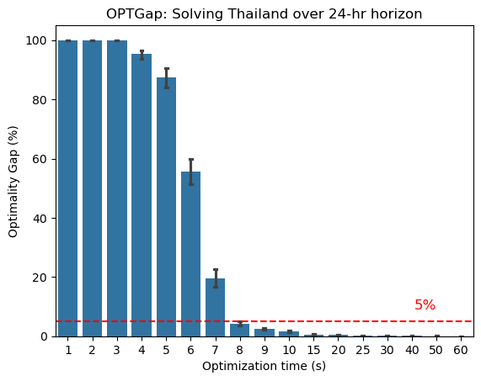
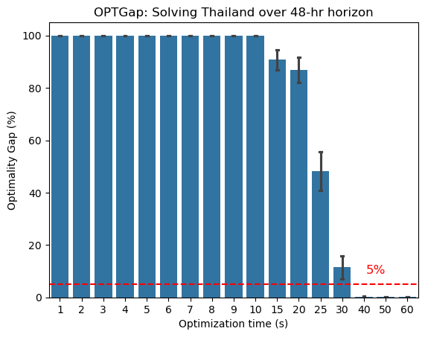
Modeling can use up to ~1,000 hours of computing time (1/2)
Based on 10 seconds to solve x 365 days in a year x 1000 synthetic climate years = 36,500,000 seconds or 1000 hours or 40 days
Plots showing the optimality gap against optimization time
24-hr horizon: can get a good solution after 10s
48-hr horizon: need at least 35s to get a good solution
Notes:
Introduce unit commitment problem
So let’s at a more concrete example of this challenge

Slide 14
Modeling can use up to ~1,000 hours of computing time (2/2)
Based on 10 seconds to solve x 365 days in a year x 1000 synthetic climate years = 36,500,000 seconds or 1000 hours or 40 days
Plots showing the optimality gap against optimization time
24-hr horizon: can get a good solution after 10s
48-hr horizon: need at least 35s to get a good solution
The default solver cannot produce a good solution within 35 seconds when simulating the Thai grid over 48-hr horizon.
Notes:
Let’s look at this problem from a more concrete example
2 mins

Slide 15
General MIP solvers - Gurobi, CPLEX, HiGHs, … - are efficient but are not tailored for solving a unit commitment problem
Solve with linear programming techniques and use branch-cut-and-bound to recover integers
Extensive branching incurs runtime and memory
Time to reach a solution depends on luck during branching
Current solution approach does not scale well with problem size because of branching
Notes:
Explain LP relaxation, which is to change all discrete variables into continuous variables
Branching means gradually fixing discrete components

Slide 16
Energy systems modelers typically trade
model representation with tractability (accuracy vs runtime)
Decrease number of variables and constraints by reducing model representation
Temporal aggregation
Spatial aggregation
Relax discrete variables
What it is?
Down-sampling time-series inputs
Selection of a representative period
Simplify the region of interest by deriving an equivalent network
Convert a mixed-integer program to a linear program (LP)
How does the runtime decrease?
Fewer variables and constraints
Fewer variables and constraints
Can use LP techniques
Any downsides?
Can moderate outliers in the input data
Need to reliably identify critical periods
Not suitable for studies that need high-spatial resolution e.g., limits of transmission lines
Over-estimate the flexibility of thermal units
SOURCE: Scholz et al (2020). Akdemir et al 2024.
Notes:
Spatial aggregation: Ward or REI methods
Start-up / shutdown costs
However, there are also other approaches to explore. Some of these lie outside the domain of energy systems modeling
Your unit of analysis cannot be the whole country

Slide 17
We can take a more fundamental look at tackling runtime
Breakdown of contributors to runtime
Strategies
Data processing
Model reduction
Mathematical
formulation
Compactness versus strength
Model building
Notable works
Akdemir et al. (2024)
Scholz et al. (2020)
Knueven et al. (2020)
Pourahmadi et al. (2024)
Translation to code
Algebraic modeling language (AML)
Runtime
Machine learning
Other Heuristics
Solution process
Solution method
Approx. methods
Exact methods
Decom. methods
Solvers
Solver tuning
Popularity among...
Energy modeling community
Enhance numerical stability
Operations research community
Notes:
Model reduction is important; make sure you explain / illustrate what options people tend to adopt.
Deep learning techniques can support the solution process (learning-to-optimize) or fully replace a solver (end-to-end learning)
Remove title and replace with DOI

Slide 18
Chapter 1 Reducing the runtime of power system models
Research questions to address
Key activities
Which UCP formulation should be adopted?
Formulate a unit commitment problem with strong formulation
What is the performance of heuristics?
Solution quality
Runtime
Design two heuristics: iterative rounding and discrete Dantzig-Wolfe decomposition
How robust are the performance of the heuristics to their parameterizations?
Evaluate the performance of these heuristics with country-scale unit commitment problems
What are modeling conditions under which these heuristics outperform the default solver?
Identify situations in which the heuristics outperform a general MIP solver

Slide 19
When formulating a unit commitment problem, should consider balancing compactness versus strength
The formulation of our unit commitment problem relies on these two works
3-bin formulation
Use $\overline{p}=p+u_{t}\overset{̳}{P}$ to get a continuous variable
Switch from angle-based flow formulation to Kirchhoff’s formulation (based on KVL)

Slide 20
Definition of performance metrics
Metric
Definition
Feasibility
Fraction of instances that are feasible
Optimality gap
$$\frac{ObjVal_{Heuristic}−ObjVal_{True}}{ObjVal_{True}}∙100\%$$
Optimization time
Runtime of Gurobi calls by the heuristic
Wall-clock time
Runtime of the heuristic (optimization time + overhead)
Speed-up
$$\frac{t_{Gurobi}}{t_{Heuristic}}$$

Slide 21
Principle of iterative rounding
Which variables to round?
What is the rounding threshold?
It is reasonable to round up any fractional value because…
Switching off the unit may not lead to other units being fully on
Switching off units with fractional values can cause electricity shortfalls if no other generators are available
the Simplex algorithm produces solutions that lie at a corner point of the feasible region, where constraints are satisfied with equality, thereby limiting the number of active variables
Notes:
Rounding heuristics, though diverse in their specific implementations, share the core idea of solving a relaxed version of a problem and iteratively rounding selected fractional variables. Once a variable is rounded, other variables may become fractional in the subsequent iteration. These heuristics are often integrated into solvers like SCIP for general mixed-integer programs, significantly improving solver performance

Slide 22
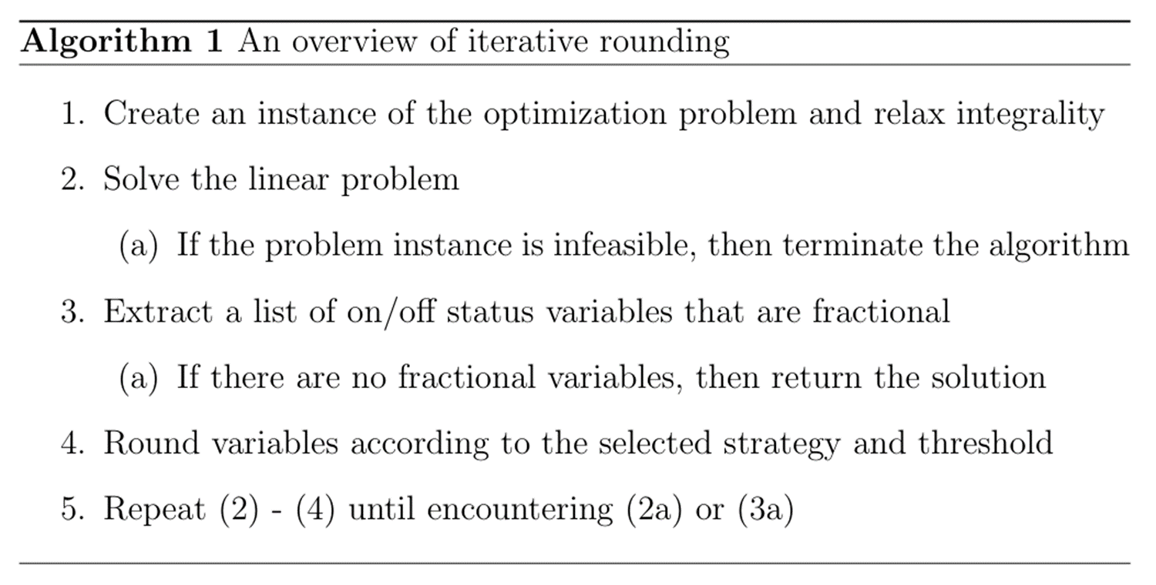
Implementing iterative rounding
Notes:
Rounding heuristics, though diverse in their specific implementations, share the core idea of solving a relaxed version of a problem and iteratively rounding selected fractional variables. Once a variable is rounded, other variables may become fractional in the subsequent iteration. These heuristics are often integrated into solvers like SCIP for general mixed-integer programs, significantly improving solver performance

Slide 23
What is the best way to round variables? (1/2)
Strategy 1: SLOW rounding >> to ensure feasibility
Optimal solution when all variables are continuous. $u$ is the unit status.
Variable | LP solution | MIP Solution
$$u_{pGas, 7}$$ | 0.404 | 1
$$u_{pGas, 8}$$ | 0.493 | 1
$$u_{pGas, 9}$$ | 0.539 | 1
$$u_{pGas, 10}$$ | 0.539 | 1
$$u_{pGas, 11}$$ | 0.539 | 1
$$u_{pGas, 12}$$ | 0.539 | 1
$$u_{pGas, 13}$$ | 0.539 | 1
$$u_{pGas, 14}$$ | 0.559 | 1
$$u_{pGas, 15}$$ | 0.533 | 1
$$u_{pGas, 16}$$ | 0.503 | 1
$$u_{pGas, 17}$$ | 0.478 | 1
$$u_{pGas, 18}$$ | 0.478 | 1
$$u_{pGas, 19}$$ | 0.478 | 1
Select a variable(s) with the largest fraction
If the fraction is larger than a pre-specified threshold, then round to one. Else, round down to zero.
Re-optimize
Repeat (1) to (3) till there is no fraction left

Slide 24
What is the best way to round variables? (2/2)
Strategy 2: FAST rounding >> to quickly solve
Optimal solution when all variables are continuous. $u$ is the unit status.
Variable | LP solution | MIP Solution
$$u_{pGas, 7}$$ | 0.404 | 1
$$u_{pGas, 8}$$ | 0.493 | 1
$$u_{pGas, 9}$$ | 0.539 | 1
$$u_{pGas, 10}$$ | 0.539 | 1
$$u_{pGas, 11}$$ | 0.539 | 1
$$u_{pGas, 12}$$ | 0.539 | 1
$$u_{pGas, 13}$$ | 0.539 | 1
$$u_{pGas, 14}$$ | 0.559 | 1
$$u_{pGas, 15}$$ | 0.533 | 1
$$u_{pGas, 16}$$ | 0.503 | 1
$$u_{pGas, 17}$$ | 0.478 | 1
$$u_{pGas, 18}$$ | 0.478 | 1
$$u_{pGas, 19}$$ | 0.478 | 1
Select all variables with fractional values
If the fraction is larger than a pre-specified threshold, then round to one. Else, round down to zero.
Re-optimize
Repeat (1) to (3) till there is no fraction left

Slide 25
Experimental set-up: Iterative rounding
Key steps
Select three power systems
Laos (8,040 variables and 4,204 constraints)
Cambodia (5,232 variables and 5,118 constraints)
Thailand (48,000 variables and 44,556 constraints)
Run the models across 365 days with Gurobi
Outputs represent the “true” solutions
Solve the problem with iterative rounding
Evaluate FAST and SLOW across several rounding thresholds
Calculate the optimality gap (OPTGap)
Solve the problem like (2) but set MIPGap equal to the OPTGap from (4)
Hardware
Hopper Cluster (@Cornell CAC)
Dual 20-core Intel Xeon Gold 5218R CPUs @ 2.1 GHz, 192 GB of RAM
Software
Python 3.10
OpenHPC 2.3 with Rocky Linux 8.4
Gurobi 3.9
Notes:
Emphasize how to get a fair comparison

Slide 26
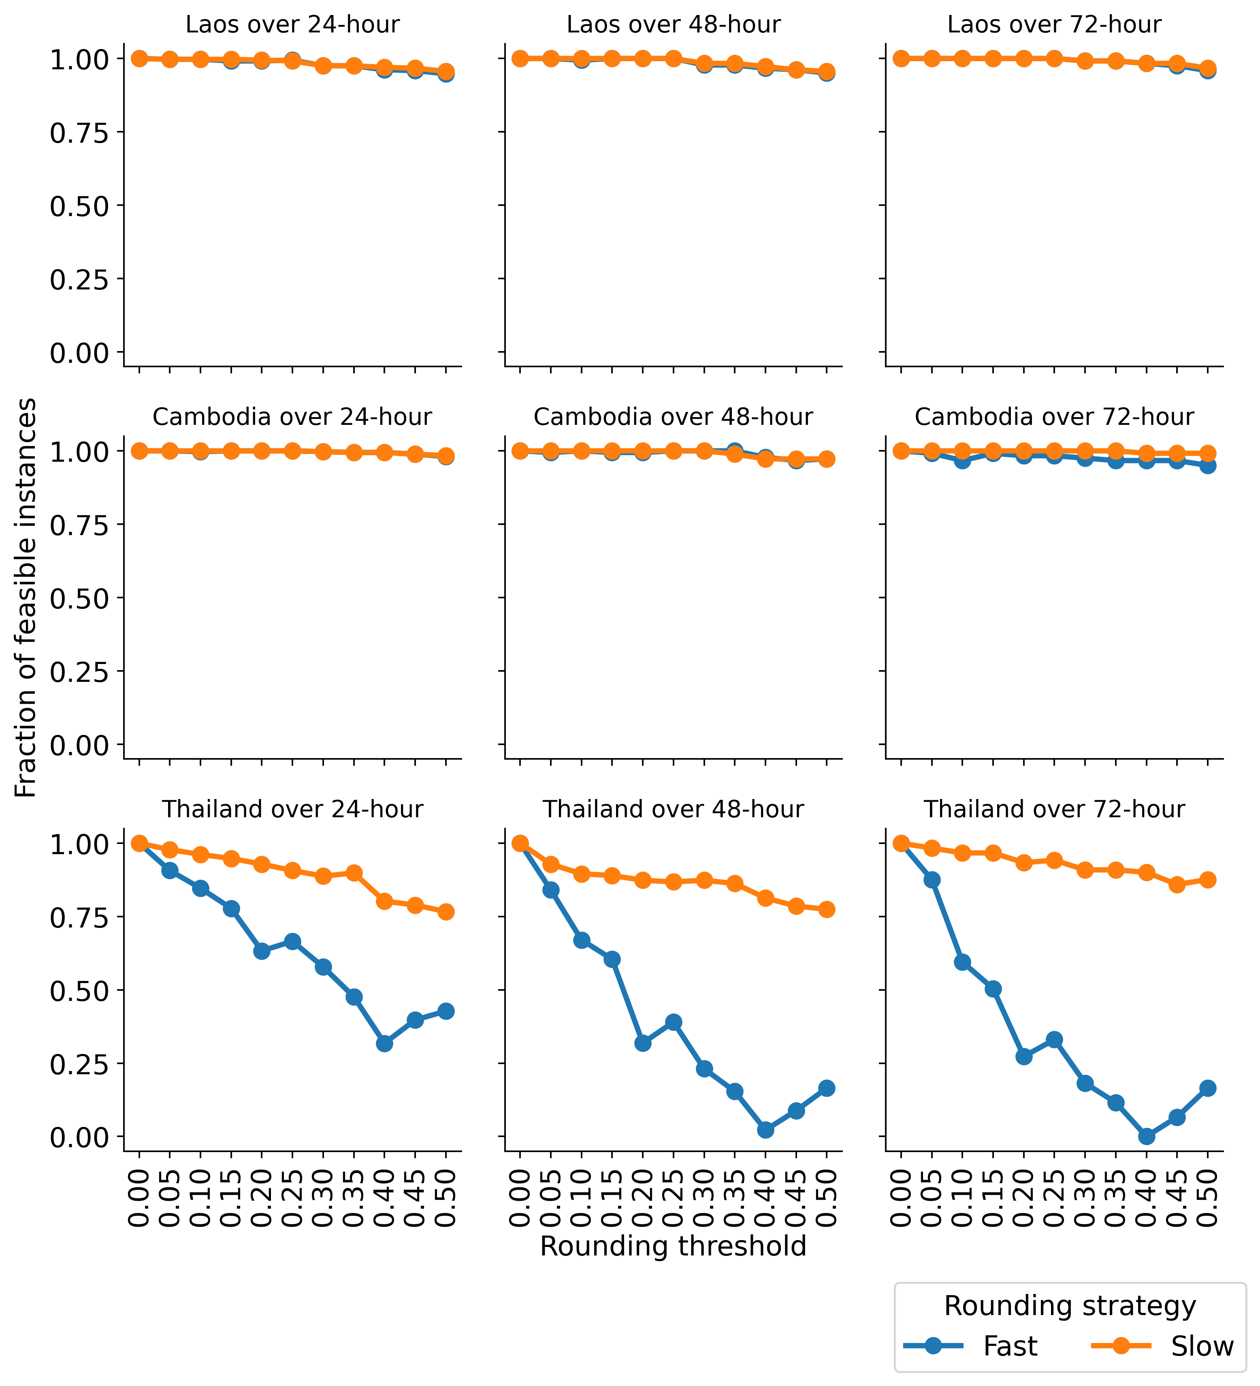
Feasibility vs. rounding thresholds
Setting very low rounding threshold can reduce infeasibility to zero

Slide 27
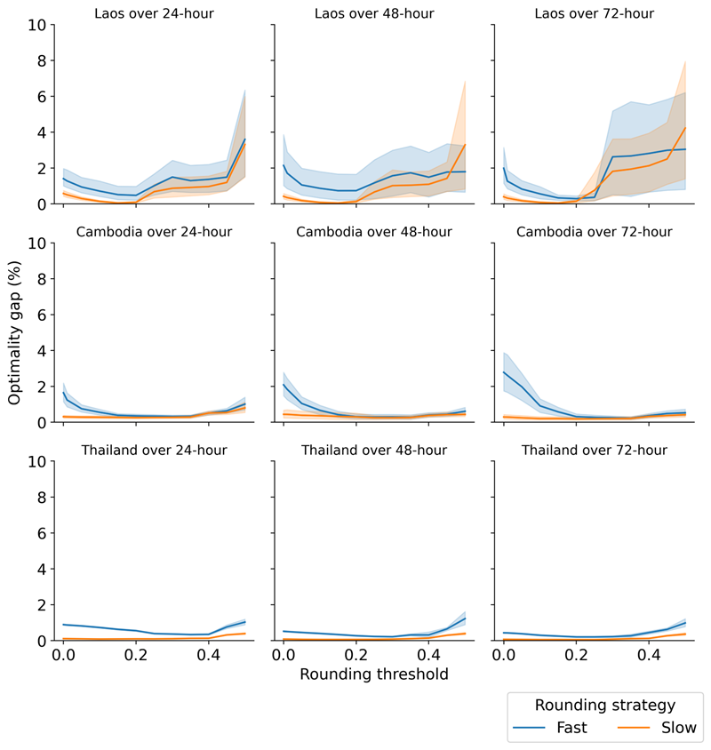
Optimality gap vs. rounding thresholds
Slow rounding attains less than 1% optimality gap

Slide 28
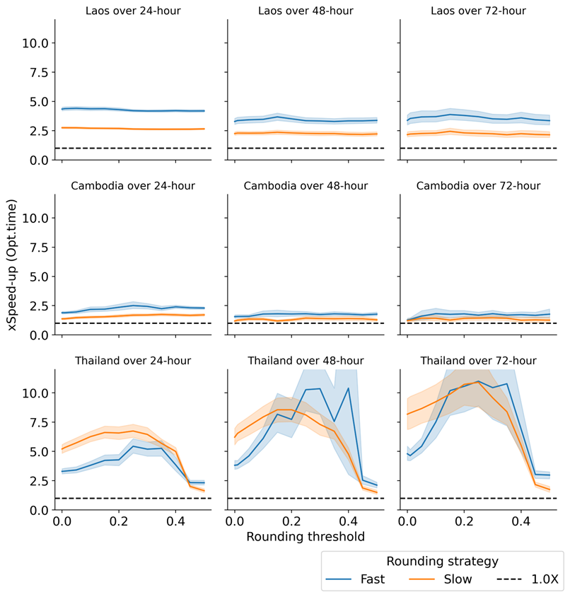
Speed-up (Opt.time) vs. rounding thresholds
Achieves 10x speed up when compared to Gurobi

Slide 29
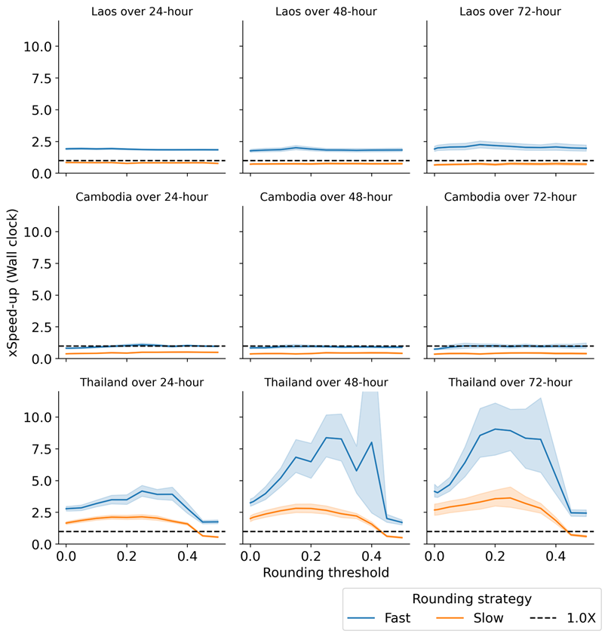
Speed-up (Wall clock) vs. rounding thresholds
The runtime for overhead is lower with the fast-rounding strategy

Slide 30
Can we ensure feasibility?
Notes:
Describe the A matrix
Parallelization

Slide 31
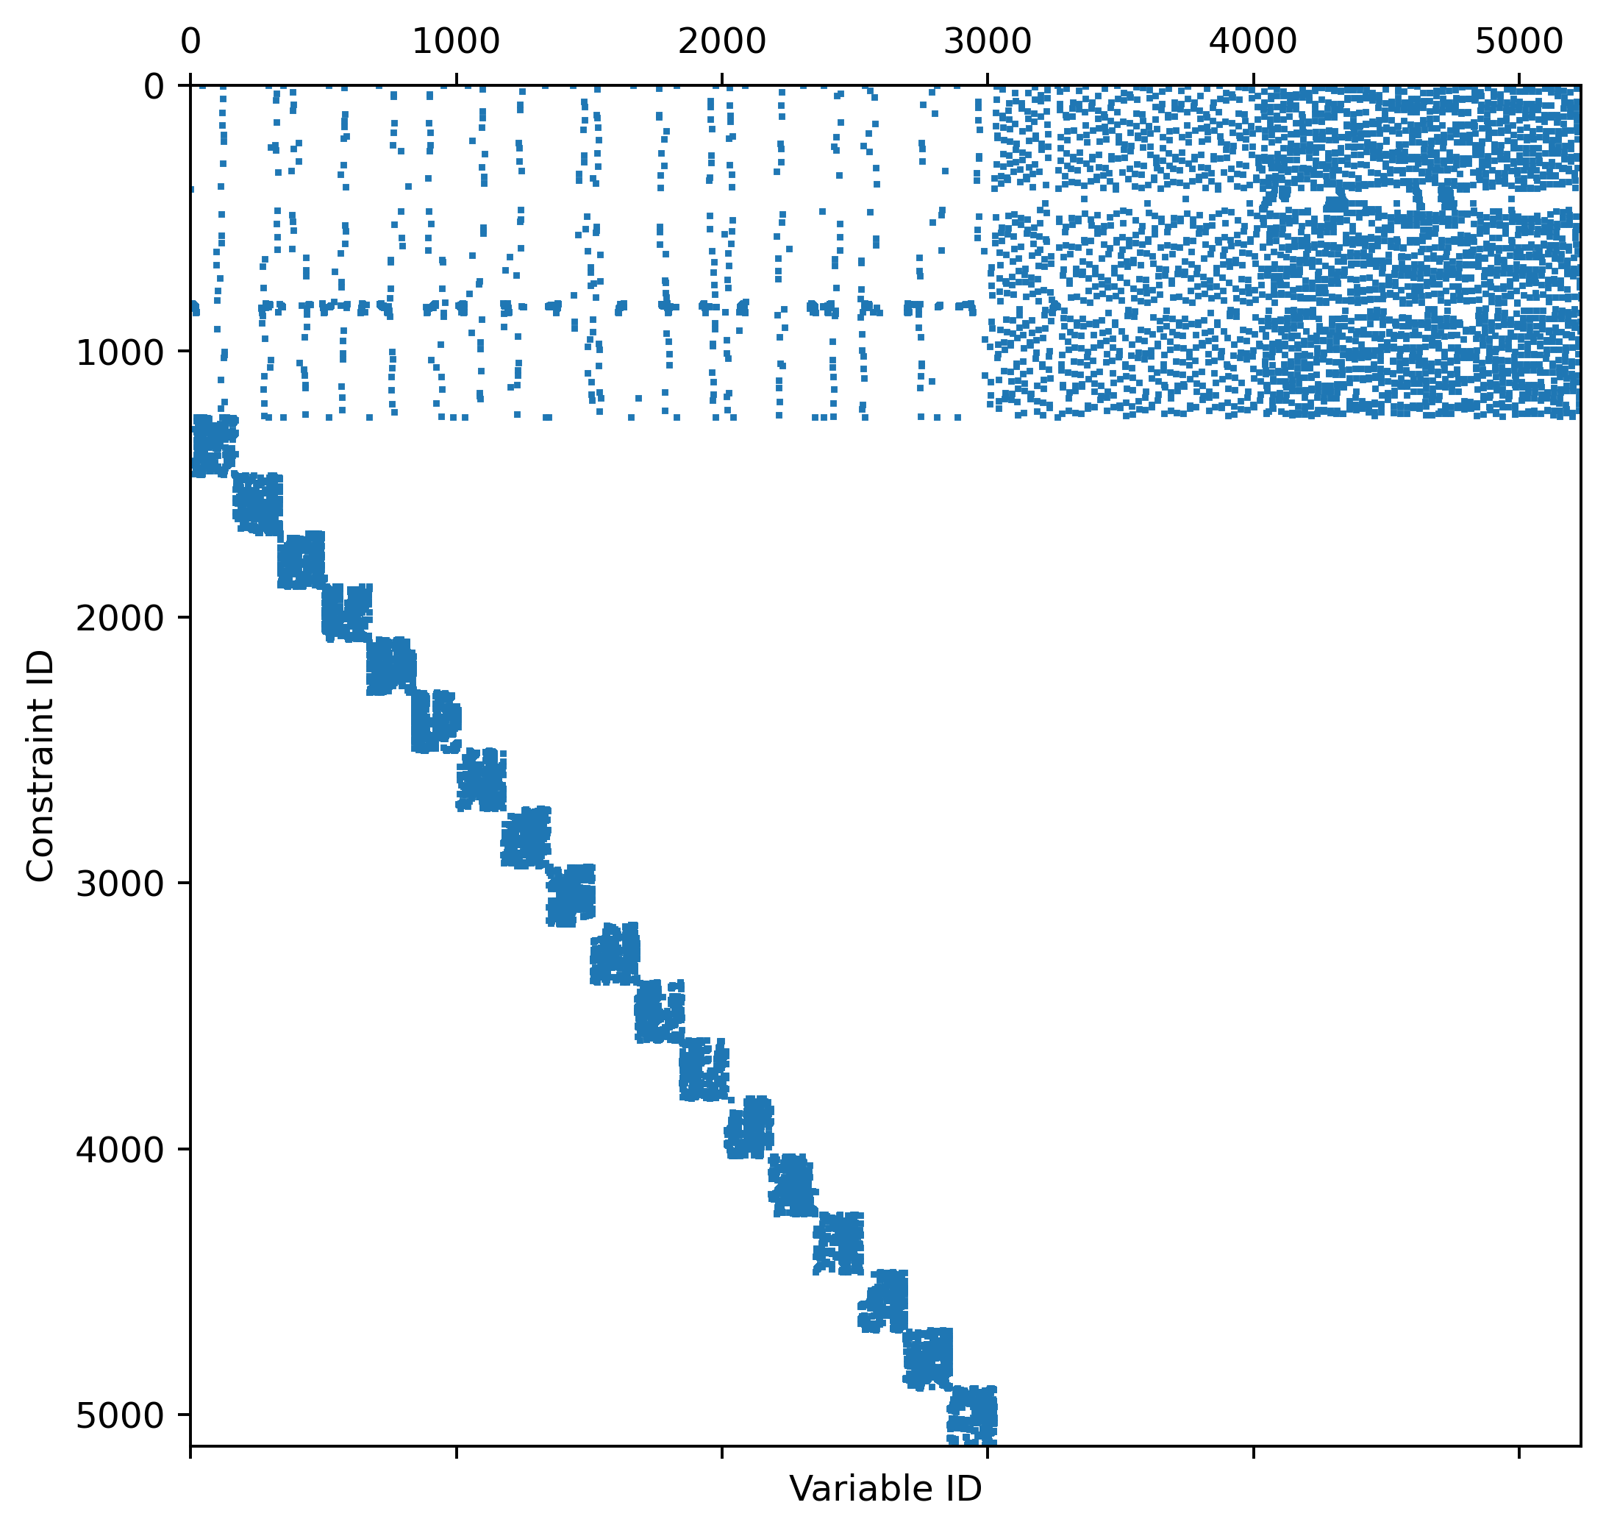
Decompose PowNet into a “master problem” and “subproblems” (1/2)
Structure of the A matrix
Structure of the constraint matrix of the Cambodian grid. Dots represent non-zero coefficients
Constraints form a system of inequalities
$$Ax≤b$$
Notes:
Describe the A matrix
Parallelization

Slide 32
Decompose PowNet into a “master problem” and “subproblems” (2/2)
Two decision-making levels
Structure of the constraint matrix of the Cambodian grid. Dots represent non-zero coefficients
System constraints
Sends pricing signals to thermal units to guide their generation
Constraints include
- Reserve requirement
- Energy flow balance
- Renewable / Import
- Shortfall/curtailment
- Transmission
- Min/Max line capacity
Unit constraints
Decides the amount to produce based on pricing signal from the master problem
- Unit ramping up/down
- Minimum shutdown time
- Minimum uptime
Notes:
Describe the A matrix
Parallelization

Slide 33
Dantzig-Wolfe Decomposition is suitable for linear programs with a block-diagonal structure
Original formulation (aka compact formulation)
Reformulation in terms of extreme points of the subproblems (aka extended formulation)
Notations
$N$ units
$x_{1}∈R^{n_{1}}, x_{2}∈R^{n_{2}}$, …
$b∈R^{m}, d_{1}∈R^{m_{1}}, d_{2}∈R^{m_{2}}, ….$
Non-negative $x_{1},x_{2},…$
Notations
$x_{1}∈R^{n_{1}}, x_{2}∈R^{n_{2}}$, …
$b∈R^{m}, d_{1}∈R^{m_{1}}, d_{2}∈R^{m_{2}}, …$
Non-negative $x_{1},x_{2},…$ and $λ_{j_{n}}$
$$\min_{λ} \sum_{j_{1}∈J_{1}}{λ_{1}^{j_{1}}c_{1}^{T}x_{1}^{j_{1}}}+\sum_{j_{2}∈J_{2}}{λ_{2}^{j_{2}}c_{2}^{T}x_{2}^{j_{2}}} + … +\sum_{j_{N}∈J_{N}}{λ_{N}^{j_{N}}c_{N}^{T}x_{N}^{j_{N}}}$$
Complicating constraints (system-level constraints)
$$\sum_{j_{1}∈J_{1}}{λ_{1}^{j_{1}}A_{1}x_{1}^{j_{1}}}+\sum_{j_{1}∈J_{1}}{λ_{2}^{j_{1}}A_{2}x_{1}^{j_{1}}}+…+\sum_{j_{1}∈J_{1}}{λ_{N}^{j_{1}}A_{3}x_{1}^{j_{1}}}=b$$
$$\sum_{j_{1}∈J_{1}}{λ_{1}}=1$$
$$\sum_{j_{2}∈J_{2}}{λ_{2}}=1$$
$$⋮$$
$$\sum_{j_{N}∈J_{N}}{λ_{N}}=1$$
$$0≤λ≤1$$
$$\min_{x} c_{1}^{T}x_{1}+c_{2}^{T}x_{2}+…+c_{N}^{T}x_{N}$$
$$s.t.$$
$$s.t.$$
$$A_{1}x_{1}+A_{2}x_{2}+…+A_{N}x_{n}≤b$$
$$B_{1}x_{1}≤d_{1}$$
$$B_{2}x_{2}≤d_{2}$$
$$⋮$$
$$B_{N}x_{N}≤d_{N}$$
Reformulation in terms of extreme points (red dots)
$$J_{1}$$
$$J_{N}$$
$$J_{2}$$

Slide 34
Dantzig-Wolfe Decomposition is suitable for linear programs with a block-diagonal structure
Original formulation (aka compact formulation)
Reformulation in terms of extreme points of the subproblems (aka extended formulation)
Notations
$N$ units
$x_{1}∈R^{n_{1}}, x_{2}∈R^{n_{2}}$, …
$b∈R^{m}, d_{1}∈R^{m_{1}}, d_{2}∈R^{m_{2}}, ….$
Non-negative $x_{1},x_{2},…$
Notations
$x_{1}∈R^{n_{1}}, x_{2}∈R^{n_{2}}$, …
$b∈R^{m}, d_{1}∈R^{m_{1}}, d_{2}∈R^{m_{2}}, …$
Non-negative $x_{1},x_{2},…$ and $λ_{j_{n}}$
$$\min_{λ} \sum_{j_{1}∈J_{1}}{λ_{1}^{j_{1}}c_{1}^{T}x_{1}^{j_{1}}}+\sum_{j_{2}∈J_{2}}{λ_{2}^{j_{2}}c_{2}^{T}x_{2}^{j_{2}}} + … +\sum_{j_{N}∈J_{N}}{λ_{N}^{j_{N}}c_{N}^{T}x_{N}^{j_{N}}}$$
Complicating constraints (system-level constraints)
$$\sum_{j_{1}∈J_{1}}{λ_{1}^{j_{1}}A_{1}x_{1}^{j_{1}}}+\sum_{j_{1}∈J_{1}}{λ_{2}^{j_{1}}A_{2}x_{1}^{j_{1}}}+…+\sum_{j_{1}∈J_{1}}{λ_{N}^{j_{1}}A_{3}x_{1}^{j_{1}}}=b$$
$$\sum_{j_{1}∈J_{1}}{λ_{1}}=1$$
$$\sum_{j_{2}∈J_{2}}{λ_{2}}=1$$
$$⋮$$
$$\sum_{j_{N}∈J_{N}}{λ_{N}}=1$$
$$0≤λ≤1$$
$$\min_{x} c_{1}^{T}x_{1}+c_{2}^{T}x_{2}+…+c_{N}^{T}x_{N}$$
$$s.t.$$
$$s.t.$$
$$A_{1}x_{1}+A_{2}x_{2}+…+A_{N}x_{n}≤b$$
$$B_{1}x_{1}≤d_{1}$$
$$B_{2}x_{2}≤d_{2}$$
$$⋮$$
$$B_{N}x_{N}≤d_{N}$$
Reformulation in terms of extreme points (red dots)
$$J_{1}$$
$$J_{N}$$
$$J_{2}$$
For DDW, $λ∈\{0, 1\}$

Slide 35
Dantzig-Wolfe Decomposition is a bi-level decision-making process(1/2)
A unit proposes generation/production schedules
Microscopic view on the scheduling of a thermal unit
Generation
(MW)
Decision-making levels
Unit level: each generator proposes production schedules (green dots)
System level: system controller selects which schedule for the unit to commit. Multiple schedules can be selected, and the final solution is the weighted schedule (red arrows)
Pricing signal
Schedule A
Max.Gen
Transmission limit
Ramp 3
Schedule B
Unit-level:
Proposes schedules to the system controller
Ramp 2
Schedule C
Ramp 1
Schedule D
Note
The unit is constrained by physical limits: min/max generation, ramping rate
Feasible solutions are in green
Blue cross represents the optimal solution
Objective function in orange arrow
Min.Gen
Schedule E
Schedule F
Unit status
$$u=0$$
$$u=1$$
Notes:
Link to next, so what does this mean in practice

Slide 36
Dantzig-Wolfe Decomposition is a bi-level decision-making process(2/2)
DDW selects one schedule from each generator
Microscopic view on the scheduling of a thermal unit
Generation
(MW)
Decision-making levels
Unit level: each generator proposes production schedules (green dots)
System level: system controller selects which schedule for the unit to commit. Multiple schedules can be selected, and the final solution is the weighted schedule (red arrows)
Pricing signal
Schedule A
Max.Gen
Transmission limit
Ramp 3
Schedule B
Ramp 2
Schedule C
System operator selects only Schedule B
Ramp 1
Schedule D
Note
The unit is constrained by physical limits: min/max generation, ramping rate
Feasible solutions are in green
Blue cross represents the optimal solution
Objective function in orange arrow
Min.Gen
Schedule E
Schedule F
Unit status
$$u=0$$
$$u=1$$
Notes:
As many would have guess, this approach ensures feasibility at the expense of suboptimality

Slide 37
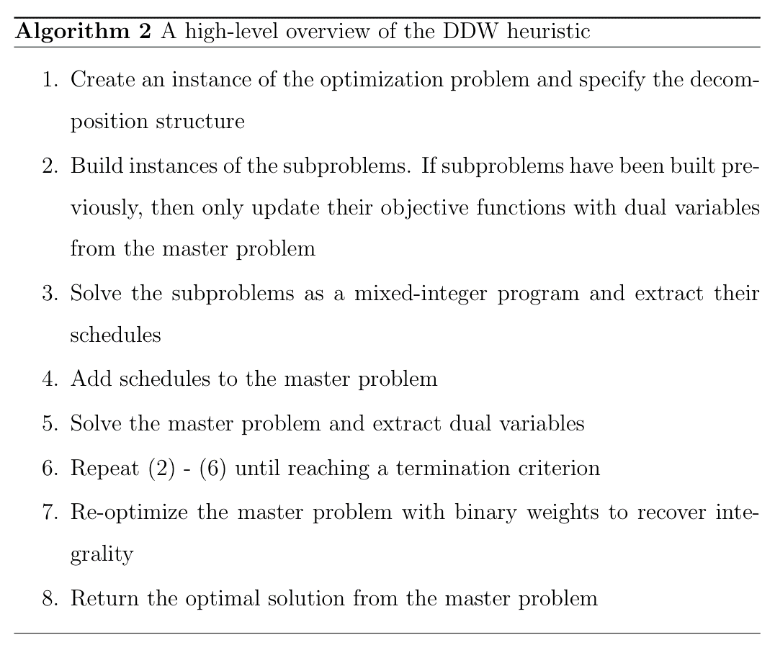
Implementing discrete Dantzig-Wolfe
Notes:
Rounding heuristics, though diverse in their specific implementations, share the core idea of solving a relaxed version of a problem and iteratively rounding selected fractional variables. Once a variable is rounded, other variables may become fractional in the subsequent iteration. These heuristics are often integrated into solvers like SCIP for general mixed-integer programs, significantly improving solver performance

Slide 38
Experimental set-up: Discrete Dantzig-Wolfe
Key steps
Select three power systems
Laos (1,411 constraints and 1,056 variables)
Cambodia (8,364 constraints and 5,952 variables)
Thailand (74,633 constraints and 54,312 variables)
Run the models across 365 days with Gurobi
Outputs will represent the “true” solutions
Specify the decomposition of the problem - which constraints in the master and subproblems?
Solve the problem with Dantzig-Wolfe package
Evaluate different combinations of termination criteria: incremental improvement and lower bound gap
Calculate the OPTGap
Solve the problem like (2) but set MIPGap equal to the OPTGap from (5)
Hardware
Hopper Cluster (@Cornell CAC)
Dual 20-core Intel Xeon Gold 5218R CPUs @ 2.1 GHz, 192 GB of RAM
Software
Python 3.10
OpenHPC 2.3 with Rocky Linux 8.4
Gurobi 3.9

Slide 39
Discrete DW is not sensitive to parameterization (1/2)
Solution quality
Optimality gap of DDW as a function of incremental improvement (%)
Notes:
DW ensures a feasible solution with an average of
Laos = 5%
Cambodia = 2%
Thailand = 10%
It does not do well at all in terms of optimization time. Why is this? Next slide

Slide 40
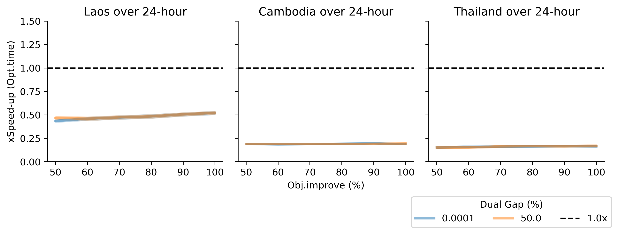
Discrete DW is not sensitive to parameterization (2/2)
Optimization time
Speed-up of DDW as a function of incremental improvement (%)
Notes:
DW ensures a feasible solution with an average of
Laos = 20%
Cambodia = 2%
Thailand = 10%
It does not do well at all in terms of optimization time. Why is this? Next slide

Slide 41
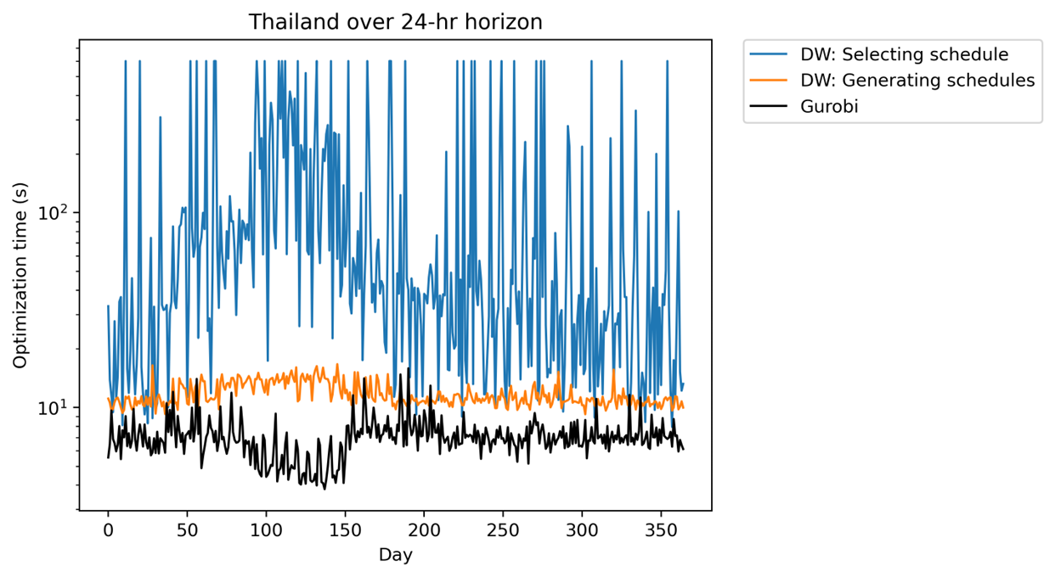
The time in selecting a schedule from each unit is too long!
Optimization time over a modeling period of one year
Notes:
So… we have created a tool to solve an optimization with Dantzig-Wolfe. Do we use it? Of course, you can if you have the courage.

Slide 42
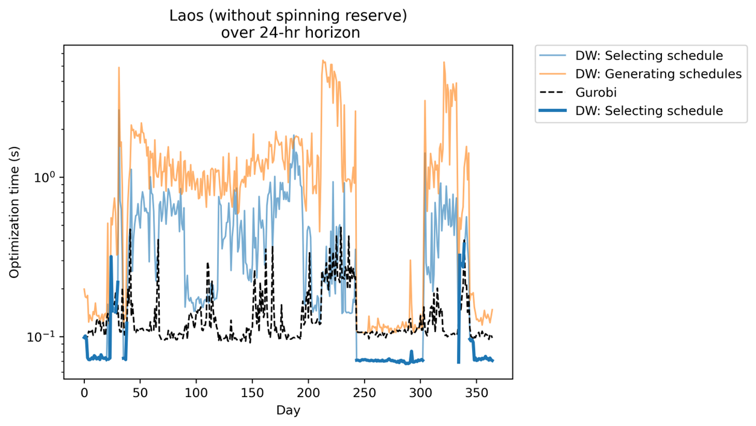
DDW might outperform the default solver thru parallelization
Shows time to solve Laos over one simulation year
Periods when the system runs on 100% renewables
Notes:
Explain monsoon -- Days 250-300 dams are full

Slide 43
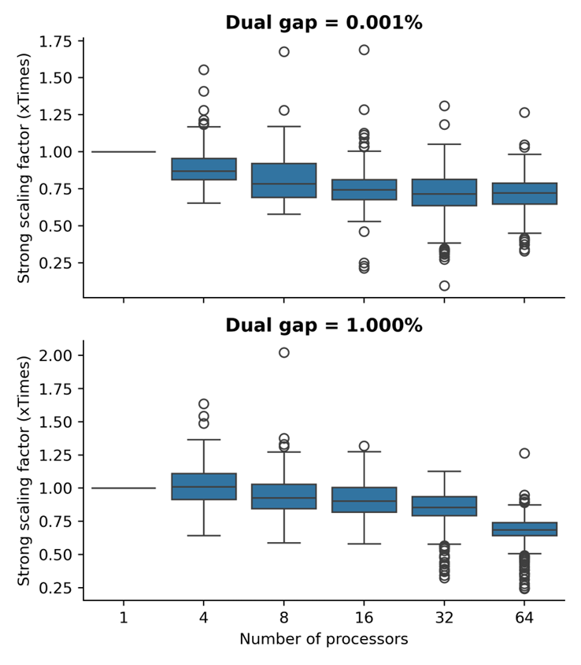
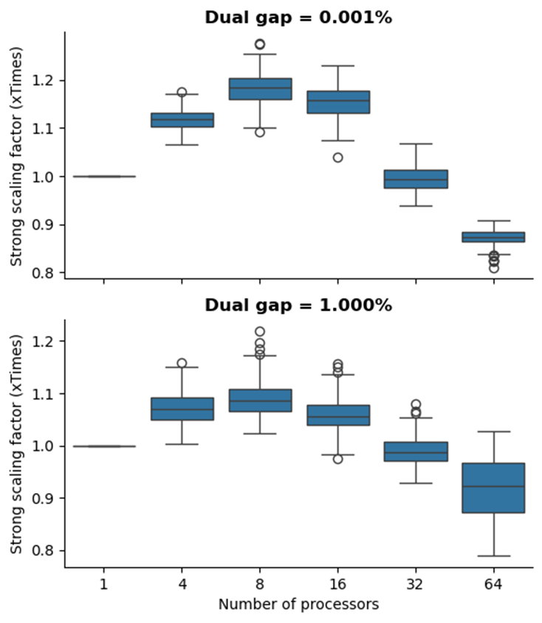
Parallelization requires tuning the number of processors
Plots of strong scaling factors
Laos (without spinning reserve) over 24-hr horizon
Thailand over 24-hr horizon
Notes:
Link to to the HPC course project

Slide 44
To conclude…
Research questions to address
What is the performance of heuristics?
Solution feasibility
Solution quality
Optimization time
How robust are the performance of the heuristics to their parameterizations?
What are modeling conditions under which these heuristics outperform the default solver?
Iterative rounding can perform well across metrics
DDW ensures feasibility but at the cost of solution quality and optimization time
Iterative rounding is sensitive to its rounding threshold
DDW is more robust against termination criteria
Iterative rounding scales with problem size
DDW requires parallelization at the least

Slide 45
Multiple contributions from the first chapter
1
2
3
4
Publication
Power system model
Decomposition technique(s)
Dataset on the ASEAN Power Grid
Bunnak, Coniglio, Galelli. (2024). Balancing Accuracy and Runtime: Heuristics to Solve a Unit Commitment Problem. Applied Energy. (in prep)
Target submission June-July 2024
Developed a new power system model in Python
Available on GitHub with Read the Docs
Planned to submit a manuscript to JOSS
Python package to implement Dantzig-Wolfe Decomposition
Planned to include other decomposition techniques: Lagrangian Relaxation and ADMM
Detailed dataset of the national grid across 10 countries in ASEAN
Notes:
Python models (PowNet 2.0) + link to GitHub and readthedocs (e.g., JOSS)

Slide 46
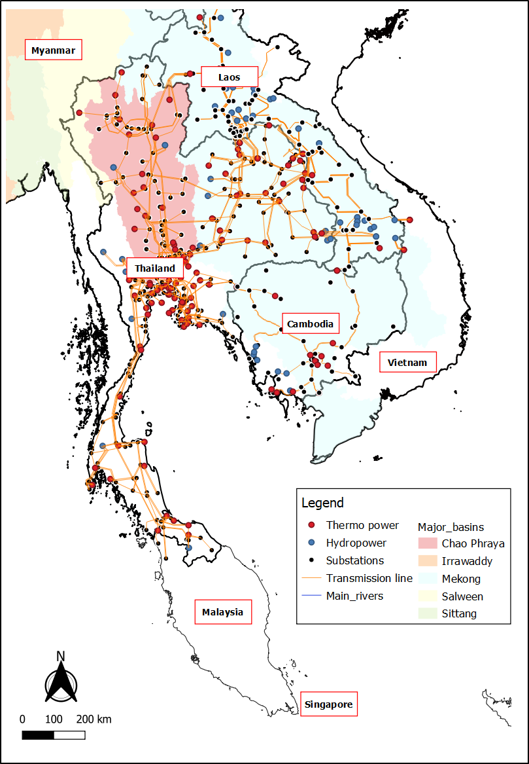
Overview of the dataset of power assets in ASEAN
A dataset of power assets in South-east Asia
Countries
Brunei
Cambodia
Philippines
Indonesia
Laos
Malaysia
Myanmar
Singapore
Thailand
Vietnam
Dataset characteristics
Detailed spatial representation
- Unit representation of power plants (10MW+)
- Transmission lines (230 kV+)
The dataset enables modeling at an hourly timescale
Notes:
Power system
Designed for click-and-run by non-expert users
Faster model building time with Gurobipy
Modular design that supports future extensions
Strong mathematical formulations
Compatibility with an open-source solver
Demonstrated use of hydropower reoperation
Decom
Solves problems with a block-diagonal structure
Implements Dantzig-Wolfe decomposition
Modular design that supports future extensions (other decomposition techniques)

Slide 47
Key themes of my research relates to the regional electricity trade
Chapter 1
Chapter 2
Chapter 3
Advancing modeling
techniques
Bridging science and policy
Bridging science and policy
Fast heuristics to solve unit commitment problems
The impact of electricity trading on system economics and performance
The impact of electricity trading on household welfare
Detailed models have long runtime
Limited knowledge of cost-benefit of trading
No one should be left behind!

Slide 48
The most comprehensive study only looks at capacity expansion under limited scenarios
SOURCE: ASEAN Center for Energy (2021). The ASEAN Interconnection Masterplan Study (AIMS) III

Slide 49
Chapter 2 The impact of electricity trading on system economics and reliability performance
Research questions to address
Key activities
How do trading schemes compare in terms of costs and CO2 emissions?
Model regional trading schemes:
Single market
bilateral trading (fixed contract)
bilateral trading (liberalized)
What are drivers for the change in system costs? (e.g., demand, solar, hydropower)
Compare economics and reliability metrics under hydroclimatic variability
Regional level
Country-level
Node-level (demand centers and reservoirs)
Which trading scheme is more robust against climate variability?
Identify strengths and weaknesses of different trading schemes
Notes:
Leave findings for the conclusions?

Slide 50
Methodology: Modeling trading schemes (1/2)
Overview of model set-ups
Trading scheme
Description
Modeling with PowNet
Harmonized bilateral trade
A common framework for entering into and managing cross-border bilateral contracts. This enables countries to trade even when not sharing a border
Current approach
Secondary trading
Domestic markets or power systems would clear first, and the secondary market would be used only if and when doing so adds value to participating AMS.
Discrete Dantzig-Wolfe
Decomposition
Increasing level of free trade
Primary trading
All generation in the participating countries would clear in the regional market.
Combine systems into
a single model
SOURCE: IEA (2019), Establishing multilateral power trade in ASEAN, IEA, Paris
Notes:
Model reduction is important; make sure you explain / illustrate what options people tend to adopt.
Deep learning techniques can support the solution process (learning-to-optimize) or fully replace a solver (end-to-end learning)

Slide 51
Methodology: Modeling trading schemes (1/2)
Overview of model set-ups
Trading scheme
Description
Modeling with PowNet
Harmonized bilateral trade
A common framework for entering into and managing cross-border bilateral contracts. This enables countries to trade even when not sharing a border.
Current model set-up
Secondary trading
Domestic markets or power systems would clear first, and the secondary market would be used only if and when doing so adds value to participating AMS.
Discrete Dantzig-Wolfe
Decomposition
Increasing level of free trade
Primary trading
All generation in the participating countries would clear in the regional market.
Combine systems into
a single model
SOURCE: IEA (2019), Establishing multilateral power trade in ASEAN, IEA, Paris
Notes:
Model reduction is important; make sure you explain / illustrate what options people tend to adopt.
Deep learning techniques can support the solution process (learning-to-optimize) or fully replace a solver (end-to-end learning)

Slide 52
Methodology: Modeling trading schemes (2/2)
Model secondary trading with discrete Dantzig-Wolfe decomposition
Structure of the constraint matrix of the Cambodian grid. Dots represent non-zero coefficient.
System constraints at regional level
Sends pricing signals to countries to guide their trading
Constraints include
- Reserve requirement at the regional level
- System-wide shortfall/curtailment
- Flow balance at trading nodes
Unit constraints
Decides the amount to produce based on pricing signal from the master problem
Constraints include
Power systems at the national level
Example studies
Wu et al. (2022). Optimal trading strategies for multi-energy microgrid cluster considering demand response under different trading modes: A comparison study. Energy, 254, 124448.
Wang et al. (2023). Distributed optimization for network-constrained peer-to-peer energy trading among multiple microgrids under uncertainty. International Journal of Electrical Power & Energy Systems, 149, 109065.

Slide 53
Methodology: Creating synthetic time series (1/3)
Solar power
Generate using time series model under clear-sky conditions
3 Fit ${\hat{I}}_{d}^{l}$ to a time series model
Notations
$I_{d}^{l}$ represents the irradiance ‘‘losses’’ on day 𝑑
$I_{cs}^{n}$ the ‘‘clear sky’ irradiance on calendar day 𝑛
$I_{obs}^{d}$ the observed irradiance on day 𝑑.
4 Generate ${\hat{I}}_{d}^{l}$ to a time series model
5 Recover $I_{d}^{l, new}$ from ${\hat{I}}_{d}^{l}$
1 Calculate irradiance losses
6 Recover irradiance
$$I_{d}^{l}=I_{cs}^{n}−I_{obs}^{d}$$
$$I_{d}^{new}=I_{cs}^{n}−I_{d}^{l, new}$$
2 Standardize the time series
$${\hat{I}}_{d}^{l}=\frac{I_{d}^{l} −E[I_{d}^{l}]}{E^{2}[I_{d}^{l}]}$$
SOURCE: Koh et al (2019), Hard-coupling water and power system models increases the complementarity of renewable energy sources

Slide 54
Methodology: Creating synthetic time series (2/3)
Electricity demand
Generate time series of electricity demand using time series and regression models
1) Use regression to predict peak demand from minimum air temperature
2) Calculate residuals between predicted and observed monthly peak demand
3) Create synthetic time series of minimum air temperature and residuals from (2)
4) Use the time series from (3) to generate the monthly peak demand
5) Downscale monthly peak demand to hourly considering using a regression model (weekday-weekend, peak and off-peak)

Slide 55
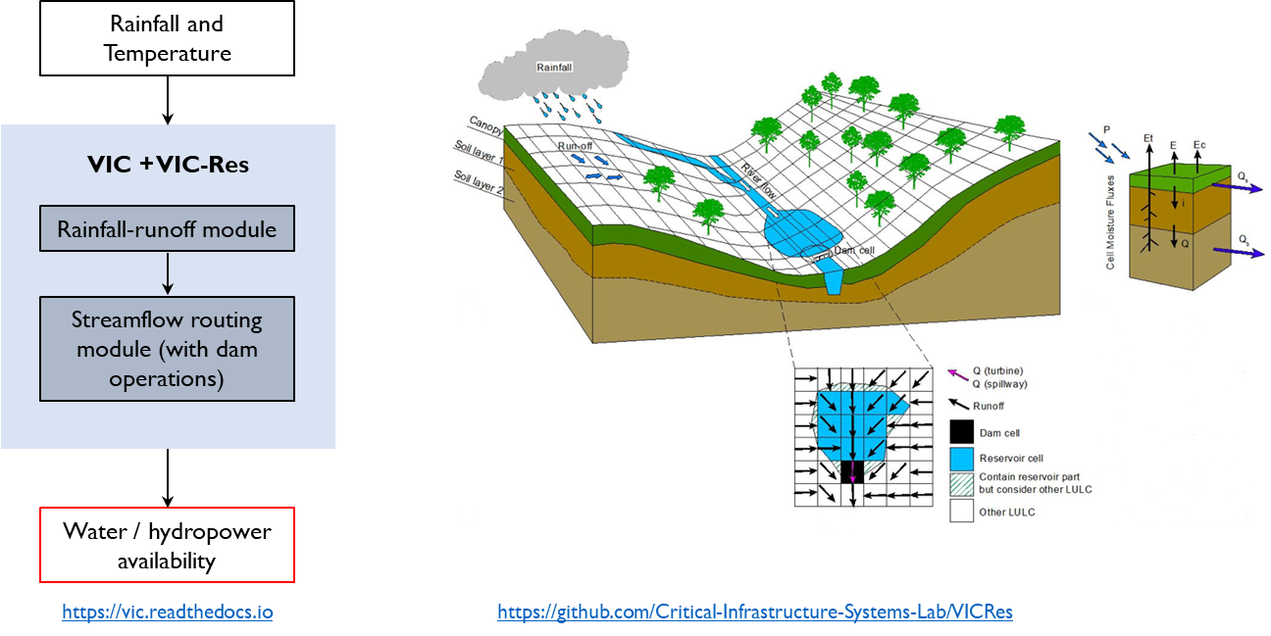
Methodology: Creating synthetic time series (3/3)
Hydropower
Generate hydropower capacity using VIC-RES
SOURCE: Critical Infrastructure Lab
Notes:
—— Use a spatially-distributes weather generator —> run VIC —> run VIC-Res
Example of spatially-distributes weather generator —> https://hyd.ifu.ethz.ch/research-data-models/awe-gen-2d.html
—— Run VIC-res and then use a multi-site stochastic generator
Rachel’s PhD defense (slide 15) —> https://critical-infrastructure-systems-lab.github.io/manual/docs/grad-studies-matters

Slide 56
Tentative experimental set-up
Key steps
Select two power systems
Laos (1,411 constraints and 1,056 variables)
Thailand (74,633 constraints and 54,312 variables)
Set-up model for the three trading schemes
Generate time-series inputs
Solar and hydro
Electricity demand
Natural gas price
Generate scenarios from time-series
Run experiments over scenarios
Extract model outputs
Hardware
Hopper Cluster (@Cornell CAC)
Dual 20-core Intel Xeon Gold 5218R CPUs @ 2.1 GHz, 192 GB of RAM
Software
Python 3.10
OpenHPC 2.3 with Rocky Linux 8.4
Gurobi 3.9

Slide 57
Key themes of my research relates to the regional electricity trade
Chapter 1
Chapter 2
Chapter 3
Advancing modeling
techniques
Bridging science and policy
Bridging science and policy
Fast heuristics to solve unit commitment problems
The impact of electricity trading on system economics and performance
The impact of electricity trading on household welfare
Detailed models have long runtime
Limited knowledge of cost-benefit of trading
No one should be left behind!

Slide 58
Energy policy should also explore impacts on consumers
Domestic energy consumption is heterogenous
(FX: 1 USD = 36 Baht)
SOURCE: Thailand household expenditure survey 2018

Slide 59
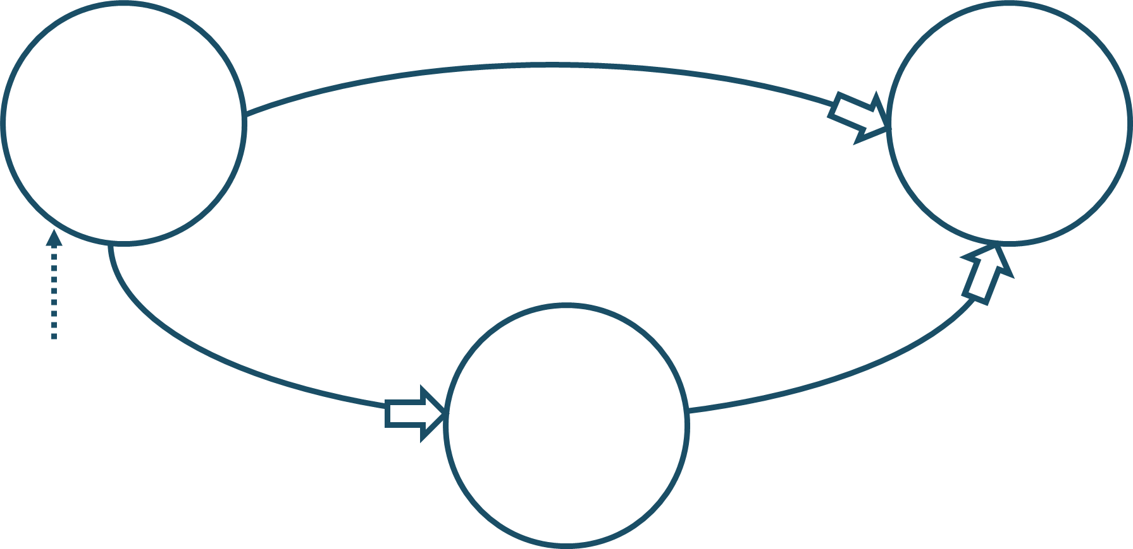
Changing electricity price will impact household welfare
Direct cost
Electricity price
Household welfare
Trading schemes
Other drivers of electricity price
Indirect cost
Prices of goods and services
Notes:
Use spending as a proxy of household welfare

Slide 60
Chapter 3 The impact of electricity trading on household welfare
Research questions to address
Key activities
How does electricity trading impact the welfare of households in Thailand-Laos?
Run a partial equilibrium model using price data from Topic 2
How does spending patterns of households affect their sensitivity to electricity price?
Perform data analysis from the partial equilibrium model
Notes:
Leave findings for the conclusions?

Slide 61
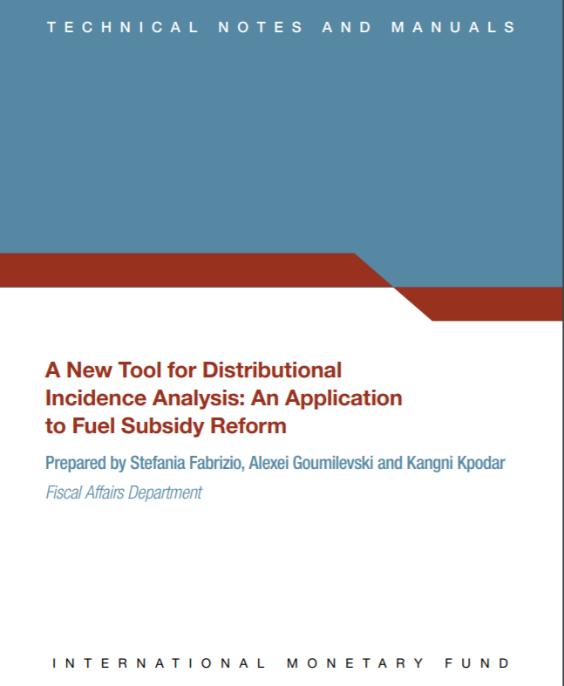
A Partial Equilibrium Model looks at the change in direct and indirect costs due to the change in electricity price
Modeling takes a data-driven approach
Required datasets
Required model
Micro-data of household expenditure survey
Micro-data be obtained from the national statistics department
Thailand Household expenditure survey from 2014, 2016, 2018
Lao Expenditure and Consumption Survey 2018
might not have a detailed breakdown of energy expenditure
Input-Output Table
Asian Development Bank provides datasets for Thailand and Laos
Covers 42 industries
Notes:
Talk about there is an implementation of the model as an excel spreadsheet

Slide 62
Mathematical formulations to calculate welfare impact
DIRECT welfare impact
Assume demand is unchanged, and spending is a proxy of household welfare
$$\frac{dY_{dir}}{Y} = b_{i} \frac{dP_{i}}{P_{i}}$$
The change in price of fuel $i$
Percentage change in household welfare of real income Y
the share of spending on fuel $i$
If electricity accounts for 10 percent of total spending of a household, the direct welfare impact of a 10 percent increase in the electricity price would be a 1 percent decline in household welfare.
SOURCE: Fabrizio et al (2016), A new tool for distributional incidence analysis: An application to fuel subsidy reform

Slide 63
Mathematical formulations to calculate welfare impact
INDIRECT welfare impact
Consider the price changes of other goods and services due to an increase in fuel price.
The change in price of other goods and services is calculated using the price shifting model from [Coady and Newhouse (2006). Ghana: Evaluating the Fiscal and Social Costs of Increases in Domestic Fuel Prices.]
Each element of input-output table ($A)$ is denoted $a_{i,j}$ , or the cost of input $i$ in producing one unit of output $j$
Price change of goods and services $∆P$ is a function of row vector of fuel price change ${∆P}_{F}$
$$∆P ={∆P}_{F} {\left(I −A\right)}^{−1}$$
Assumption
Factor prices are constant except fuel prices
No change in firm consumption > This calculation provides an upper bound on welfare impact
SOURCE: Fabrizio et al (2016), A new tool for distributional incidence analysis: An application to fuel subsidy reform
Notes:
Second perform a similar calculation as the direct cost, but for other goods

Slide 64
Tentative experimental set-up
Key steps
Select two power systems
Laos (1,411 constraints and 1,056 variables)
Thailand (74,633 constraints and 54,312 variables)
Use the following data from topic 2
Leading drivers for electricity price across trading schemes
Price change under each scenario
Set-up and run partial equilibrium model
Extract model outputs
Hardware
Hopper Cluster (@Cornell CAC)
Dual 20-core Intel Xeon Gold 5218R CPUs @ 2.1 GHz, 192 GB of RAM
Software
Python 3.10
OpenHPC 2.3 with Rocky Linux 8.4
Gurobi 3.9

Slide 65
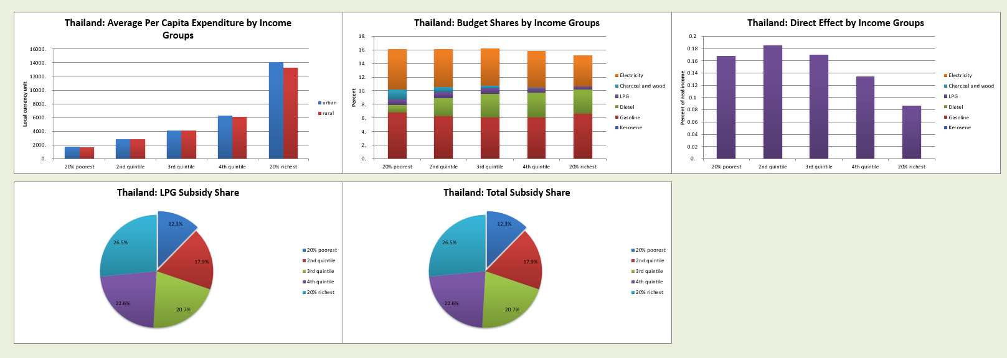
Hypotheses - Expected results
Example outputs based on a case study of LPG subsidy reform
Notes:
I did a study on LPG subsidy reform

Slide 66
PhD roadmap for 2024-2026
Conferences to attend
INFORMS
Timeline
Fall 2024
Audit infrastructure policy course
July 2024
Start topic 2
(TBC)
July-August 2025
Secure an internship
13 June 2024
Preliminary exam
By August 2026
PhD Defense
August 2025
Start topic 3
June/July 2024
Submit paper 1
June 2025
Submit paper 2
June 2026
Submit paper 3
Spring 2025
Audit infrastructure financing course

Slide 67
Thank you
Let me know if you have questions
Phumthep Bunnak
pb585@cornell.edu
Notes:
Talk about back-up topic 3 – LTMS versus trading versus climate change scenarios

Slide 68
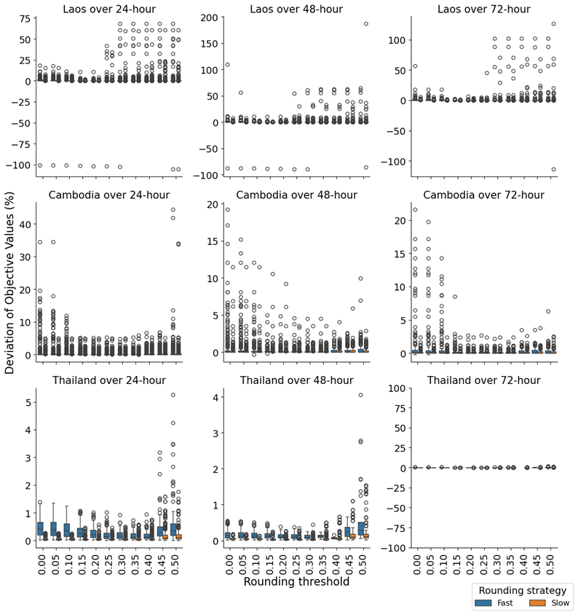
Result is promising but need some caution when looking at speed-up of Laos and Cambodia
Summary statistics of deviation in objective values from iterative rounding and Gurobi
Boxplot of the deviations
Country | Sim. horizon (hr) | Mean | Standard Deviation | Min | Max
Cambodia | 24 | 0.388 | 1.519 | -0.007 | 44.46
Cambodia | 48 | 0.309 | 1.088 | -0.445 | 19.232
Cambodia | 72 | 0.334 | 1.378 | -0.25 | 21.643
Laos | 24 | 0.557 | 5.286 | -105.274 | 68.123
Laos | 48 | 0.603 | 6.797 | -89.493 | 187.03
Laos | 72 | 1.145 | 8.047 | -113.601 | 126.516
Thailand | 24 | 0.185 | 0.255 | 0.008 | 5.253
Thailand | 48 | 0.105 | 0.162 | 0.006 | 4.053
Thailand | 72 | 0.101 | 0.117 | 0.006 | 1.68

Slide 69
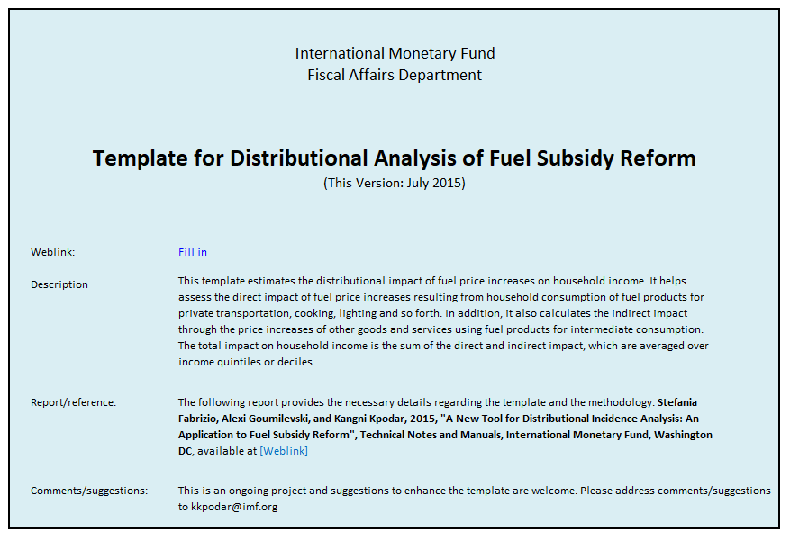
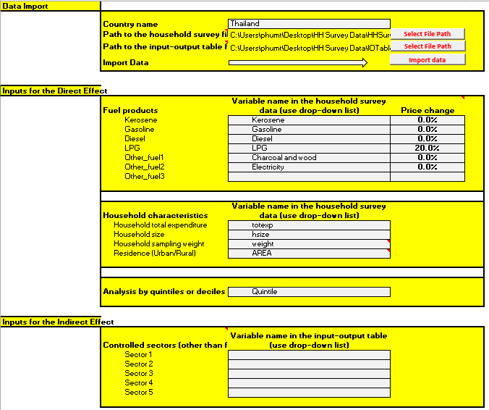
How do we implement the model? (1/2)
Convert excel VBA to Python
There is a excel spreadsheet with VBA code ~ 1500 lines of code
SOURCE: Fabrizio et al (2016), A new tool for distributional incidence analysis: An application to fuel subsidy reform

Slide 70
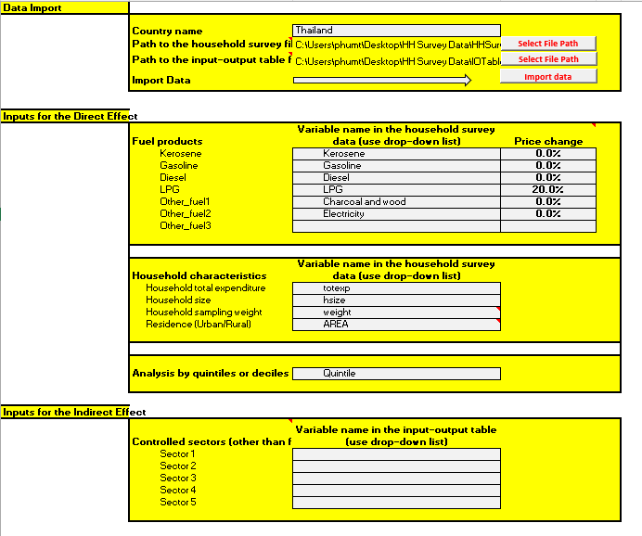
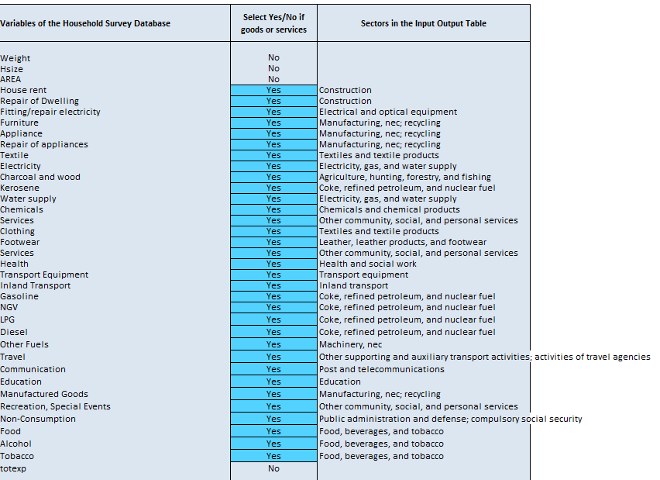
How do we implement the model? (1/2)
Map goods and services to input-output table
Use the household expenditure survey and the Input-Output table
SOURCE: Fabrizio et al (2016), A new tool for distributional incidence analysis: An application to fuel subsidy reform

Slide 71
How can we use the heuristics in solving PowNet?
Rough sketch of the idea
Solve with iterative rounding
Completed
Get the solution
No
Feasibility
check
Yes
Solve with Gurobi
Wait for the default solver
Solve with iterative rounding and Gurobi in parallel

Slide 72
Power system modeling can leverage the advantages of Gurobipy and Linopy
pandas
xarray, pandas
Pyomo
Gurobipy
Linopy
JUMP
(as implemented)
(as assumed)
Functional Requirements
$$⋆⋆$$
$⋆⋆⋆$ : array-based modeling
--
Ease of using timeseries
Ease of model building
Suitable with decom research
Inclusion of ML models
$$⋆$$
$⋆⋆⋆$ : array-based modeling
$$⋆$$
$$⋆$$
$$⋆$$
$$⋆$$
$$⋆$$
NO
YES
NO
NO
Interface Requirements
Parent organization
Is Solver agnostic?
Can use GPU?
Pyomo
Gurobi
PyPSA
JUMP
YES
NO
YES
YES
Other Requirements
$$⋆$$
$⋆⋆$ : Array-based modeling
$$⋆$$
Level of maintainability
Model set-up time
RAM requirement
$$⋆$$
Should be faster because not a wrapper
$$⋆$$
--
<= JUMP
Notes:
PyPSA/linopy: Linear optimization with N-D labeled arrays in Python (github.com)
Benchmarks — linopy master documentation
Inclusion of ML models → Demand energy response

Slide 73
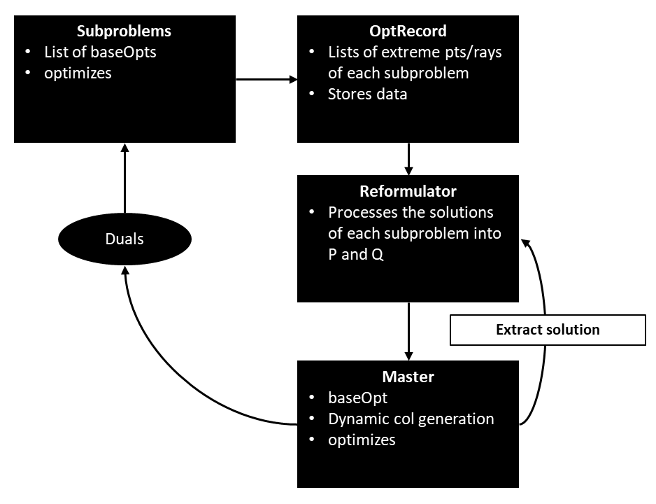
Implementation details of the DW algorithm
Key Steps
Create problem instances and the decomposition file
Solve each subproblem using the original coefficients in the objective function
The initial proposals from the subproblems form the master problem
Solve the master problem and extract a vector of duals
If the master problem is in Stage I, we update each subproblem using Farkas pricing. If the master problem is in Stage II, we apply reduced cost pricing
Solve the subproblems with the updated cost coefficients, so the subproblems generate new proposals
Repeat steps 2-5 until the maximum number of iterations is reached or the objective value of the master problem decreases below a threshold
Design pattern of the Dantzig-Wolfe code
Notes:
Experiments carried out on Hopper Cluster (@Cornell CAC)
Dual 20-core Intel Xeon Gold 5218R CPUs @ 2.1 GHz, 192 GB of RAM
OpenHPC 2.3 with Rocky Linux 8.4
Gurobi 3.9

Slide 74
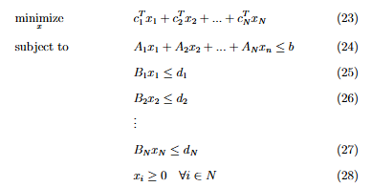
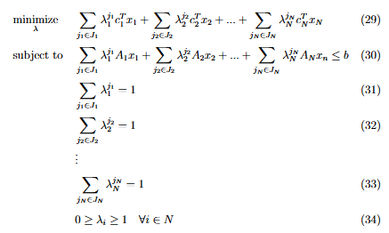
Dantzig-Wolfe Decomposition is suitable for linear programs with a block-diagonal structure
Compact formulation
Extended formulation
Notes:
Constraints define the search space

Slide 75
Discrete Dantzig-Wolfe Decomposition is a slight modification
Compact formulation
Extended formulation
For DDW, $λ∈\{0, 1\}$
Notes:
Constraints define the search space

