Slide 1
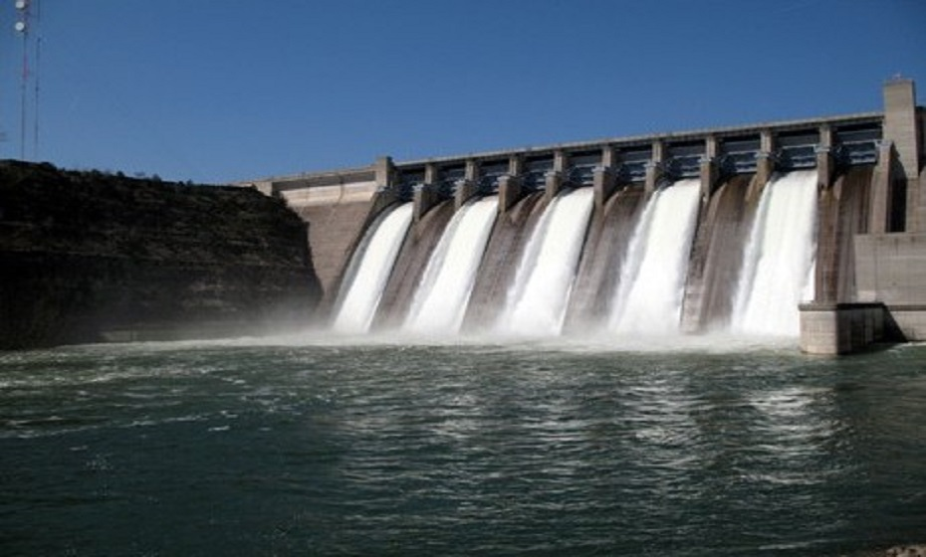
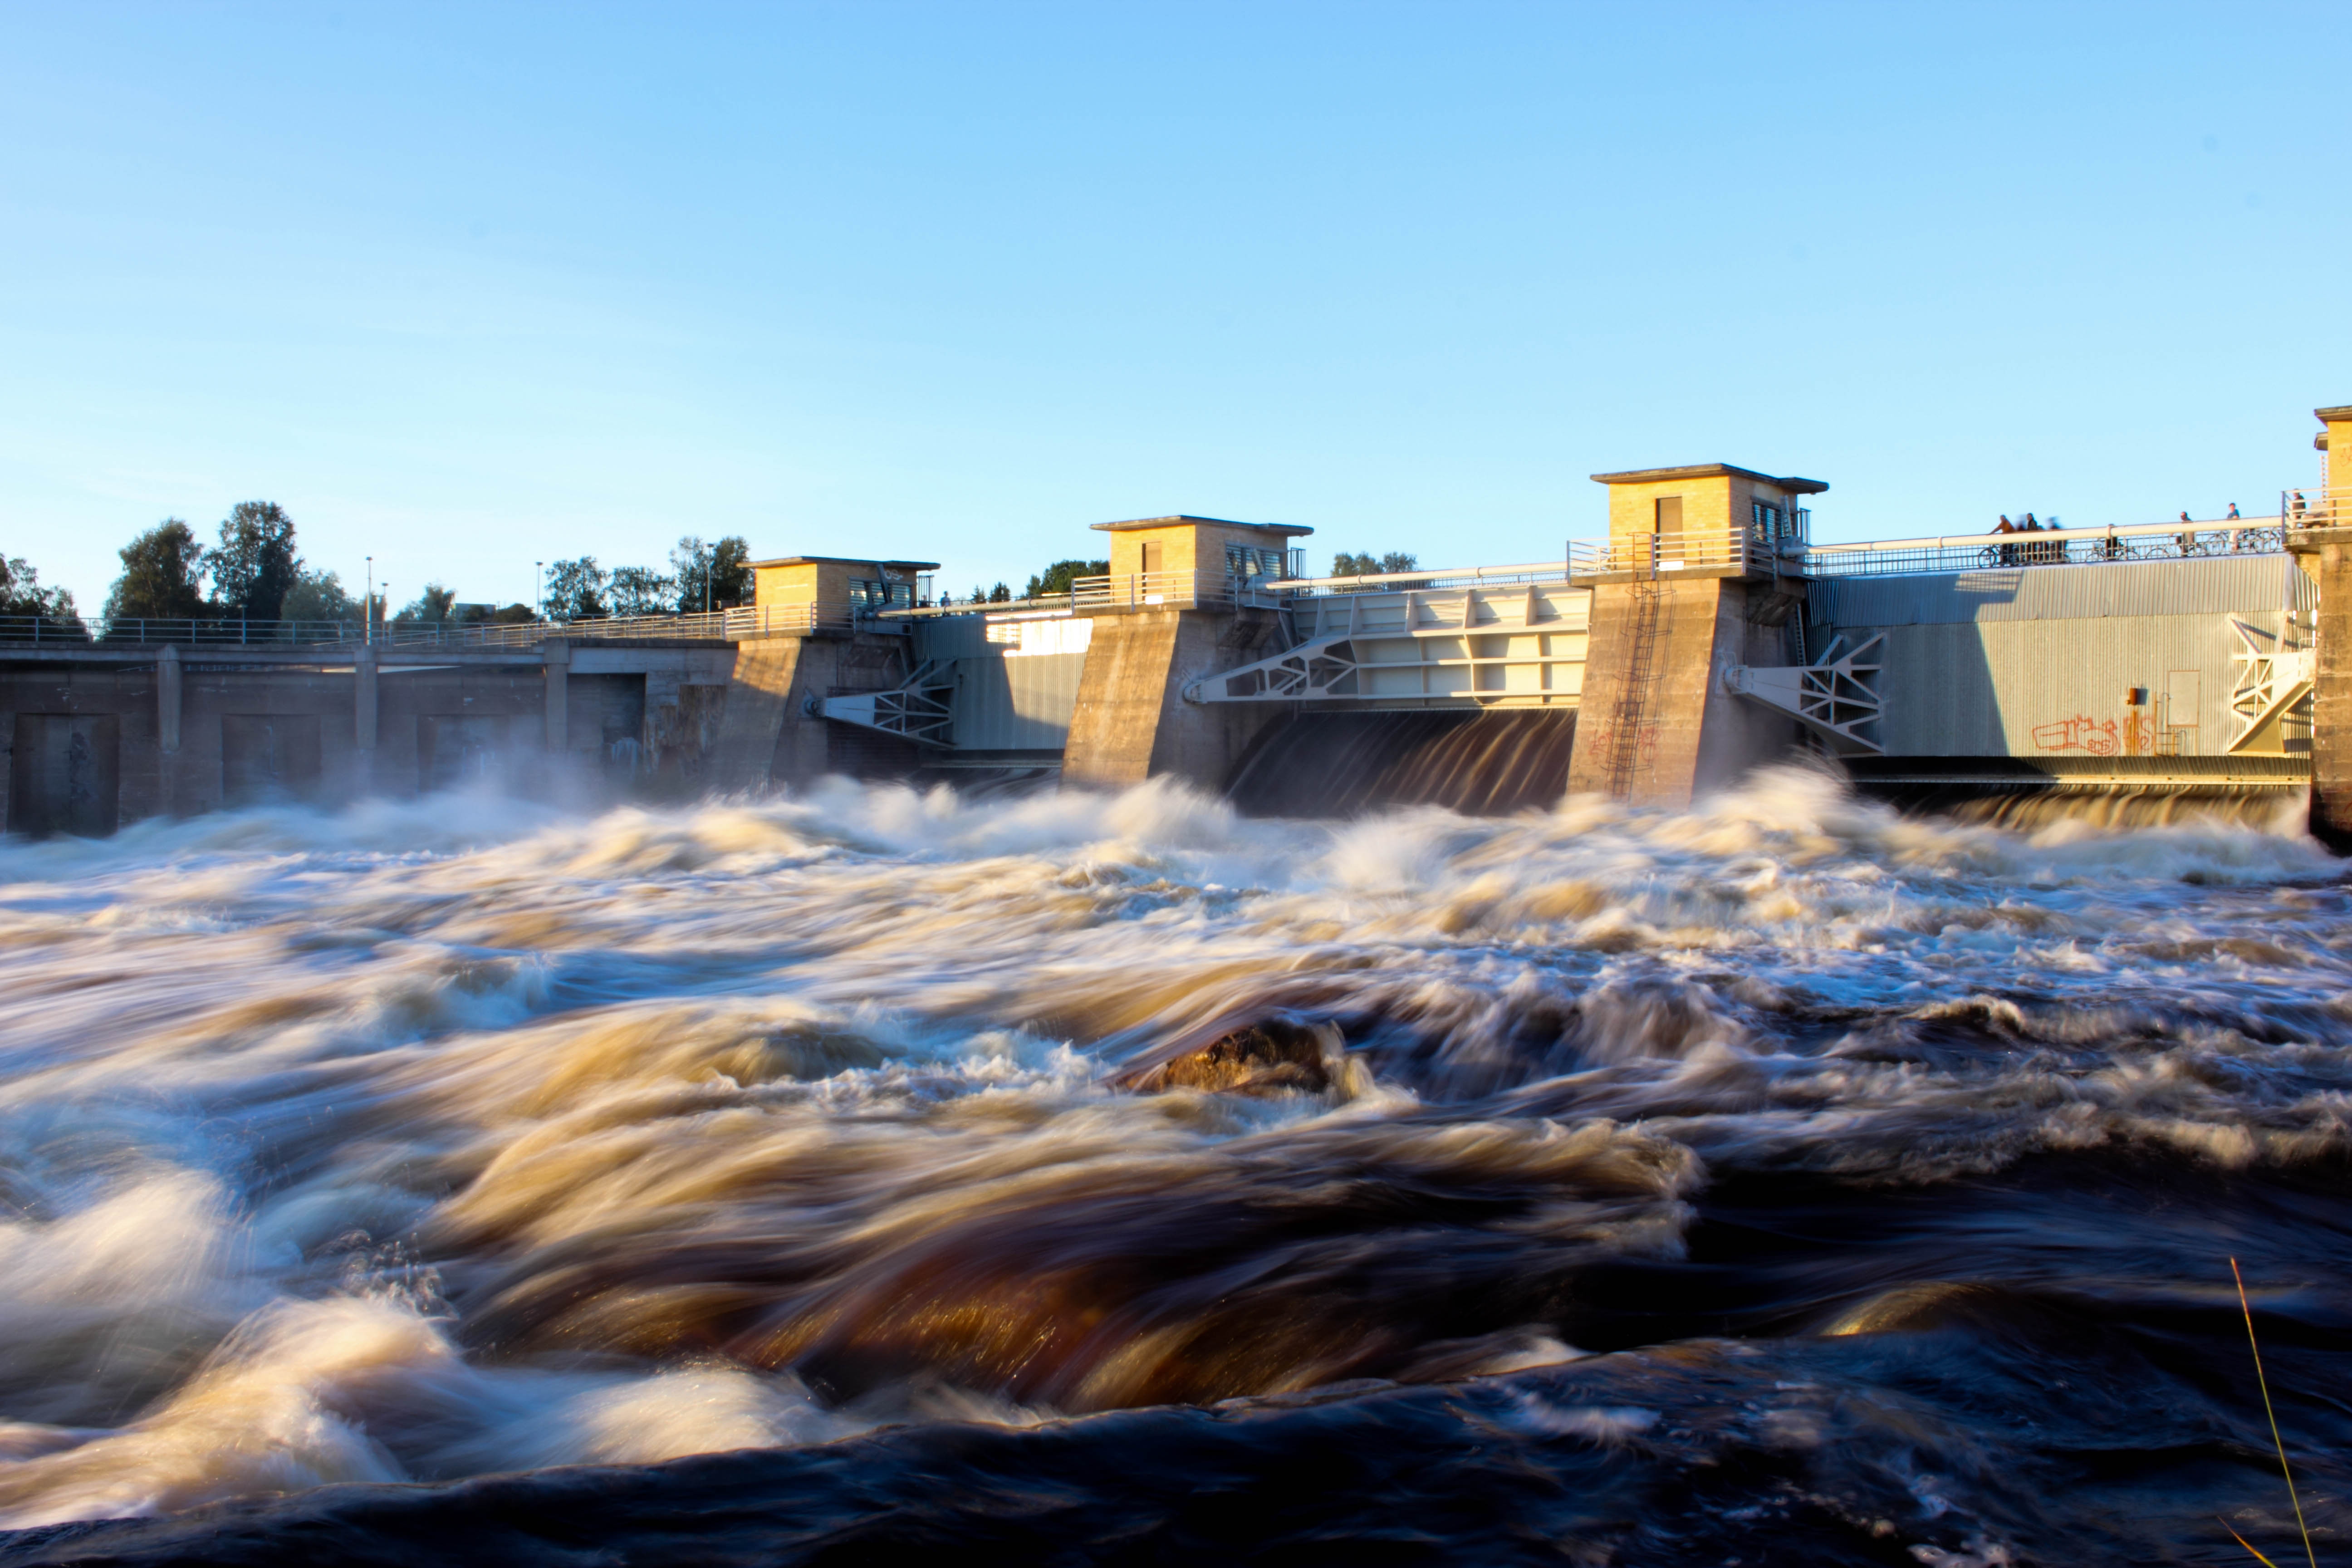
PhD Preliminary Examination
Enhancing the performance of
water-energy-land systems through synergized operations
by Rachel Koh
under the guidance of Assoc. Prof. Stefano Galelli
26 August 2021

Slide 2
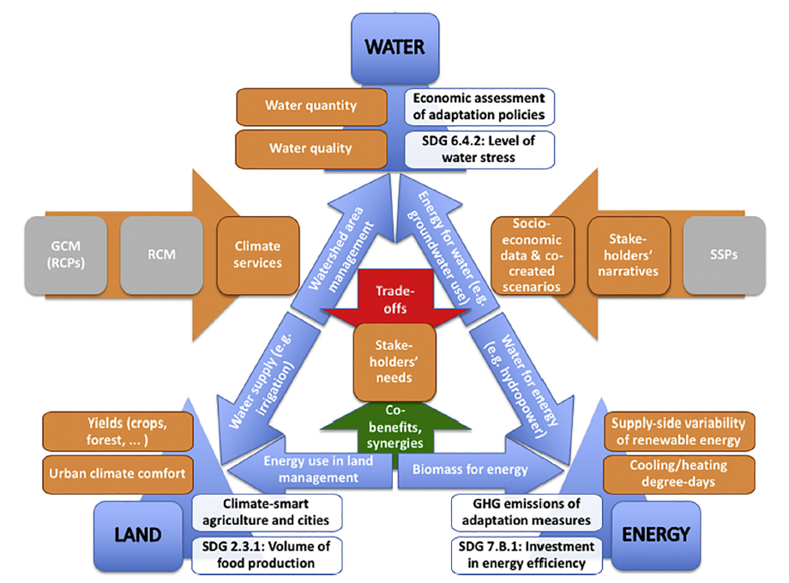
Water-Energy-Land Nexus
Population growth
Climate change
Investments
Infrastructures
Policies
Sustainability
Co-dependencies
Cremades, R., Mitter, H., Tudose, N. C., Sanchez-Plaza, A., Graves, A., Broekman, A., ... & Marin, M. (2019). Ten principles to integrate the water-energy-land nexus with climate services for co-producing local and regional integrated assessments. Science of the Total Environment, 693, 133662.

Slide 3
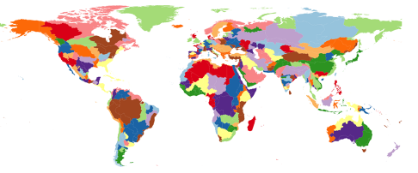
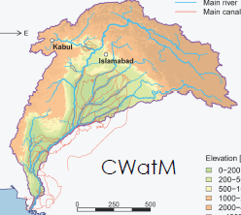
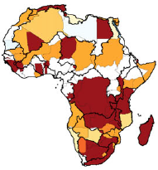
Water-Energy-Land Models
Temporal scale
“
Individual component modules in GCAM are designed to capture key characteristics of the underlying systems; however, because its focus is on the interactions among systems,
it does not include the level of detail found in sector- or process-specific models.
Calvin et al. (2019)
Model: GCAM v5.1
Scale: Global
Time-step: 5 years
“
Planning
Vinca et al. (2019)
Model: NEST
Scale: River basin
Time-step: Monthly
“
Increasing spatial and temporal resolution might be helpful to focus on sub-regions and identify possible critical areas with higher detail.
“
Hours Days Months Years
While these assumptions are reasonable for modeling at large scale, it may not be suitable for detailed basin studies …
“
“
Kahil et al. (2018)
Model: ECHO
Scale: Continental
Time-step: Monthly
Characterize co-dependencies among different sectors at
the operational level
Operations
Spatial scale
Regional Continental Global

Slide 4
Research goals
To harness the co-dependencies of
water-energy-food systems at the
operational scale.
Sub-topic 1:
Advancing the integration of renewables by co-simulating water and energy systems
Sub-topic 2:
Improving the performance of water, energy and food systems through co-simulations
Sub-topic 3:
Improving the scalability of models
Water
Energy
Food

Slide 5
Sub-topic 1
PhD Preliminary Examination
Advancing the integration of renewables by co-simulating
water and energy systems
In collaboration with Dr. Jordan Kern (North Carolina State University)

Slide 6
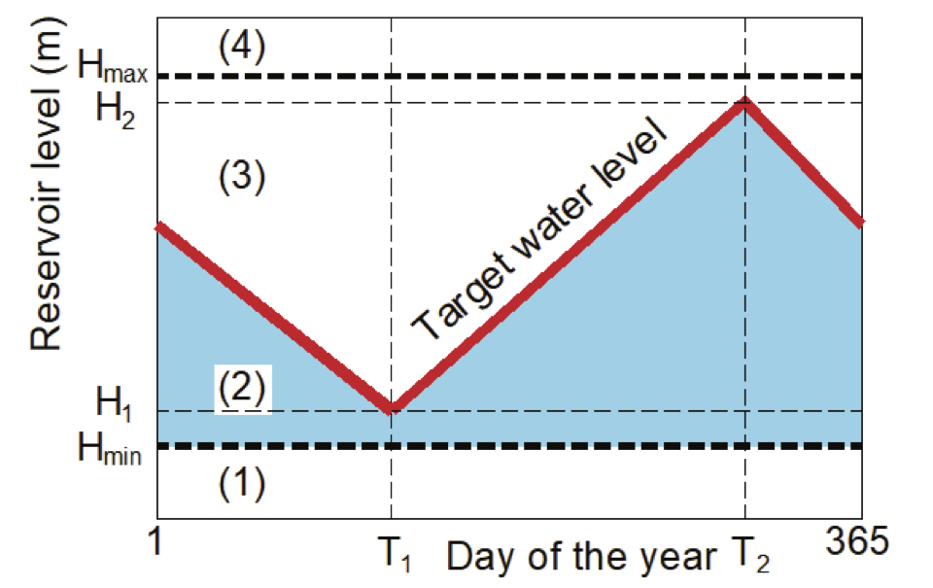
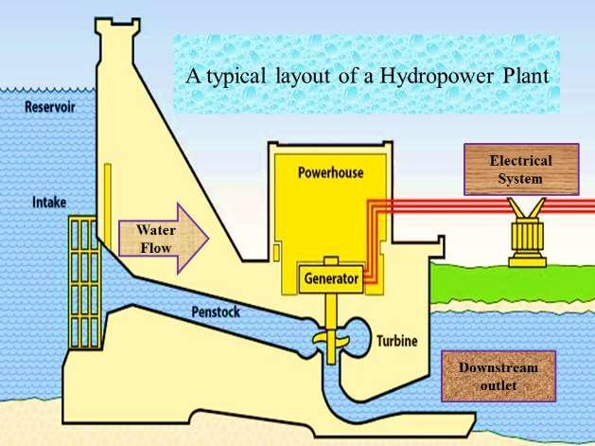
Reservoir Operations
Influence of
water
on
energy supply
Hydropower produced from turbine
Hydropower equation:
${HP}_{t}=η$ x $ρ$ x g x $R_{t}$ x $H_{t}$
Controlled release from reservoir
Storage at time t
Inflow to reservoir
Water density
Hydraulic head
Mass balance equation:
$S_{t}=S_{t−1}+Q_{t}−R_{t}−{spill}_{t}$ $−{evaporation}_{t}$
s.t. $0≤ S_{t} ≤ S_{cap}$
Turbine efficiency
Min, Ho & Wagh, Sumit & Kadier, Abudukeremu & Gondal, Irfan & Azim, Nur & Mishra, Mukesh. (2018).
Renewable Energy Technologies.

Slide 7
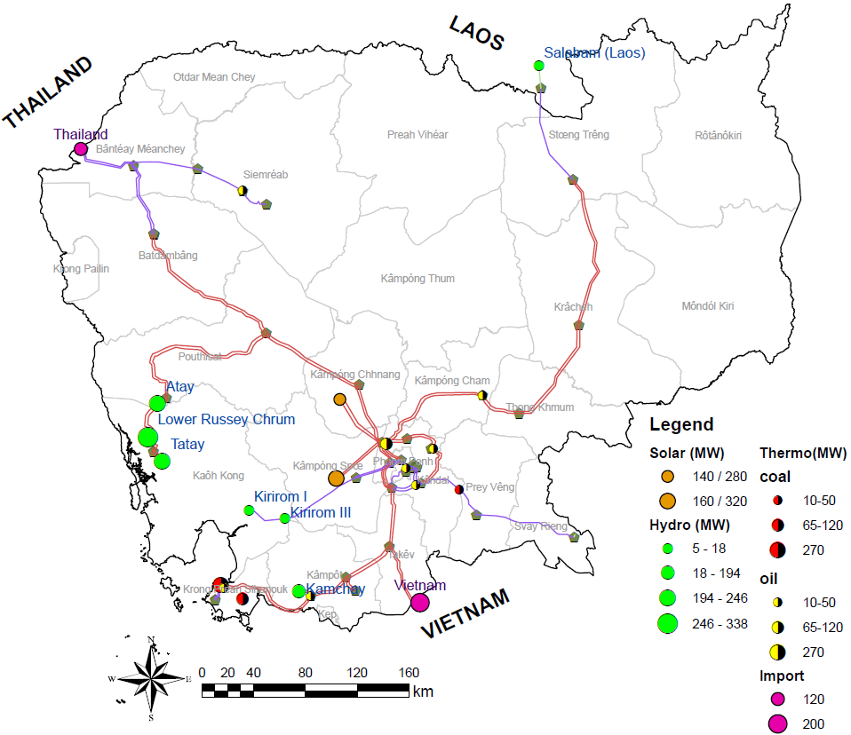
Research Questions
What are the benefits of co-simulating the water and energy systems?
What are the conditions in which the co-simulation mechanism works best?
How does the co-simulation mechanism affect the system performance at different temporal scales?

Slide 8
Traditional simulation environment
Day d
Day d+1
Day d+n
$$Q_{d}$$
$$S_{d−1}$$
Reservoir model
$$Q_{d+1}$$
Reservoir model
$$Q_{d+n}$$
Reservoir model
Water system
…
$$S_{d}=S_{d−1}+Q_{d}−R_{d}$$
Release $R_{d}$
Release $R_{d+1}$
Release $R_{d+n}$
$$S_{d+1}$$
$$S_{d+n−1}$$
Available hydropower: ${HP}_{d}$
Available hydropower: ${HP}_{d+1}$
Available hydropower: ${HP}_{d+n}$
Energy system

Slide 9
Power System Operations
Power system model (MILP)
Goal: Supply all demands at minimum cost, while complying with the technical constraints of the transmission network
Which generators should be used?
How much should each generator generate?
Unit Commitment
Economic dispatch
Integer variables
Continuous variables
On
Fixed costs
Variable costs
Switch
Start-up cost
Shut-down cost
Production
Fuel costs
Imports
Import costs

Slide 10
Traditional simulation environment
State-of-the-art simulation environment
Day d
Day d+1
Day d+n
$$Q_{d}$$
$$S_{d−1}$$
Reservoir model
$$Q_{d+1}$$
Reservoir model
$$Q_{d+n}$$
Reservoir model
Water system
…
$$S_{d}=S_{d−1}+Q_{d}−R_{d}$$
Release $R_{d}$
Release $R_{d+1}$
Release $R_{d+n}$
$$S_{d+1}$$
$$S_{d+n−1}$$
Available hydropower: ${HP}_{d}$
Available hydropower: ${HP}_{d+1}$
Available hydropower: ${HP}_{d+n}$
Power system model
Power system model
Power system model
…
Energy system
Hourly energy production mix
(HP dispatched = ${HP}_{d}$*),
Operating cost,
CO₂ emi.
Hourly energy
production mix
(HP dispatched = ${HP}_{d+1}$*),
Operating cost,
CO₂ emi.
Hourly energy
production mix
(HP dispatched = ${HP}_{d+n}$*),
Operating cost,
CO₂ emi.

Slide 11
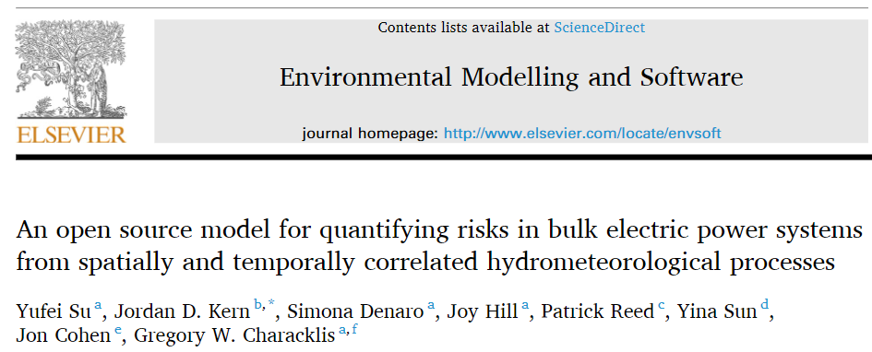
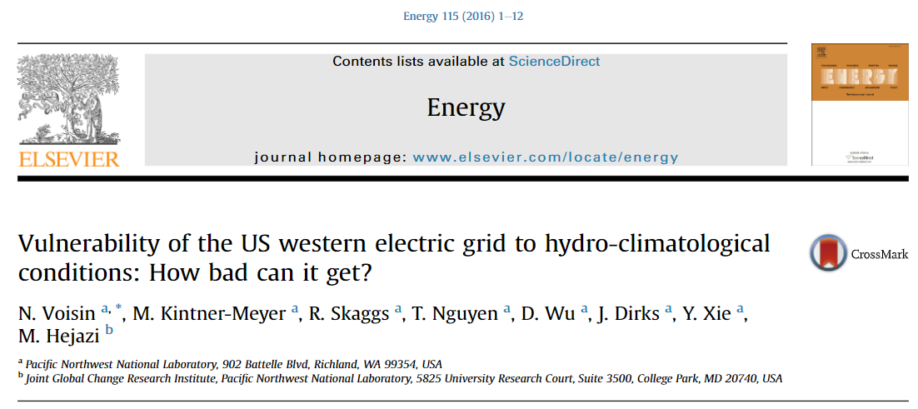
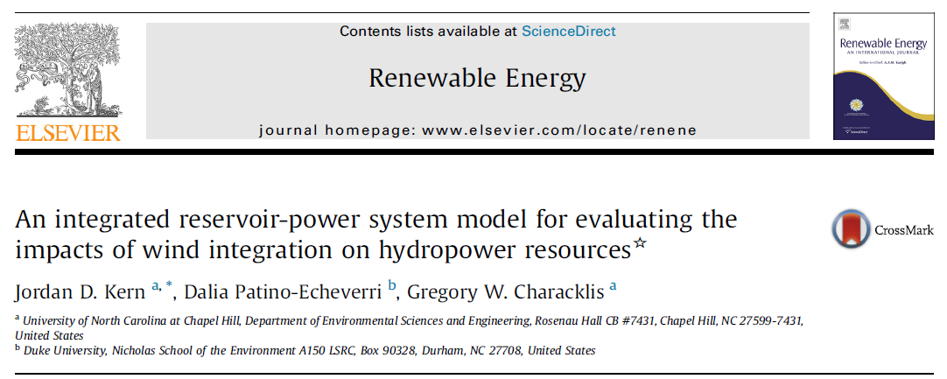
State-of-the-art simulation environment
Hydrological model
Available hydropower
Power system model
Notes:
Example papers

Slide 12
Co-
State-of-the-art simulation environment
Day d
Day d+1
Day d+n
What happens if ${HP}_{d}$* < ${HP}_{d}$?
Excess hydropower (${HP}_{d}−{HP}_{d}$*) curtailed (wasted)
Why do such events happen?
Variability in:
Energy demand
Seasonal
Temperature-driven
Supply
Reservoir inflow
Solar / wind
Physical constraints
Transmission line capacity
How can we improve the overall system performance?
$$Q_{d}$$
$$S_{d−1}$$
Reservoir model
$$Q_{d+1}$$
Reservoir model
$$Q_{d+n}$$
Reservoir model
Water system
$S_{d}\text{∗}=S_{d−1}+Q_{d}−R_{d}$ *
…
$$S_{d}=S_{d−1}+Q_{d}−R_{d}$$
Release $R_{d}$
Release $R_{d+1}$
Release $R_{d+n}$
$$S_{d+1}$$
$$S_{d+n−1}$$
Release $R_{d}$*
Produce
${HP}_{d}$*
Available hydropower: ${HP}_{d}$
Available hydropower: ${HP}_{d+1}$
Available hydropower: ${HP}_{d+n}$
Power system model
Power system model
Power system model
…
Energy system
Hourly energy production mix
(HP dispatched = ${HP}_{d}$*),
Operating cost,
CO₂ emi.
Hourly energy
production mix
(HP dispatched = ${HP}_{d+1}$*),
Operating cost,
CO₂ emi.
Hourly energy
production mix
(HP dispatched = ${HP}_{d+n}$*),
Operating cost,
CO₂ emi.

Slide 13
Modelling Framework
Release $R_{d}$*
Store $S_{d}$*
DAILY
$$S_{d−1}$$
implement
Reservoir re-operation model
$$Q$$
Reservoir model
☒ ${HP}_{d}$* < ${HP}_{d}$
No
Release $R_{d}$
Store $S_{d}$
implement
Yes
☑ ${HP}_{d}$* = ${HP}_{d}$
Hydropower fully utilised?
Daily available: ${HP}_{d}$
HOURLY
oil
Total daily dispatched: ${HP}_{d}$*
Solar
Wind
Load
coal
Power system model
hourly
hydropower
other renewables
imports

Slide 14
Reservoir re-operation model
Input: Data from reservoir & power system models
$S_{d−1}$, hourly $Q$
${HP}_{t}$*$∀t∈[1,24]$
Hydropower equation (Eq. 1):
${HP}_{t}=η$ x $ρ$ x g x $R_{t}$ x $H_{t}$
→ ${HP}_{t}=η$ x $ρ$ x g x $R_{t}$ x ${f(S}_{t−1}$, $S_{t})$
Mass balance equation (Eq. 2):
$$S_{t}=S_{t−1}+Q_{t}−R_{t}−{spill}_{t}$$
Set boundary conditions
Initialise reservoir storage
$${S_hr}_{0}=S_{d−1}$$
Output:
$R_{d}$*$=Σ_{t}{R_hr}_{t}$, $t∈[1,24]$
$S_{d}$*$={S_hr}_{24}$
goal
constants
known
assume
= $S_{t−1}$
Initialise simulation
$$t=1$$
known
known
calc.
Compute spills
Assume storage for the next hour
$${S_hr}_{t}={S_hr}_{t−1}$$
time loop
Compute hourly release ($r$) using (Eq.1)
Compute reservoir storage ($s$) using derived $r$ in (Eq.2)
Update hourly release, ${R_hr}_{t}=r$
Update reservoir storage, ${S_hr}_{t}=s$
Implicit equation

Slide 15
Reservoir re-operation model
Input: Data from reservoir & power system models
$S_{d−1}$, hourly $Q$
${HP}_{t}$*$∀t∈[1,24]$
$$END$$
Hydropower equation (Eq. 1):
${HP}_{t}=η$ x $ρ$ x g x $R_{t}$ x $H_{t}$
→ ${HP}_{t}=η$ x $ρ$ x g x $R_{t}$ x ${f(S}_{t−1}$, $S_{t})$
Mass balance equation (Eq. 2):
$$S_{t}=S_{t−1}+Q_{t}−R_{t}−{spill}_{t}$$
Set boundary conditions
Initialise reservoir storage
$${S_hr}_{0}=S_{d−1}$$
Output:
$R_{d}$*$=Σ_{t}{R_hr}_{t}$, $t∈[1,24]$
$S_{d}$*$={S_hr}_{24}$
goal
constants
known
assume
= $S_{t−1}$
Initialise simulation
$$t=1$$
Yes
known
known
calc.
Compute spills
No
$$t=t+1$$
$t=24$?
Assume storage for the next hour
$${S_hr}_{t}={S_hr}_{t−1}$$
Yes
time loop
No
Compute hourly release ($r$) using (Eq.1)
Compute reservoir storage ($s$) using derived $r$ in (Eq.2)
Update hourly release, ${R_hr}_{t}=r$
Update reservoir storage, ${S_hr}_{t}=s$
Convergence?
Yes
Implicit equation
No
$t=1$?

Slide 16
Experimental set-up
Model:
Reservoir model
Power system model: PowNet
Set-up:
Input data: Deterministic / Stochastic
Experimental horizon: 1 year / 5 years / 10 years
Simulations: With / Without co-simulation
No. of simulations
start and fixed costs, variable o&m costs,
fuel price, heat rate
Energy demand and export
(in substations)
Ramp up/down limit, min up/down time
$$S_{t}=S_{t−1}+Q_{t}−R_{t}−{spill}_{t}$$
s.t. $0≤ S_{t} ≤ S_{cap}$
${HP}_{t}=η$ x $ρ$ x g x $R_{t}$ x $H_{t}$
Electricity from thermo-plants and import nodes
Transmission capacity, susceptance
PowNet
(MILP problem: minimize cost, meet demand and exports)
Available hydro-power
Operating cost
CO₂ emissions
Hourly energy production mix
+
Power flow through the grid
Adapted from Chowdhury et al. (2020), Journal of Open Research Software, 8(1).

Slide 17
Release R_{d}*
Store S_{d}*
DAILY
S_{d-1}
implement
Reservoir re-operation model
Q
Reservoir model
☒ HP_{d}* < HP_{d}
No
Release R_{d}
Store S_{d}
implement
☑ HP_{d}* = HP_{d}
Yes
Stochastic inputs
Hydropower fully utilised?
Daily available: HP_{d}
HOURLY
oil
Total daily dispatched: HP_{d}*
coal
Solar
Load
Power system model
hourly
hydropower
other renewables
imports

Slide 18
Case Study
Design specifications of the Cambodian HP dams
Reservoir | Installed capacity (MW) | Dam height (m) | Storage (Mm3) | Design discharge (m3/s) | Hydraulic head (m) | Basin area (km2)
Kamchay Kirirom I Kirirom III LR Chrum Atay Tatay | 194.1 12 18 338 240 246 | 110 34 40 68 45 77 | 680 30 30 62 443.8 322 | 163.5 20 40 300 125 150 | 122 373.5 271 132 216 188 | 710 99 105 1550 1157 1073
Experimental setup
Case | 1 | 1CS | 2 | 2CS | 3 | 3CS
Installed cap (MW) Coal Oil Hydro Solar | 400 602 1048 | 400 602 1048 | 400 602 1048 300 | 400 602 1048 300 | 400 602 1048 600 | 400 602 1048 600
Co-simulation |  | ✓ |  | ✓ |  | ✓

Slide 19
Synthetic data
Data | Source | Source
Solar irradiance |  | Renewables.ninja https://www.renewables.ninja/
Temperature |  | National Center for Atmospheric Research https://climatedataguide.ucar.edu/climate-data/climate-forecast-system-reanalysis-cfsr
Load |  | Electricite Du Cambodge EDC Annual Report, 2016
River discharge |  | Global Flood Awareness System https://cds.climate.copernicus.eu/cdsapp#!/dataset/cems-glofas-historical?tab=overview

Slide 20
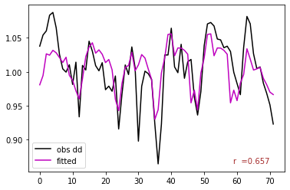
Synthetic data – Solar irradiance & Load
Raw data ($y_{t}$)
Synthetically expanded 1000-year time series
Detrend
Solar irradiance
Residuals ($\frac{y_{t}− μ(y_{t})}{σ(y_{t})}$ )
ARMA model
Load
$$peak demand=f\left(tmin\right)+residuals$$
Synthetic standardized residuals
Re-trend
Synthetically expanded time series

Slide 21
Synthetic data – Reservoir inflow
Daily streamflow time series for each reservoir
Kirsch-Nowak Streamflow Generator
https://github.com/julianneq/Kirsch-Nowak_Streamflow_Generator
Multi-site streamflow time series generator
Resolution: Daily
Accounts for correlation across sites
Rescales synthetic flows with monsoon
Kirsch-Nowak Streamflow Generator
Synthetic daily streamflow time series for each reservoir
Synthetically expanded 1000-year spatially-aggregated streamflow
time series

Slide 22
No. of Simulations
Experimental setup
Case | 1 | 1CS | 2 | 2CS | 3 | 3CS
Installed cap (MW) Coal Oil Hydro Solar | 400 602 1048 | 400 602 1048 | 400 602 1048 300 | 400 602 1048 300 | 400 602 1048 600 | 400 602 1048 600
Co-simulation |  | ✓ |  | ✓ |  | ✓
6 scenarios x
1000 simulations each
Notes:
obs_vs_syn.py

Slide 23
What are the benefits of co-simulating the water and energy systems?
Notes:
var1 = [ALL_cost_an,ALL_co2_an,ALL_pc_renew_an];
metrics1=['cost','co2','ALL_pc_renew_an']
diff_kde_cdf(var1,metrics1)

Slide 24
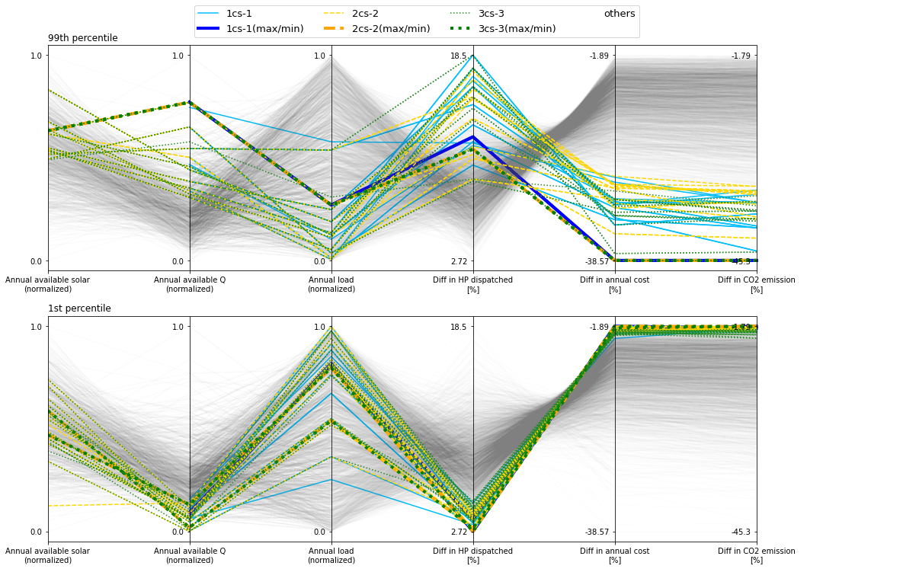
What are the conditions in which the co-simulation mechanism works best?

Slide 25
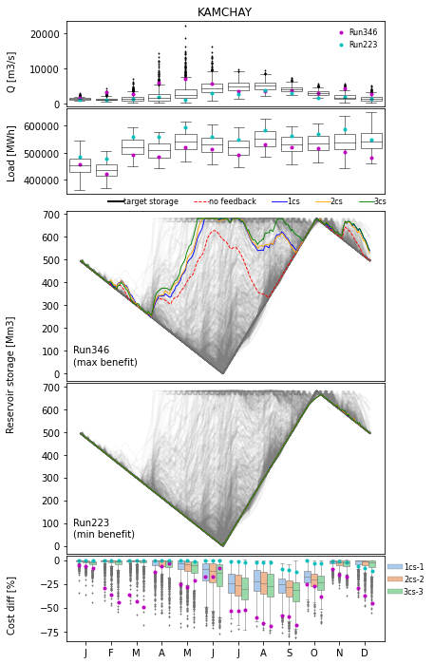
How does the co-simulation mechanism affect the system performance at different temporal scales?
Notes:
plot_res_storage_Q_cost()

Slide 26
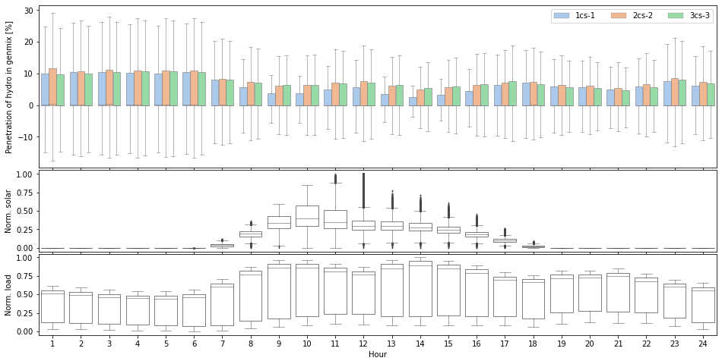
How does the co-simulation mechanism affect the system performance at different temporal scales?
Notes:
plot_hyd_solar_hr()

Slide 27
Conclusions
Co-simulating the two systems bring system benefits in terms of cost-savings, CO₂ emissions and renewable penetration.
The co-simulation mechanism works best in conditions of high inflow and low load.
At seasonal scale, more water stored during wet periods for use during dry periods
At hourly scale, mechanism facilitates more hydropower penetration in generation mix, especially during low-load hours.

Slide 28
Sub-topic 1
Energy
Water
Food
Reservoir operations

Slide 29
Sub-topic 2
Goal:
To investigate synergies and trade-offs of different irrigation strategies within the nexus
Reservoir
model
Crop water
Crop
model
Hydropower
Reservoir
re-operation model
Power system model

Slide 30
Sub-topic 3
Goal:
To improve scalability of our
water-energy-food modelling tool
Reservoir
model
Crop water
Crop
model
Hydropower
Reservoir
re-operation model
Power system model

Slide 31
Timeline
What I plan to do
Oct 2021
Submit
1st paper
Spring 2022
Research attachment
Jul 2021
Complete
1st sub-topic
Prelim Exam
Jun 2022
Complete
2nd sub-topic
May 2023
Complete
3rd sub-topic
Jul 2023
Final Exam
Sep 2023
Deadline

Slide 32
References
Chowdhury, A. K., Dang, T. D., Nguyen, H. T., Koh, R., & Galelli, S. (2021). The Greater Mekong's Climate‐Water‐Energy Nexus: How ENSO‐Triggered Regional Droughts Affect Power Supply and CO2 Emissions. Earth's Future, 9(3), e2020EF001814. doi: 10.1029/2020EF001814
Chowdhury, A. K., Kern, J., Dang, T. D., & Galelli, S. (2020). PowNet: a network-constrained unit commitment/economic dispatch model for large-scale power systems analysis. Journal of Open Research Software, 8(1). doi: 10.5334/jors.302
Electricite Du Cambodge (2016). 2016 Annual Report. Technical Report, Electricite Du Cambodge
Gebretsadik, Y., Fant, C., Strzepek, K., & Arndt, C. (2016). Optimized reservoir operation model of regional wind and hydro power integration case study: Zambezi basin and South Africa. Applied Energy, 161, 574-582. doi: 10.1016/j.apenergy.2015.09.077
Harrigan, S., Zsoter, E., Alfieri, L., Prudhomme, C., Salamon, P., Wetterhall, F., C. Barnard, H. Cloke & Pappenberger, F. (2020). GloFAS-ERA5 operational global river discharge reanalysis 1979–present. Earth System Science Data, 12(3), 2043-2060. doi: 10.24381/cds.a4fdd6b9
Kahil, T., Parkinson, S., Satoh, Y., Greve, P., Burek, P., Veldkamp, T. I., ... & Wada, Y. (2018). A continental‐scale hydroeconomic model for integrating water‐energy‐land nexus solutions. Water resources research, 54(10), 7511-7533. doi: 10.1029/2017WR022478
Kelly, T. D., & Foster, T. (2021). AquaCrop-OSPy: Bridging the gap between research and practice in crop-water modeling. Agricultural Water Management, 254, 106976. doi: 10.1016/j.agwat.2021.106976
Kern, J. D., Patino-Echeverri, D., & Characklis, G. W. (2014). An integrated reservoir-power system model for evaluating the impacts of wind integration on hydropower resources. Renewable energy, 71, 553-562. doi: 10.1016/j.renene.2014.06.014
National Center for Atmospheric Research Staff (Eds). Last modified 08 Nov 2017. "The Climate Data Guide: Climate Forecast System Reanalysis (CFSR)." Retrieved from https://climatedataguide.ucar.edu/climate-data/climate-forecast-system-reanalysis-cfsr.
Pfenninger, S. & Staffell, I. (2016). Long-term patterns of European PV output using 30 years of validated hourly reanalysis and satellite data. Energy 114, pp. 1251-1265. doi: 10.1016/j.energy.2016.08.060
Staffell, Iain and Pfenninger, Stefan (2016). Using Bias-Corrected Reanalysis to Simulate Current and Future Wind Power Output. Energy 114, pp. 1224-1239. doi: 10.1016/j.energy.2016.08.068
Su, Y., Kern, J. D., Denaro, S., Hill, J., Reed, P., Sun, Y., Cohen, J., & Characklis, G. W. (2020). An open source model for quantifying risks in bulk electric power systems from spatially and temporally correlated hydrometeorological processes. Environmental Modelling & Software, 126, 104667. doi: 10.1016/j.envsoft.2020.104667
Vinca, A., Parkinson, S., Byers, E., Burek, P., Khan, Z., Krey, V., ... & Riahi, K. (2020). The NExus Solutions Tool (NEST) v1. 0: an open platform for optimizing multi-scale energy–water–land system transformations. Geoscientific Model Development, 13(3), 1095-1121. doi: 10.5194/gmd-2019-134
Voisin, N., Kintner-Meyer, M., Skaggs, R., Nguyen, T., Wu, D., Dirks, J., Xie, Y., & Hejazi, M. (2016). Vulnerability of the US western electric grid to hydro-climatological conditions: How bad can it get?. Energy, 115, 1-12. doi: 10.1016/j.energy.2016.08.059

Slide 33
THANK YOU!

