Slide 2
The key to the future lies in the past.

Slide 3
Paleohydrology
Παλαιός = old, ancient

Slide 4
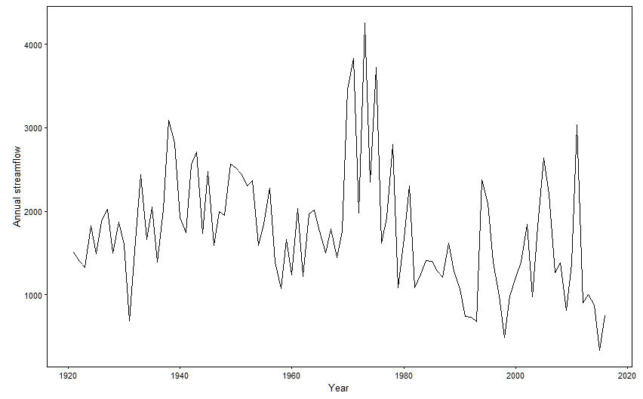
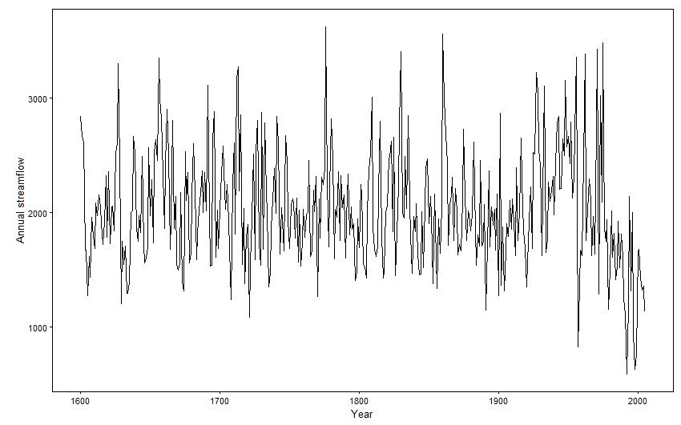
Paleohydrology
Παλαιός = old, ancient
Tree rings
Ice core
Corals
…
Streamflow
Precipitation
Drought index
…
Proxy data
Instrumental data
Model
Paleoreconstructed data

Slide 5
b
http://www.paleoflow.org/

Slide 6
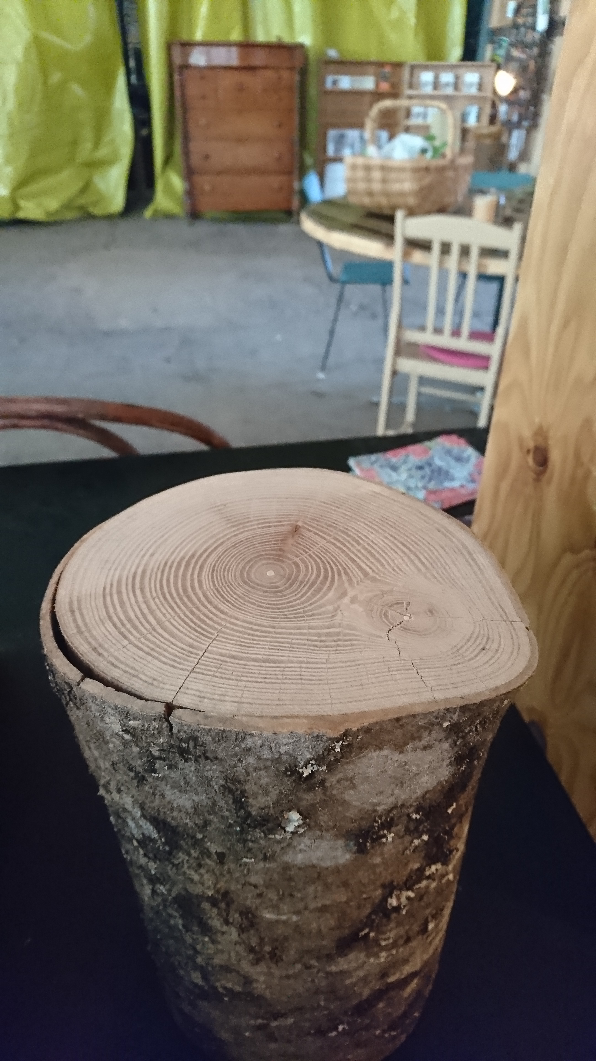
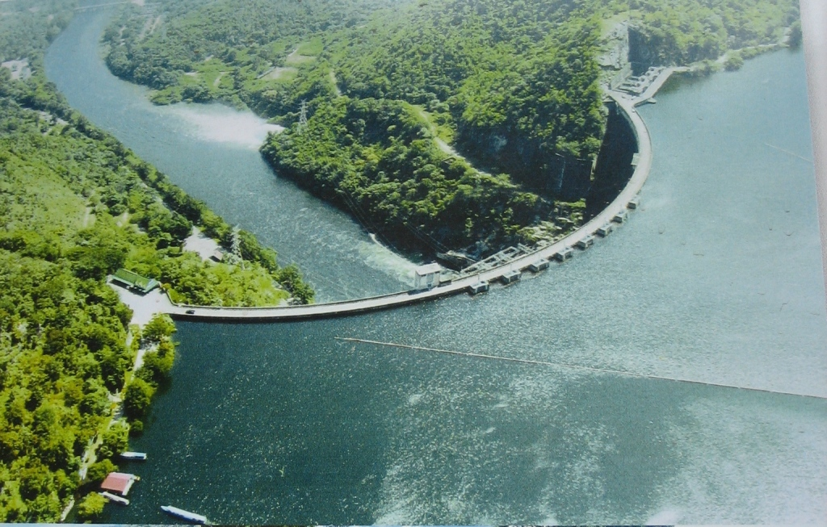
Past
Present
Future

Slide 7
Value of reconstructed streamflow
How do we improve streamflow reconstruction performance?
How does the hydro-climatic variability captured in paleo records compare with that in instrumental records and climate projections?
What is the economic value of reconstructed streamflow to water resources management?

Slide 8
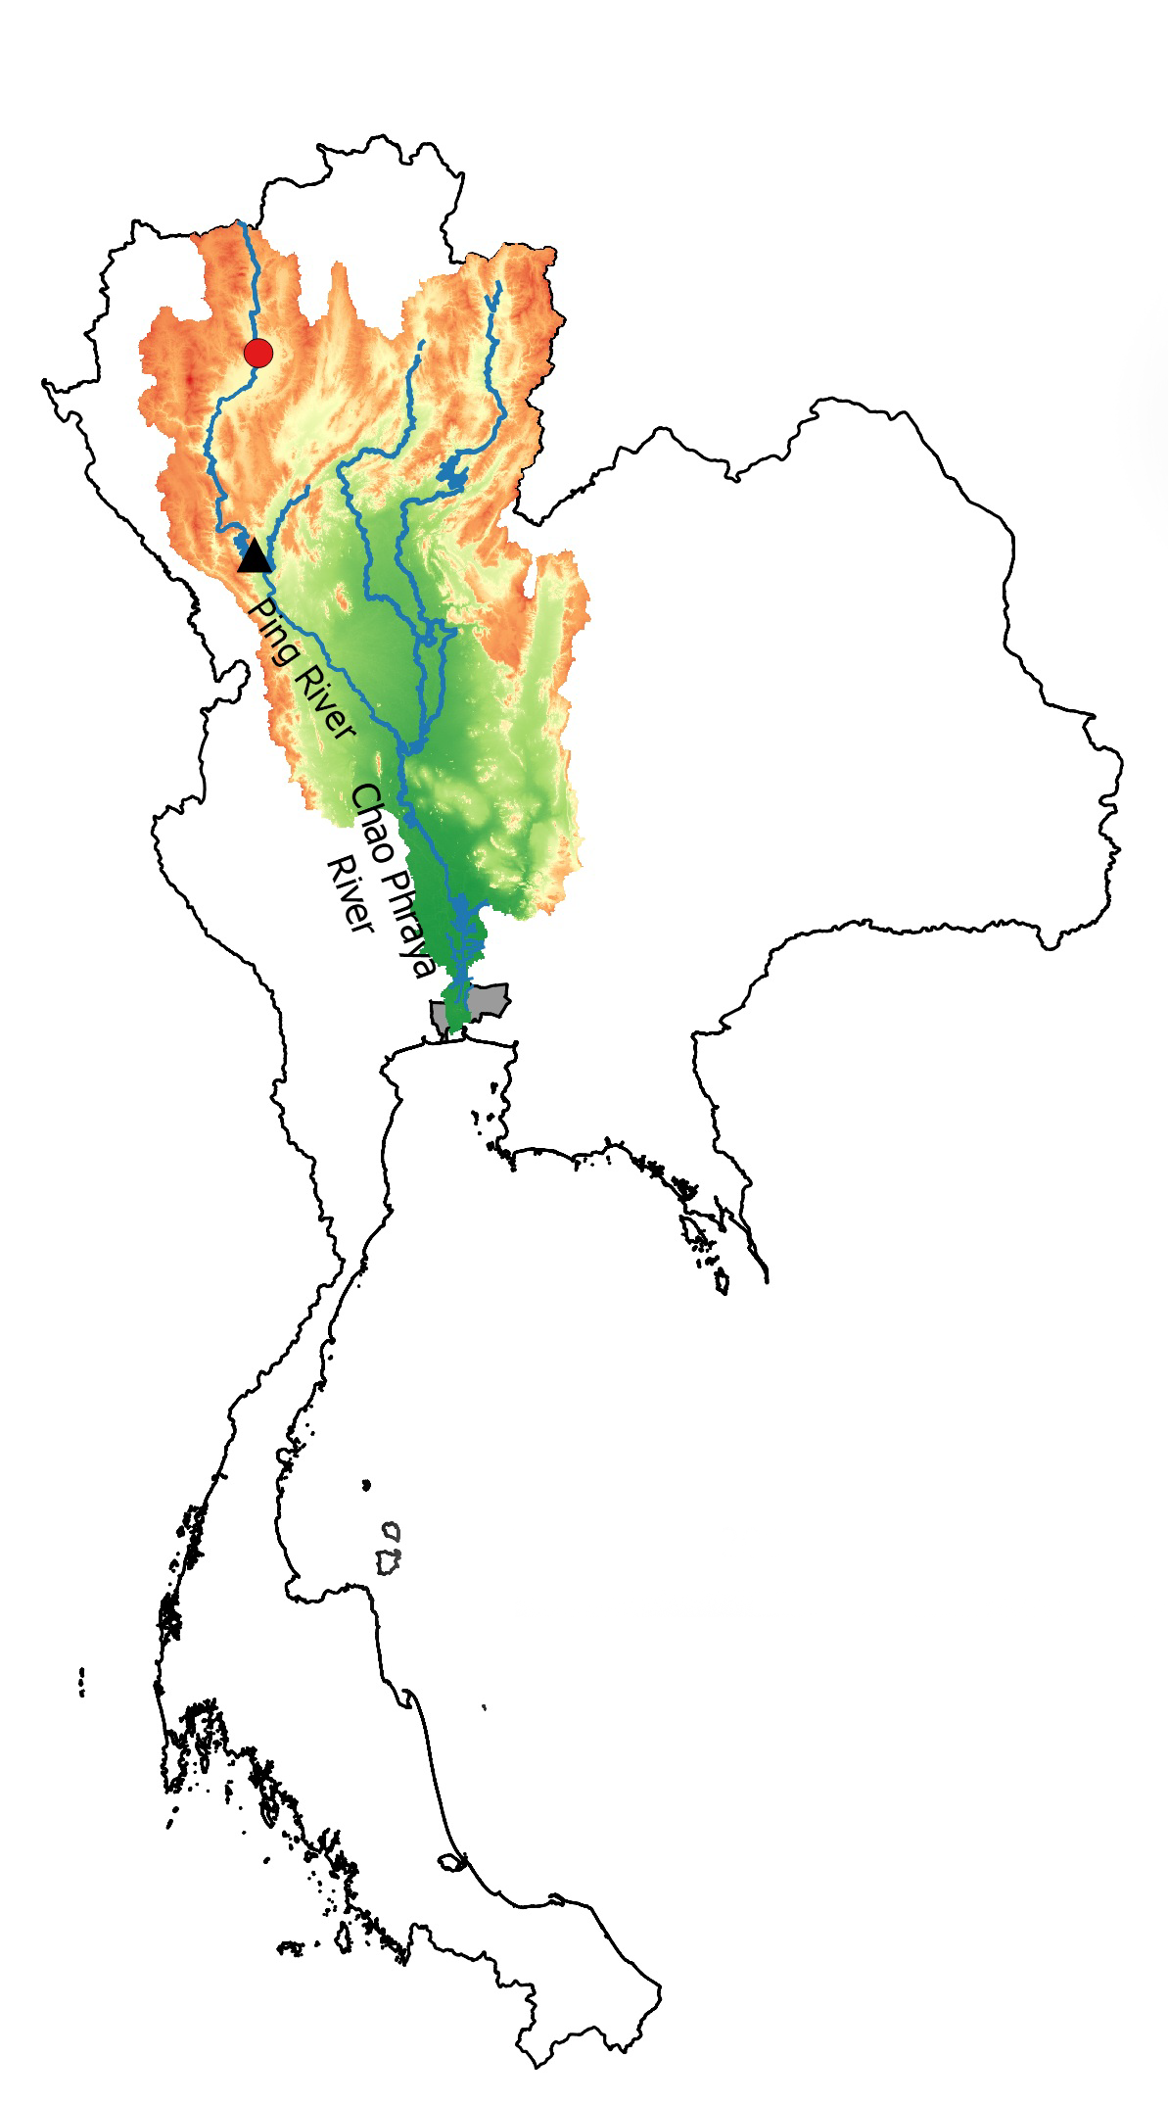
A linear dynamical systems approach
To streamflow reconstruction
Reveals history of regime shifts
In northern Thailand
Hung T.T. Nguyen and Stefano Galelli
Water Resources Research, 54(3), 2057–2077. http://doi.org/10.1002/2017WR022114
First published: 02 March 2018
Notes:
Board work: 4 components: instrumental, paleo, model, reconstructed time series

Slide 9
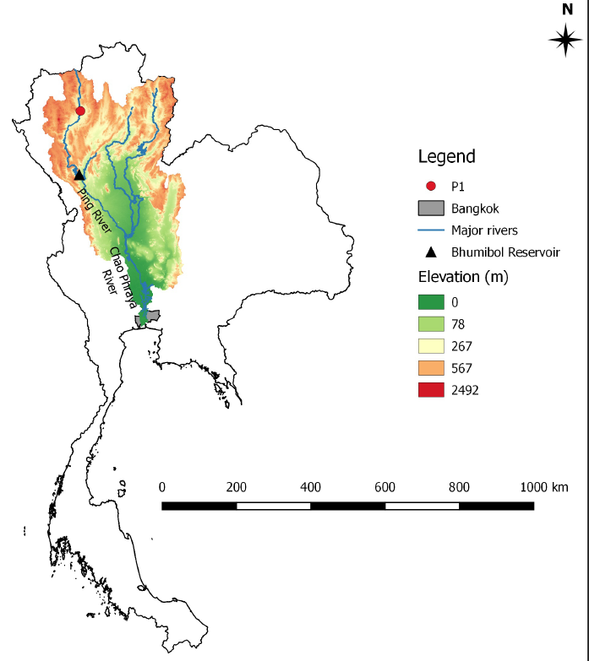
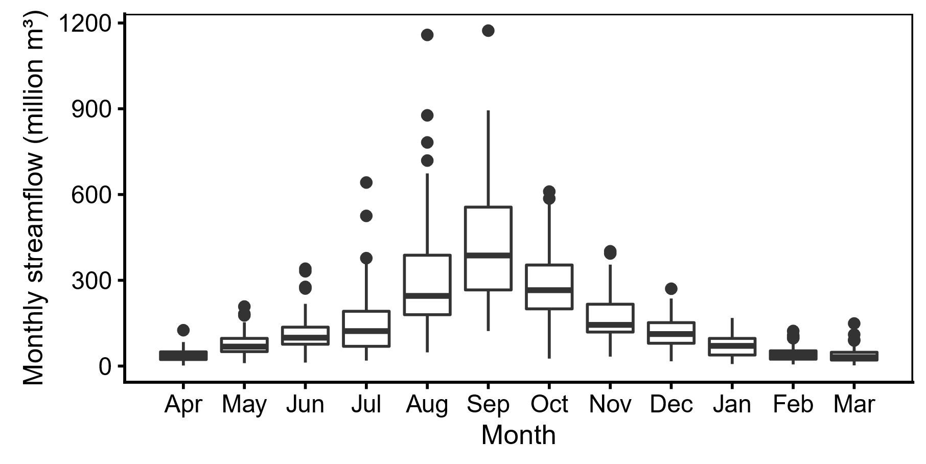
Ping River
85 years of data (1921 – 2005)
Notes:
Area: 33,896 km².
Reservoir: 13.46 billion m³

Slide 10
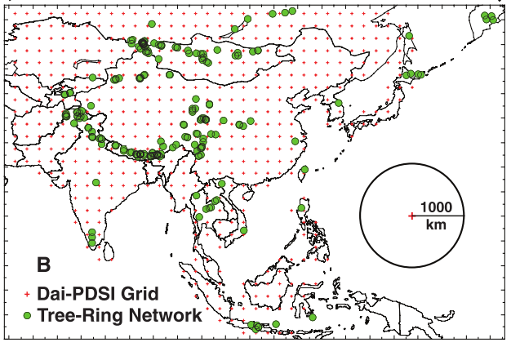
Monsoon Asia Drought Atlas (MADA)
Gridded time series of the Palmer’s Drought Severity Index
Temporal resolution | Annual
Spatial resolution | 2.5º x 2.5º
Temporal range | 1300 – 2005
Figure 1B in Cook et al (2010)
Cook, E. R., Anchukaitis, K. J., Buckley, B. M., D’Arrigo, R. D., Jacoby, G. C., & Wright, W. E. (2010). Asian Monsoon Failure and Megadrought During the Last Millennium. Science, 328(5977), 486–489. http://doi.org/10.1126/science.1185188
Ho, M., Lall, U., & Cook, E. R. (2016). Can a paleodrought record be used to reconstruct streamflow?: A case study for the Missouri River Basin. Water Resources Research, 52(7), 5195–5212. https://doi.org/10.1002/2015WR018444
Notes:
Its North American brother has proved useful!
Ho et al (2016) Missouri River Basin
Kwon and Han (2016) Extreme value

Slide 11
The conventional method
$$y_{t}=α+βu_{t}+ε_{t}$$
$$ε_{t}∼𝒩\left(0,σ^{2}\right)$$
How do we model catchment dynamics without requiring more data?
Will a dynamic model be more accurate?
What insights can we gain with a dynamic model?
Allen, K. J., Nichols, S. C., Evans, R., Allie, S., Carson, G., Ling, F., … Baker, P. J. (2017). A 277 year cool season dam inflow reconstruction for Tasmania, southeastern Australia. Water Resources Research, 53(1), 400–414. https://doi.org/10.1002/2016WR018906
Tozer, C. R., Kiem, A. S., Vance, T. R., Roberts, J. L., Curran, M. A. J., & Moy, A. D. (2018). Reconstructing pre-instrumental streamflow in Eastern Australia using a water balance approach. Journal of Hydrology, 558, 632–646. https://doi.org/S0022169418300738

Slide 12
Linear dynamical systems
$$\begin{aligned}\begin{aligned}x_{t+1}&=Ax_{t}+Bu_{t}+w_{t} \\ y_{t}&=Cx_{t}+Du_{t}+v_{t}\end{aligned}\end{aligned}$$
Input
$$u$$
System
$$x$$
Output
$$y$$
$$\begin{aligned}w_{t}&∼𝒩\left(0,Q\right) \\ v_{t}&∼𝒩(0,R) \\ x_{1}&∼𝒩(μ_{1},V_{1}) \end{aligned}$$
$x∈ℝ^{p}$ | system state
$y∈ℝ^{q}$ | system output
$u∈ℝ^{m}$ | system input
$A∈ℝ^{p×p}$ | state transition matrix
$B∈ℝ^{p×m}$ | input-state matrix
$C∈ℝ^{p×p}$ | observation matrix
$D∈ℝ^{p×p}$ | input-observation matrix
$Q∈ℝ^{p×p}$ | covariance matrix of the state noise
$R∈ℝ^{q×q}$ | covariance matrix of the observation noise
Notes:
Milestones

Slide 13
Learning: Expectation-Maximization
Forward pass:
Kalman filter
$${\hat{x}}_{t|t}=𝔼\left[x_{t}|y_{1},…,y_{t},{\hat{θ}}_{k}\right]$$
E-Step
$$\hat{X}\left({\hat{θ}}_{k}\right)=𝔼\left[X|Y,{\hat{θ}}_{k}\right]$$
Kalman smoother
Backward pass: RTS recursion
$${\hat{x}}_{t|T}=𝔼\left[x_{t}|y_{1},…,y_{T},{\hat{θ}}_{k}\right]$$
M-Step
Maximum likelihood
$${\hat{θ}}_{k+1}=arg max ℒ\left(Y|\hat{X},{\hat{θ}}_{k}\right)$$
Shumway, R. H., & Stoffer, D. S. (1982). An Approach to The Time Series Smoothing and Forecasting Using the EM Algorithm. Journal of Time Series Analysis, 3(4), 253–264. https://doi.org/10.1111/j.1467-9892.1982.tb00349.x
Ghahramani, Z., & Hinton, G. E. (1996). Parameter Estimation for Linear Dynamical Systems. Technical Report CRG-TR-96-2. https://doi.org/10.1080/00207177208932224
Cheng, S., & Sabes, P. N. (2006). Modeling Sensorimotor Learning with Linear Dynamical Systems. Neural Computation, 18(4), 760–793. https://doi.org/10.1162/089976606775774651
Notes:
Milestones

Slide 14
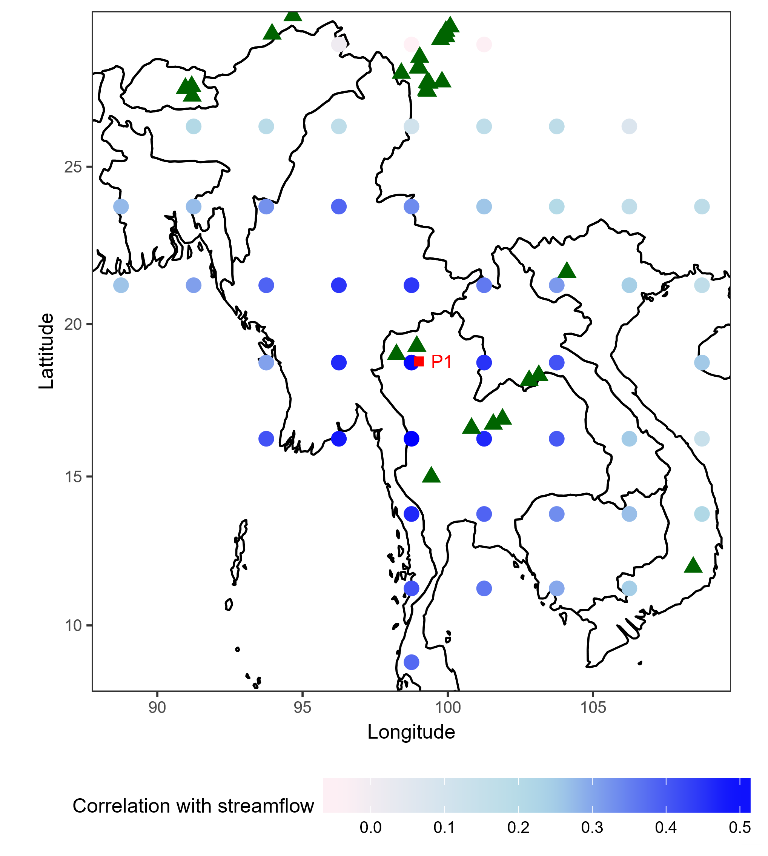
Experiment setup
$$RE=1−\frac{\sum_{t∈𝒱}{{\left(y_{t}−{\hat{y}}_{t}\right)}^{2}}}{\sum_{t∈𝒱}{{\left(y_{t}−{\overline{y}}_{c}\right)}^{2}}}$$
$$CE=1−\frac{\sum_{t∈𝒱}{{\left(y_{t}−{\hat{y}}_{t}\right)}^{2}}}{\sum_{t∈𝒱}{{\left(y_{t}−{\overline{y}}_{v}\right)}^{2}}}$$
Woodhouse, C. A., Gray, S. T., & Meko, D. M. (2006). Updated streamflow reconstructions for the Upper Colorado River Basin. Water Resources Research, 42(5), 1–16. https://doi.org/10.1029/2005WR004455

Slide 15
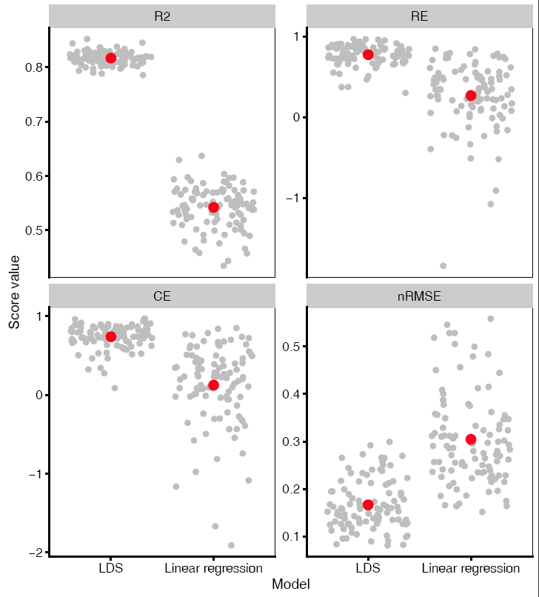
Model performance

Slide 16
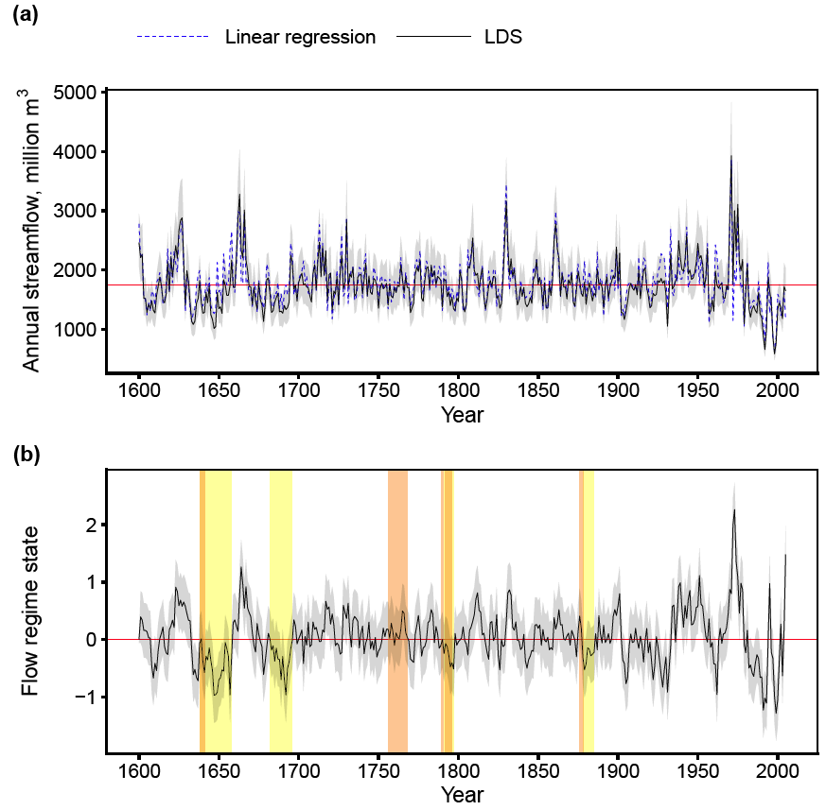
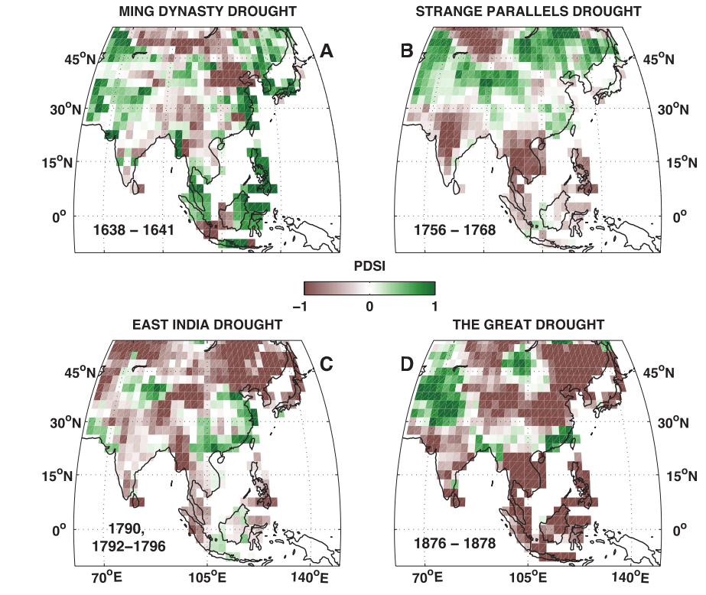
A reconstructed history of the Ping River
Figure 2 in Cook et al (2010)

Slide 17
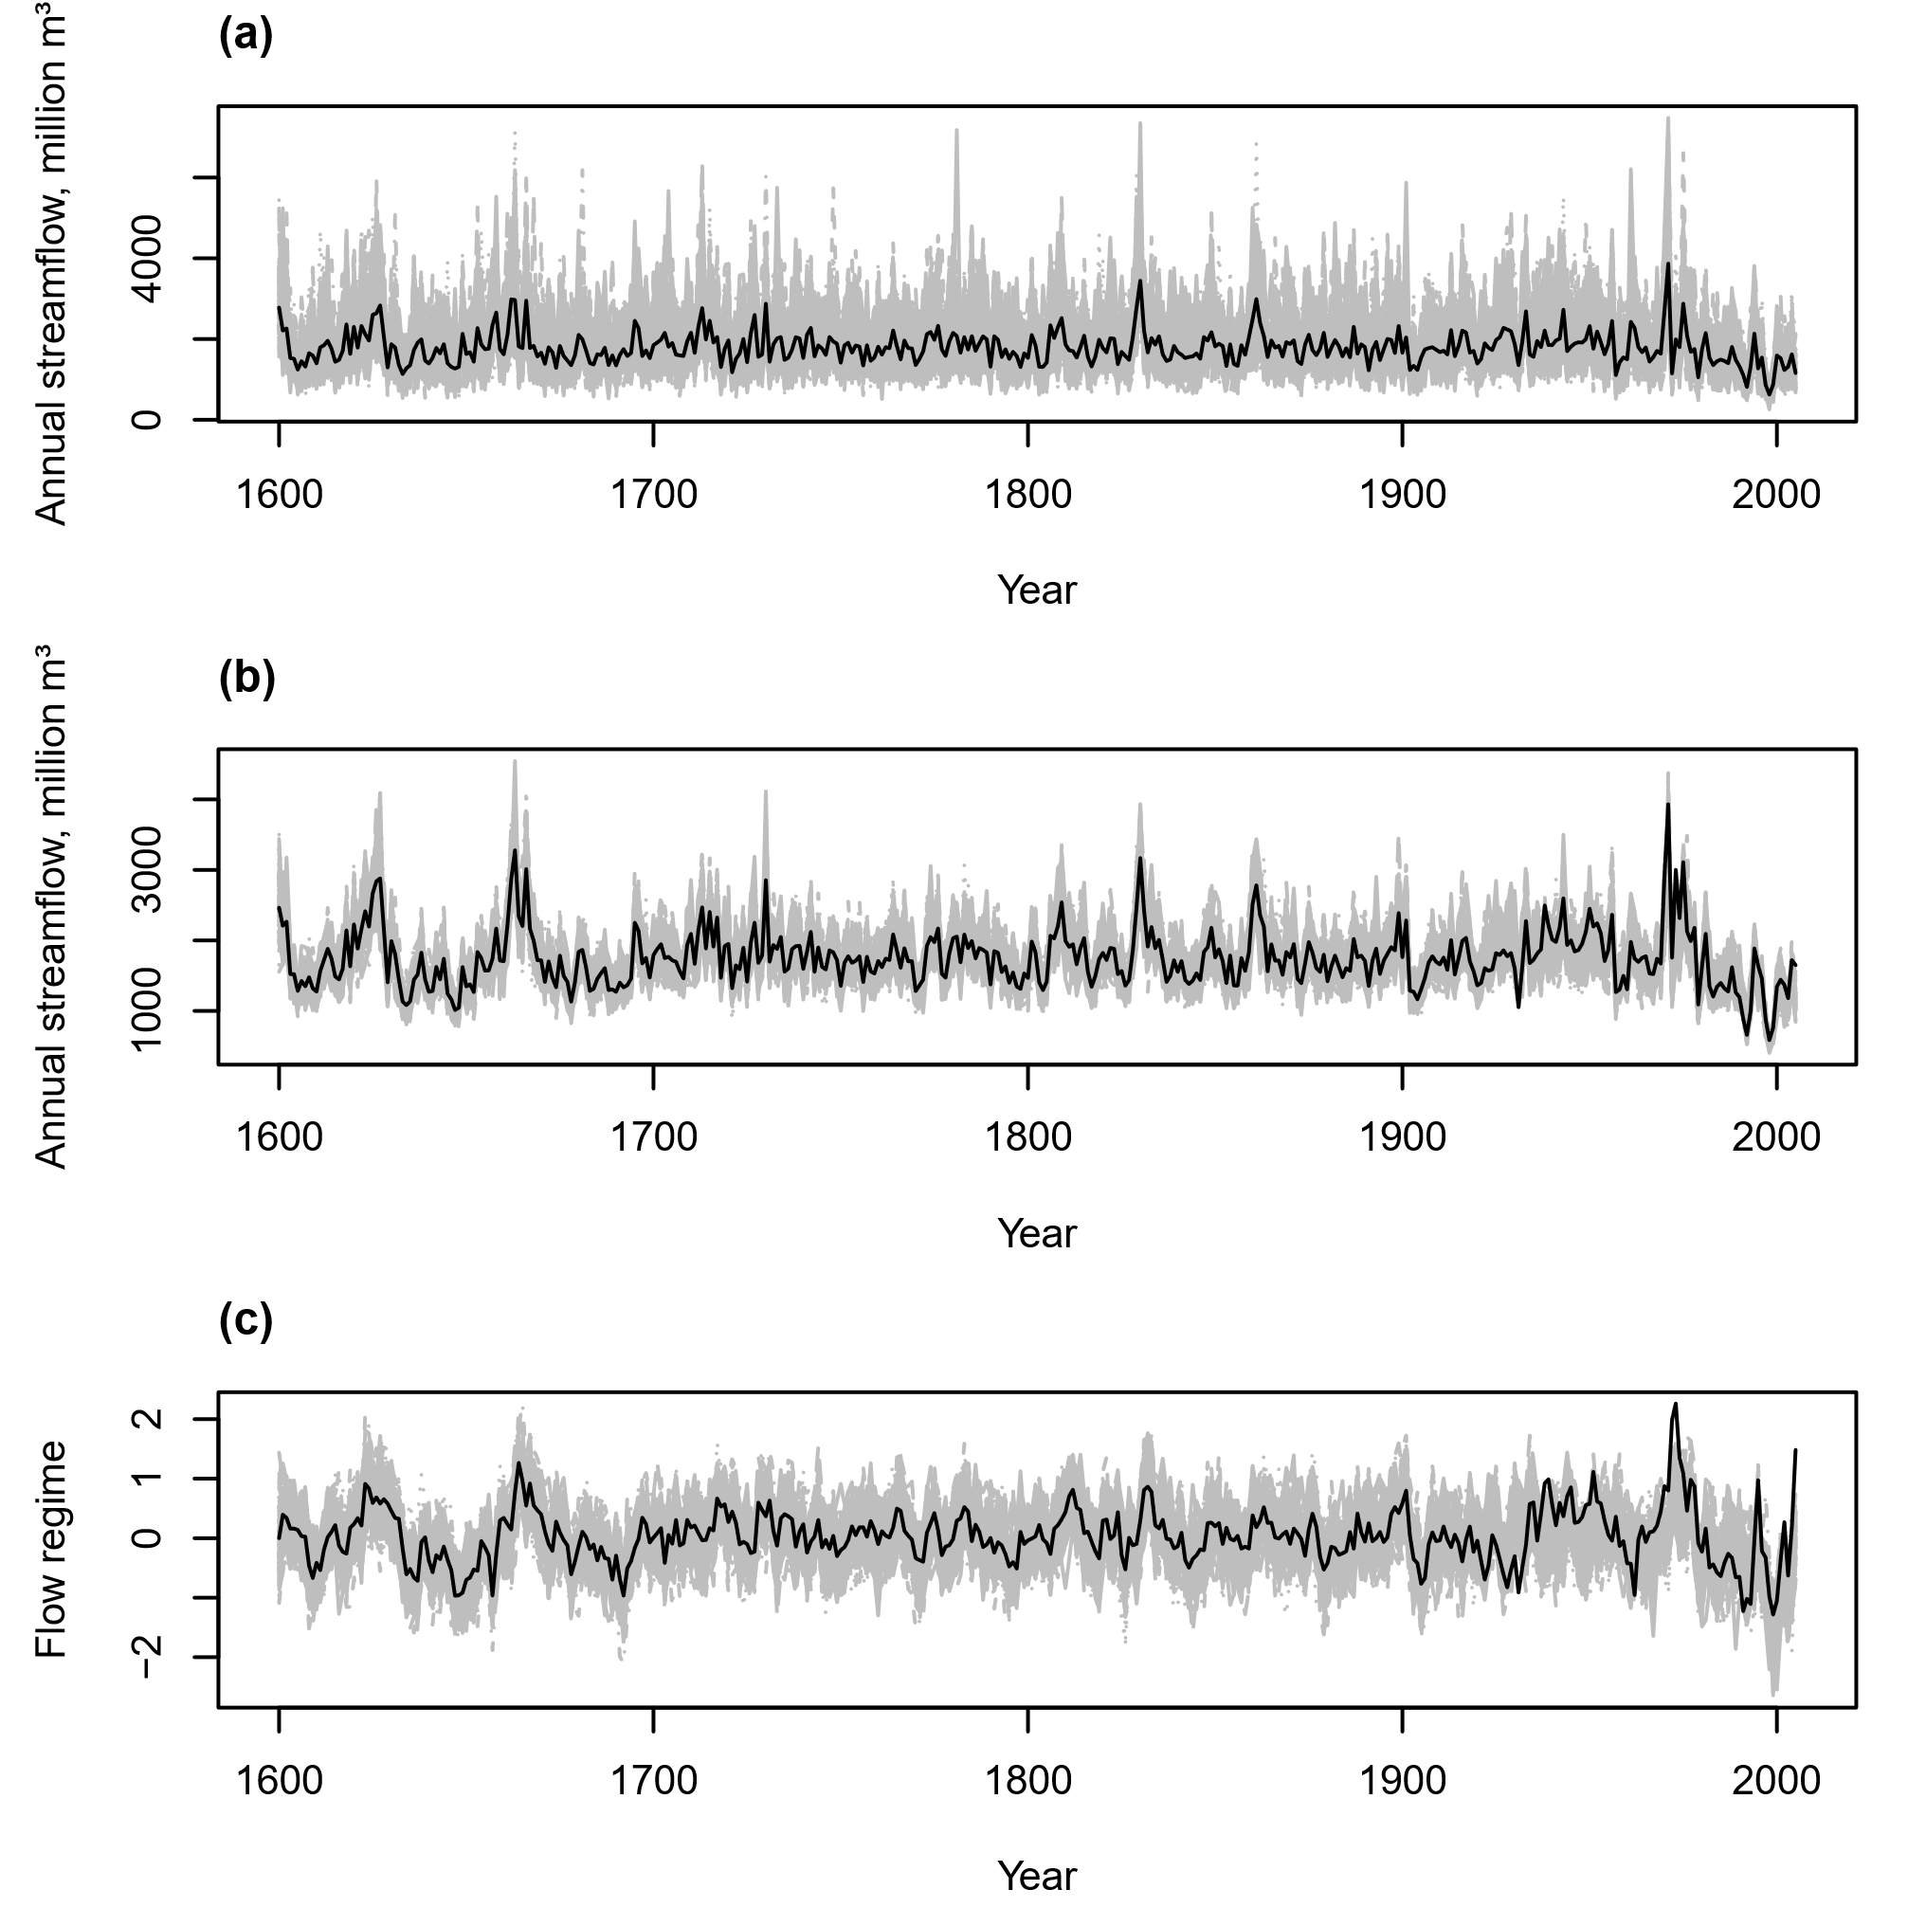
Stochastic replicates
Linear regression
LDS – Streamflow
LDS – State variable

Slide 18
Conclusions
Linear dynamical systems approach to streamflow reconstruction
Better model performance
Replacement for linear regression
Less water available in the catchment
A more conservative policy for the Bhumibol
History of regime shifts
Regional hydrological understanding (complementing the MADA)
Stochastic streamflow generator with flow regime variable
Downstream applications such as reservoir operations

Slide 19
Streamflow variability of the past, present, and future
Paleoreconstructed data versus projections derived from climate models
Joint work with Sean Turner, Pacific Northwest National Laboratory

Slide 20
Brown, C., & Wilby, R. L. (2012). An Alternate Approach to Assessing Climate Risks. EOS Transactions American Geophysical Union, 93(41), 401–412.

Slide 21
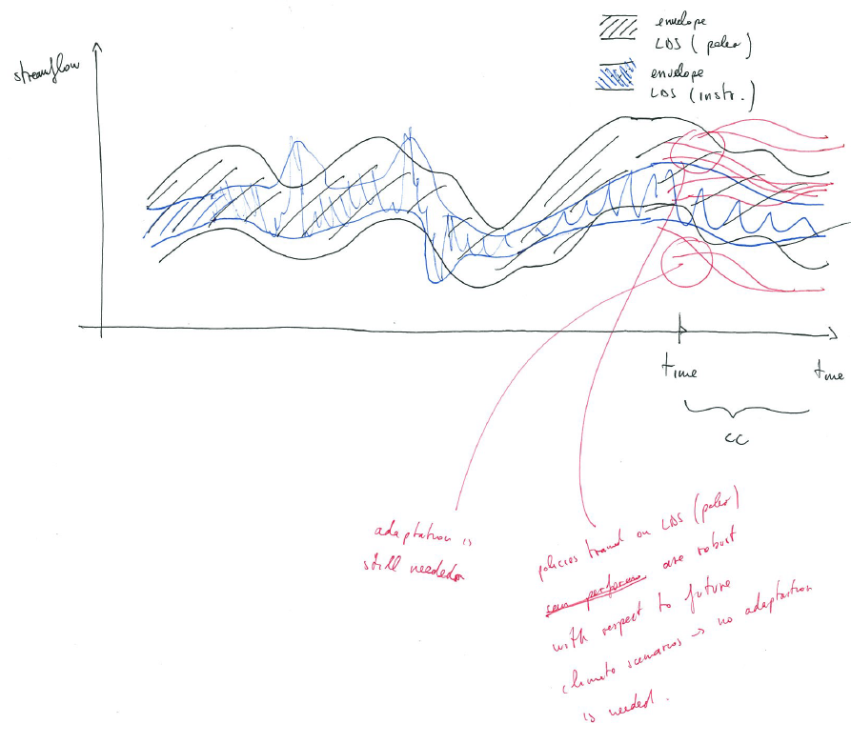

Slide 22
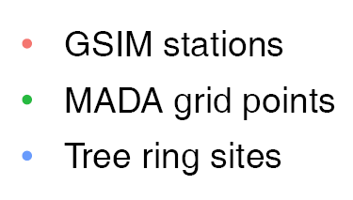
Global Streamflow Indices and Metadata (GSIM)
All stations
Test subset
Do, H. X., Gudmundsson, L., Leonard, M., Westra, S., & Seneviratne, S. I. (2017). The Global Streamflow Indices and Metadata Archive (GSIM) - Part 1: The production of daily streamflow archive and metadata. Earth System Science Data Discussions, 1–31. https://doi.org/10.5194/essd-2017-103
Gudmundsson, L., Do, H. X., Leonard, M., Westra, S., & Seneviratne, S. I. (2017). The Global Streamflow Indices and Metadata Archive (GSIM) - Part 2: Quality Control, Time-series Indices and Homogeneity Assessment. Earth System Science Data Discussions, 1(September), 1–27. https://doi.org/10.5194/essd-2017-104
Notes:
Explain why we should go from one point to a large scale study

Slide 24
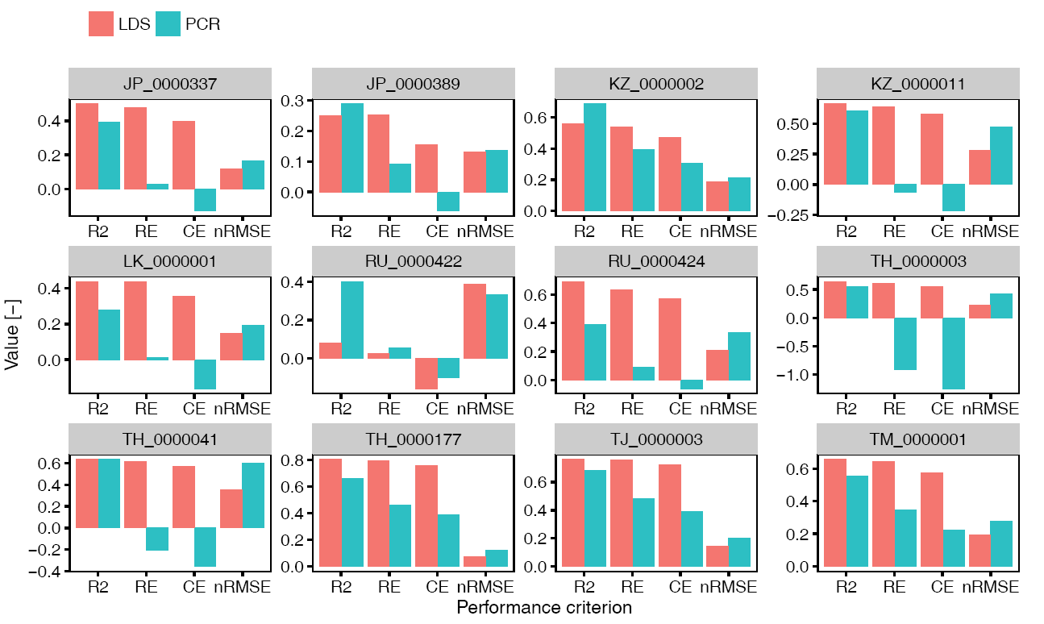

Slide 25
Planned workflow
General Circulation Models (GCMs)
Global Hydrological Model
P, T
Streamflow projections E1
Compare variability
Streamflow reconstruction model
Stochastic streamflow generation
Paleo data
Stochastic replicates E2

Slide 26
Expected outcomes & potential implications
If $E1⊃E2$
If 𝐸1⊃𝐸2
If $E1⊂E2$
If 𝐸1⊂𝐸2
If in between (most likely)
Climate projections and adaptation pathways are crucial.
Less emphasis on climate projection studies; more work on streamflow reconstructions.
An indication where streamflow reconstructions will be potentially more useful.

Slide 27
Economic Value of reconstructed streamflow in water resources management
Joint work with Joost Buurman, Lee Kwan Yew School of Public Policy, National University of Singapore

Slide 28
Expected outcomes & potential implications
Different, and possibly “improved”, streamflow distribution estimation
Extreme values
Regime shifts
Hence better operating policies

Slide 30
On the value of paleoreconstructed data:
Understanding long-term hydro-climatic variability and its implications to water resources management

Slide 31
Timeline
What I have done
Summer Project 1
Aug 2016
May 2017
QE
AOGS
Aug 2017
Mar 2018 WRR paper
Sep 2017 Outstanding TA award
May 2018 PE
2nd TA Apr 2018
Summer Project 2 December 2017
EGU
AGU: American Geophysical Union Annual Meeting EGU: European Geosciences Union Annual Meeting

Slide 32
Timeline
What I plan to do
Dec 2018
Graduation Dec 2019
Sep/Oct 2019 Thesis defense
ENSO paper Jun 2018
Conference
AGU
Paleo vs GCMs
Paleo for WRM Apr/ May 2018

Slide 33
Appendices

Slide 34
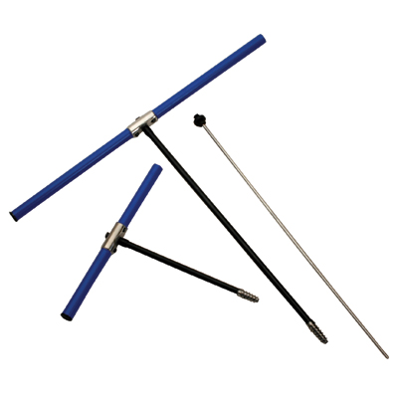
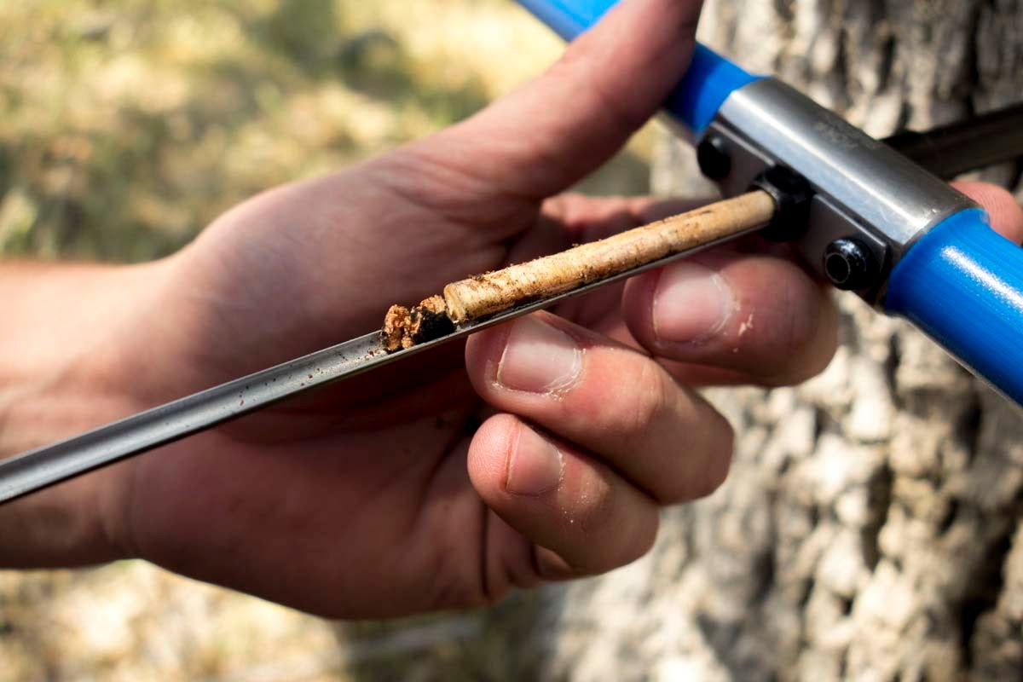
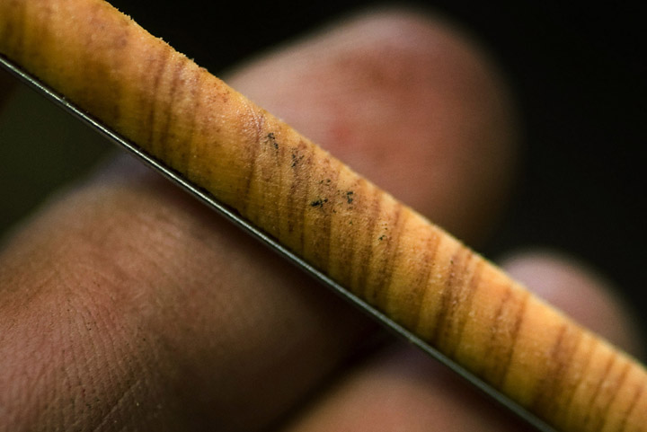
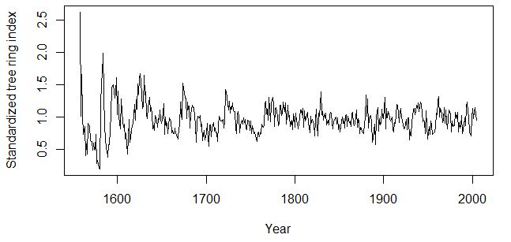
Dendrochronology
δένδρον (tree limb) + χρόνος (time) = tree dating

Slide 35
Applications
Drought adaptation planning
Agriculture & Agri-Food Canada
Prairie Provinces Water Board
Denver Water Board
Informing the public (Colorado River)
Reliability of urban water supply
Cities of Calgary and Edmonton

Slide 36
Spatial correlation
MADA
Tree rings
Site | Distance | r | p-value
LS001 | 406.71438 | -0.2225 | 0.0407
LS002 | 438.74650 | -0.1447 | 0.1863
TH001 | 55.37224 | 0.2024 | 0.0632
TH002 | 354.28653 | 0.1293 | 0.2757
TH003 | 369.80428 | -0.0365 | 0.7589
TH004 | 423.49371 | 0.1829 | 0.0919
TH006 | 85.10499 | -0.0358 | 0.7464

Slide 37
Kalman filter
For $t=2,…,T$
$${\hat{x}}_{t|t}=𝔼\left[x_{t}|y_{1},…,y_{t},{\hat{θ}}_{k}\right]$$
Forward pass:
Kalman filter
Backward pass: RTS recursion
Figure 5 in Faragher (2012)
$$\begin{aligned} \\ \\ \\ K_{t}&=\begin{aligned}{\hat{V}}_{t|t−1}\end{aligned}C^{′}{\left(C{\hat{V}}_{t|t−1}C^{′}+R\right)}^{−1} \\ \begin{aligned}{\hat{x}}_{t|t}\end{aligned}&={\hat{x}}_{t|t−1}+K_{t}\left(y_{t}−{\hat{y}}_{t|t−1}\right) \\ {\hat{V}}_{t|t}&=\left(I−K_{t}C\right){\hat{V}}_{t|t−1}\end{aligned}$$
Maximum likelihood
$$\begin{aligned}\begin{aligned}{\hat{x}}_{t|t−1}\end{aligned}&=A{\hat{x}}_{t−1|t−1}+Bu_{t} \\ {\hat{y}}_{t|t−1}&=C{\hat{x}}_{t|t−1}+Du_{t} \\ \begin{aligned}{\hat{V}}_{t|t−1}\end{aligned}&=A{\hat{V}}_{t−1|t−1}A′+Q \\ \\ \\ \end{aligned}$$
Kalman, R. E. (1960). A New Approach to Linear Filtering and Prediction Problems. Journal of Basic Engineering, 82(1), 35. https://doi.org/10.1115/1.3662552
Faragher, R. (2012). Understanding the basis of the Kalman filter via a simple and intuitive derivation [lecture notes]. IEEE Signal Processing Magazine, 29(5), 128–132. https://doi.org/10.1109/MSP.2012.2203621
Notes:
Milestones

Slide 38
RTS recursion
Forward pass:
Kalman filter
For $t=T−1,…,1$
$${\hat{x}}_{t|T}=𝔼\left[x_{t}|y_{1},…,y_{T},{\hat{θ}}_{k}\right]$$
Backward pass: RTS recursion
$$\begin{aligned}J_{t}&={\hat{V}}_{t|t}A{\left({\hat{V}}_{t+1|t}\right)}^{−1} \\ {\hat{x}}_{t|T}&={\hat{x}}_{t|t}+J_{t}\left({\hat{x}}_{t+1|T}−{\hat{x}}_{t+1|t}\right) \\ {\hat{V}}_{t|T}&={\hat{V}}_{t|t}+J_{t}\left({\hat{V}}_{t+1|T}−{\hat{V}}_{t+1|t}\right)J_{t}^{′} \\ {\hat{y}}_{t|T}&=C{\hat{x}}_{t|T}+Du_{t}\end{aligned}$$
Maximum likelihood
Rauch, H. E., Tung, F., & Striebel, C. T. (1965). Maximum likelihood estimates of linear dynamic systems. AIAA Journal, 3(8), 1445–1450. https://doi.org/10.2514/3.3166
Notes:
Milestones

Slide 39
Maximum likelihood estimation
Forward pass:
Kalman filter
Backward pass: RTS recursion
Quadratic terms only → Analytical solutions
Maximum likelihood
Notes:
Milestones

Slide 40
M-step solution

Slide 41
Algorithm 1: LDS-EM
$$t=T,…,1$$

Slide 42
Simultaneous learning–reconstruction
$$x_{1}$$
Replace missing $y_{t}$ with its best available estimate
$$y_{t}←{\hat{y}}_{t|t−1}$$
Forward pass
$$y_{t}←{\hat{y}}_{t|T}$$
M-step

Slide 43
Rationale for SLR
E-Step
$$\begin{aligned}{\hat{x}}_{t|t}\end{aligned}={\hat{x}}_{t|t−1}+K_{t}\left(y_{t}−{\hat{y}}_{t|t−1}\right)$$
M-Step
The substitution turns all terms related to missing $y_{t}$ into zero

Slide 44
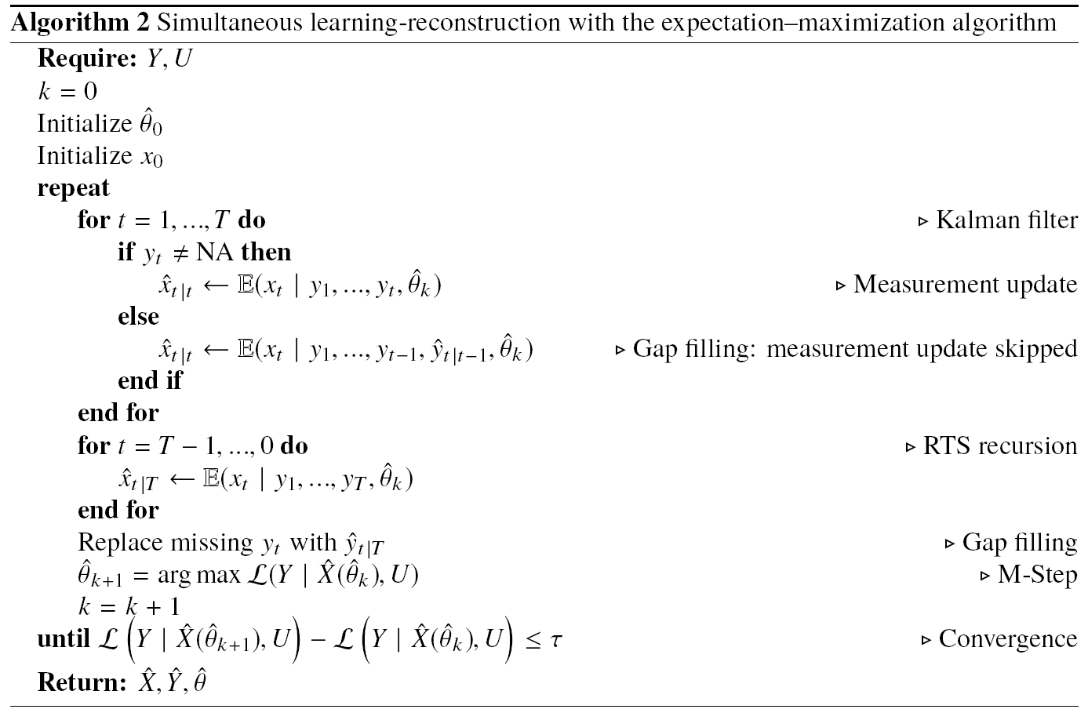
Algorithm 2: SLR
$$t=T,…,1$$

Slide 45
Residual analysis

Slide 46
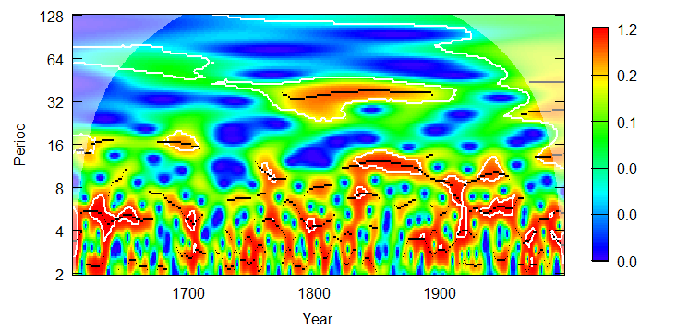
Wavelet analysis

Slide 47
Other reconstructions
 | Woodhouse et al, 2006 | Gangopadhyay et al, 2009 | Devineni et al, 2013 | Patskoski et al, 2015 | Ho et al, 2016
Location & Data | Colorado River 4 stations 62 chronologies | Colorado River at Lees Ferry, Arizona 62 chronologies | Upper Delaware River Basin 5 stations 8 chronologies | South-eastern US (NC, SC, GA, FL) 8 stations 7 chronologies | Missouri River Basin 55 stations LBDA
Performance | RE ~ 0.65 - 0.8 nRMSE ~ 0.14 adjusted R² ~ 0.7 - 0.8 | R² = 0.76 | RE ~ 0.2 - 0.5 CE ~ 0.1 - 0.5 | Adjusted R2 ~ 0.1 - 0.4 Normalized RMSE ~0.25 - 0.5 | NSE (positive / negative, average positive) Reduction of error (mostly positive, average around ~0.2 Adjusted R² ~0.5 - 0.9

